Slide 1
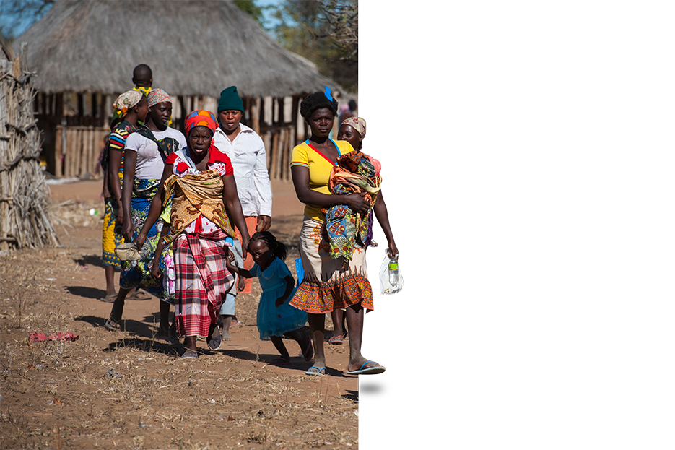
Orientation on
Cluster Approach
For Nutrition Cluster partners
© UNICEF/UN051647/Rich

Slide 2
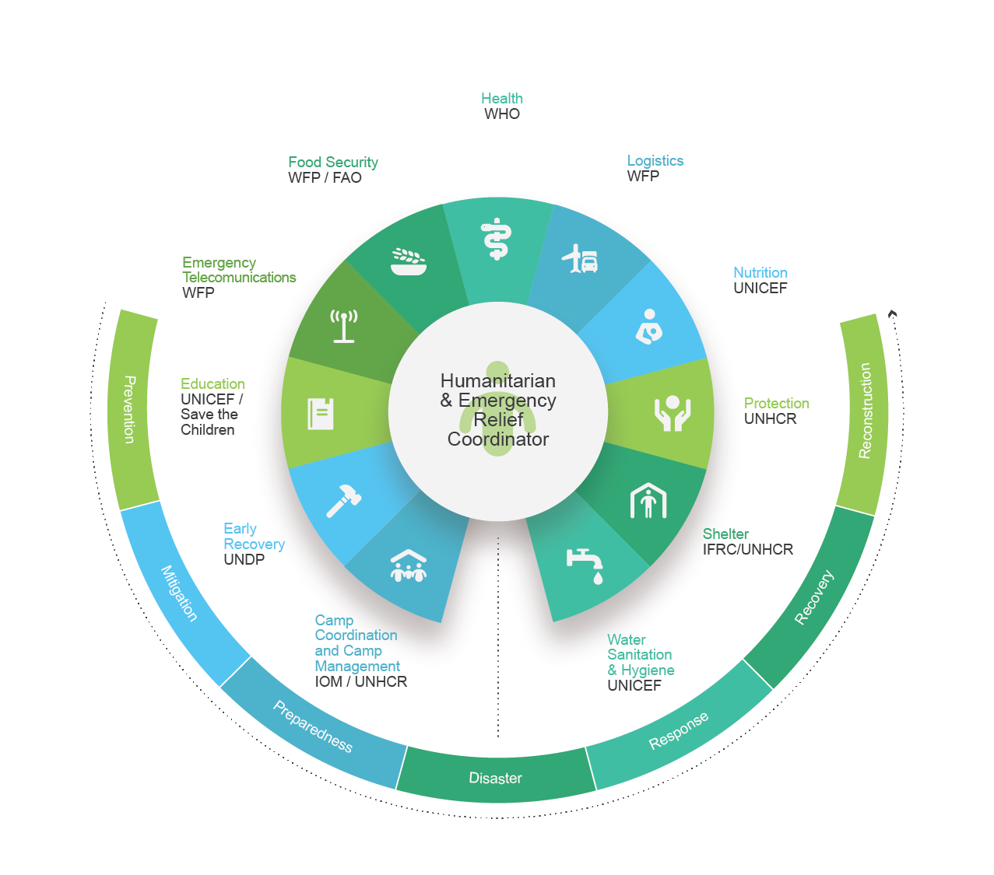
What is the
Cluster
approach?
Orientation on Cluster Approach
Notes:
A cluster is a group of agencies that gather to work together towards common objectives within a particular sector of emergency response.
The cluster approach, instituted in 2006 as part of the UN Humanitarian Reform process, is an important step on the road to more effective humanitarian coordination. Ultimately the cluster approach aims to improve the predictability, timeliness, and effectiveness of humanitarian response, and pave the way for recovery. It strengthens leadership and accountability in key sectors. It also seeks to enhance partnerships and complementarity among the UN, Red Cross Movement, and non-governmental organizations (NGOs).
At the global level, clusters have been established in 11 key areas to support the cluster approach as shown in the table. The global cluster leads report to the UN Emergency Relief Coordinator (ERC). At global level, the GNC has 46 partners and observers representing International Non-Governmental Organizations (INGOs), research and development groups, academic institutions, UN agencies, donors and individuals. Besides, UNICEF is cluster lead agency for Education and Wash.
At country level, clusters (or “sectoral groups”) will normally be established for any major emergency – any situation where humanitarian needs are of sufficient scale and complexity to justify a multi-sectoral response with the engagement of a wide range of international humanitarian actors
In some cases the cluster approach may cohexist and complement other forms of national coordination and its application must take into account the specific needs of the context.

Slide 3
Cluster
activation
Criteria
Response and coordination gaps exist due to a sharp deterioration or significant change in the humanitarian situation.
Existing national response or coordination capacity is unable to meet needs in a manner that respects humanitarian principles.
Interdependence of Health WASH Food Security and Nutrition responses.
Orientation on Cluster Approach
Notes:
Country level clusters are not forever. Clusters will be activated and deactivated according to the circumstances.
note: while the official cluster activation for each sector is dependent on the contextual needs and capacity, whenever a crisis a crisis affects significantly the health, nutrition, WASH or Food Security sectors, it is important to ensure that adequate coordination capacity exists in all of the 4 "life-saving" sectors.

Slide 4
Cluster
activation
Procedure
The procedure for activating one or more clusters includes consultation between the Resident/Humanitarian Coordinator and the Humanitarian Country Team, and then correspondence with the Emergency Relief Coordinator on the rationale for each cluster and the selection of cluster lead agencies based on coordination and response capacity.
Orientation on Cluster Approach
Notes:
Country level clusters are not forever. Clusters will be activated and deactivated according to the circumstances.
note: while the official cluster activation for each sector is dependent on the contextual needs and capacity, whenever a crisis a crisis affects significantly the health, nutrition, WASH or Food Security sectors, it is important to ensure that adequate coordination capacity exists in all of the 4 "life-saving" sectors.

Slide 5
Cluster
deactivation
…when at least one of the conditions that led to its activation is no longer present:
The humanitarian situation improves, significantly reducing humanitarian needs and therefore the associated response and coordination gaps.
National structures acquire sufficient capacity to coordinate and meet residual humanitarian needs in line with humanitarian principles.
Orientation on Cluster Approach

Slide 6
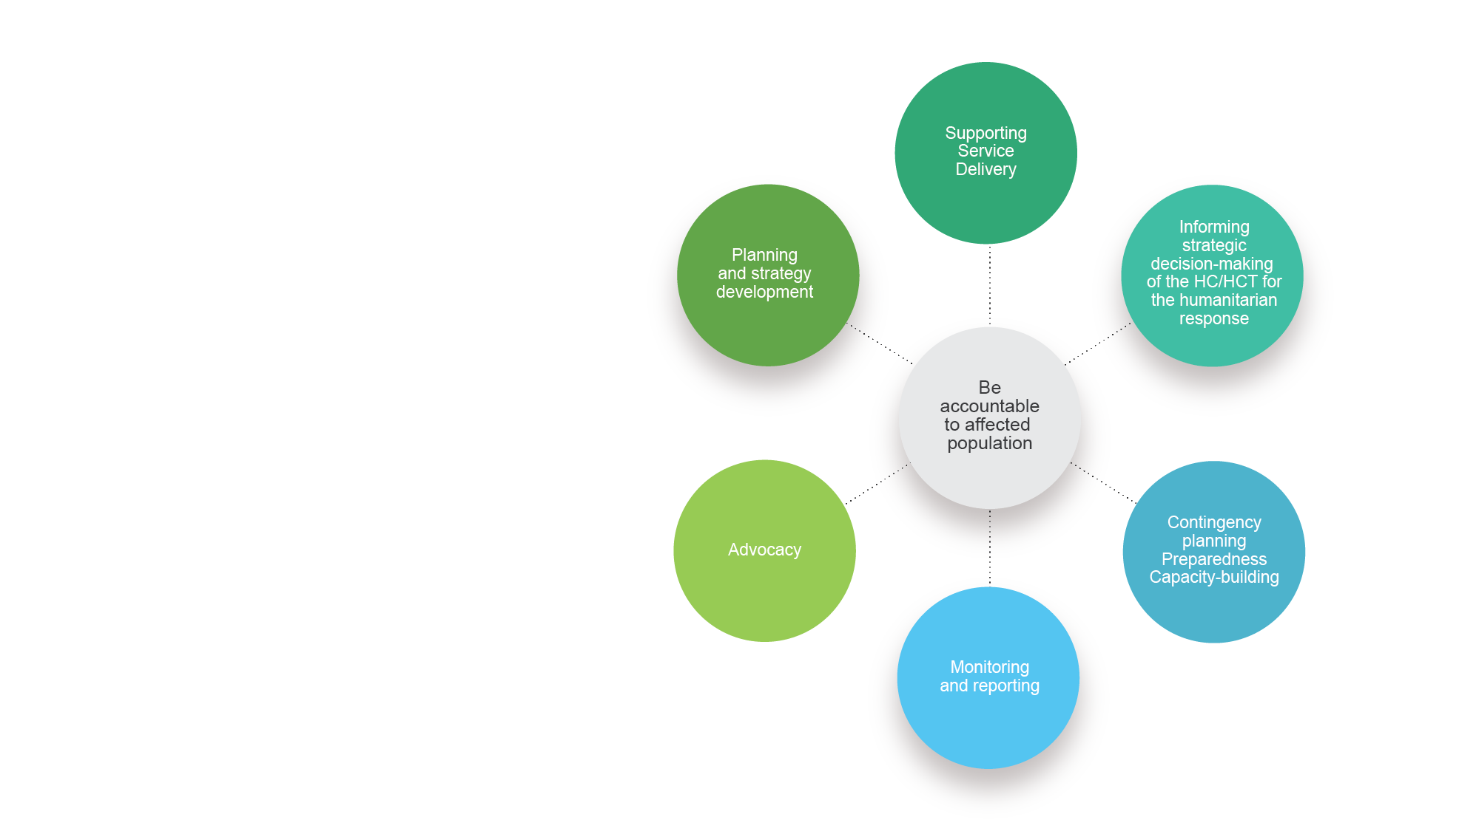
What does
a cluster do?
The six core functions
of a cluster.
© UNICEF/UN051609/Rich
Orientation on Cluster Approach

Slide 7
Cluster core functions and deliverables
1. Supporting
service delivery
1.1 Provide a platform to ensure that service delivery is driven by the agreed strategic priorities.
1.2 Develop mechanisms to eliminate duplication of service delivery.
Orientation on Cluster Approach

Slide 8
Cluster core functions and deliverables
2. Informing strategic decision-making
of the HC/HCT for the humanitarian response
2.1 Needs assessment and gap analysis (across other sectors and within the sector)
2.2 Analysis to identify and address (emerging) gaps, obstacles, duplication, and cross-cutting issues including age, gender, environment and HIV/AIDS.
2.3 Prioritization, grounded in response analysis.
Orientation on Cluster Approach

Slide 9
Cluster core functions and deliverables
3. Planning and
strategy development
3.1 Develop sectorial plans, objectives and indicators directly support realization of the HC/HCT strategic priorities.
3.2 Apply and adhere to existing standards and guidelines.
3.3 Clarify funding requirements, prioritization, and cluster contributions for the HC’s overall humanitarian funding consideration (e.g.: Flash Appeal, CERF, Emergency Response Fund/Common Humanitarian Fund).
Orientation on Cluster Approach

Slide 10
Cluster core functions and deliverables
4. Advocacy
4.1 Identify advocacy concerns to contribute to HC and HCT messaging and action.
4.2 Undertaking advocacy activities on behalf of cluster participants and the affected population.
5. Monitoring and reporting
5.1 Monitoring and reporting the implementation of the cluster strategy and results; recommending corrective action where necessary.
Orientation on Cluster Approach

Slide 11
Each cluster is also responsible for integrating early recovery from the outset of the humanitarian response.
Cluster core functions and deliverables
6. Contingency planning / Preparedness Capacity building
6.1 In situation where there is a high risk of recurring or significant new disaster and where sufficient capacity exists within the cluster.
7. Accountability to affected population
7.1 Demonstrate commitment to accountability to affected populations by ensuring feedback and accountability mechanisms are integrated into country strategies, proposal designing, monitoring and evaluations.
Orientation on Cluster Approach

Slide 12
Humanitarian
principles
Humanity
Neutrality
Impartiality
Operational
independence
Notes:
Cluster members have to abide to humanitarian principles
Humanity
Human suffering must be addressed wherever it is found. The purpose of humanitarian action is to protect life and health and ensure respect for human beings.
Impartiality
Humanitarian actors must not take sides in hostilities or engage in controversies of a political, racial, religious or ideological nature.
Neutrality
Humanitarian action must be carried out on the basis of need alone, giving priority to the most urgent cases of distress and making no distinctions on the basis of nationality, race, gender, religious belief, class or political opinions.
Independence
Humanitarian action must be autonomous from the political, economic, military or other objectives that any actor may hold with regard to areas where humanitarian action is being implemented.

Slide 13
Principles of
Humanitarian partnerships
Equality
Transparency
Result-oriented
Responsibility
Complementarity
Orientation on Cluster Approach
Notes:
Equality requires mutual respect between members of the partnership irrespective of size and power. The participants must respect each other's mandates, obligations and independence and recognize each other's constraints and commitments. Mutual respect must not preclude organizations from engaging in constructive dissent.
Transparency is achieved through dialogue (on equal footing), with an emphasis on early consultations and early sharing of information. Communications and transparency, including financial transparency, increase the level of trust among organizations.
Result-oriented approach Effective humanitarian action must be reality-based and action-oriented. This requires result-oriented coordination based on effective capabilities and concrete operational capacities.
Responsibility Humanitarian organizations have an ethical obligation to each other to accomplish their tasks responsibly, with integrity and in a relevant and appropriate way. They must make sure they commit to activities only when they have the means, competencies, skills, and capacity to deliver on their commitments. Decisive and robust prevention of abuses committed by humanitarians must also be a constant effort.
Complementarity The diversity of the humanitarian community is an asset if we build on our comparative advantages and complement each other’s contributions. Local capacity is one of the main assets to enhance and on which to build. Whenever possible, humanitarian organizations should strive to make it an integral part in emergency response. Language and cultural barriers must be overcome.

Slide 14
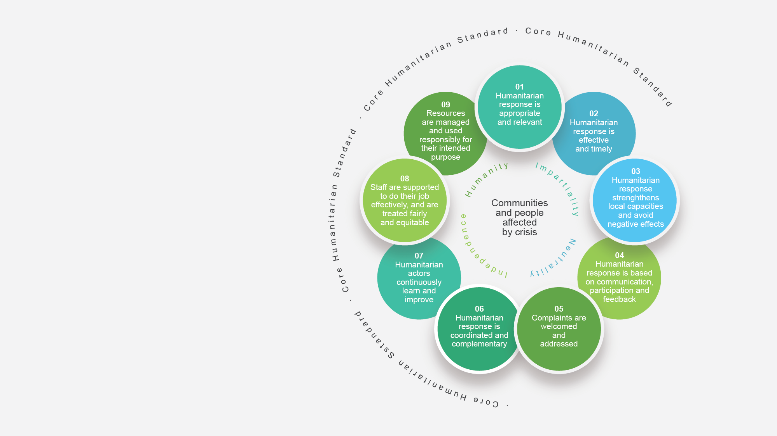
Core Humanitarian Standards
Orientation on Cluster Approach
Notes:
The Core Humanitarian Standard on Quality and Accountability (CHS) sets out nine commitments for humanitarian and development actors to measure and improve the quality and effectiveness of their assistance. The CHS places communities and people affected by crisis at the centre of humanitarian action. Humanitarian organisations may use it as a voluntary code with which to align their own internal procedures. It can also be used as a basis for verification of performance.
The CHS was launched on 12 December 2014 in Copenhagen, Denmark as the result of a global consultation process involving 2,000 humanitarian and development practitioners. It draws together key elements of existing humanitarian standards and commitments. The founders and copyright holders of the CHS are Groupe URD, Sphere and the CHS Alliance.

Slide 15
Minimum Commitments for participation to clusters*
Commitment to humanitarian principles and principles of partnership
Commitment to
mainstream protection
Improve accountability to affected populations
Understanding of duties and responsibilities associated with membership of the cluster Contribute to cluster’s response plan and activities
Active participation in the cluster and a commitment to consistently engage in the cluster’s collective work
Mainstream cross cutting issues (including age, gender, environment, and HIV/AIDS).
Commitment to work cooperatively with other cluster partners to ensure an optimal and strategic use of available resources, and share information on organizational resources.
* Please note this list is neither complete not prescriptive. It’s a basic starting point that has to be adapted at completed at country level. Consult OCHA. (2015). Reference Module for Cluster Coordination and Country Level for more information.
Orientation on Cluster Approach
Notes:
Examples of AAP integration into the HPC include:
- Establishing management systems to solicit, hear and act upon the voices and priorities of affected people
Adopt and sustain equitable partnerships with local actors to build upon their long-term relationships and trust with communities.
Measure and document AAP actions and results

Slide 16
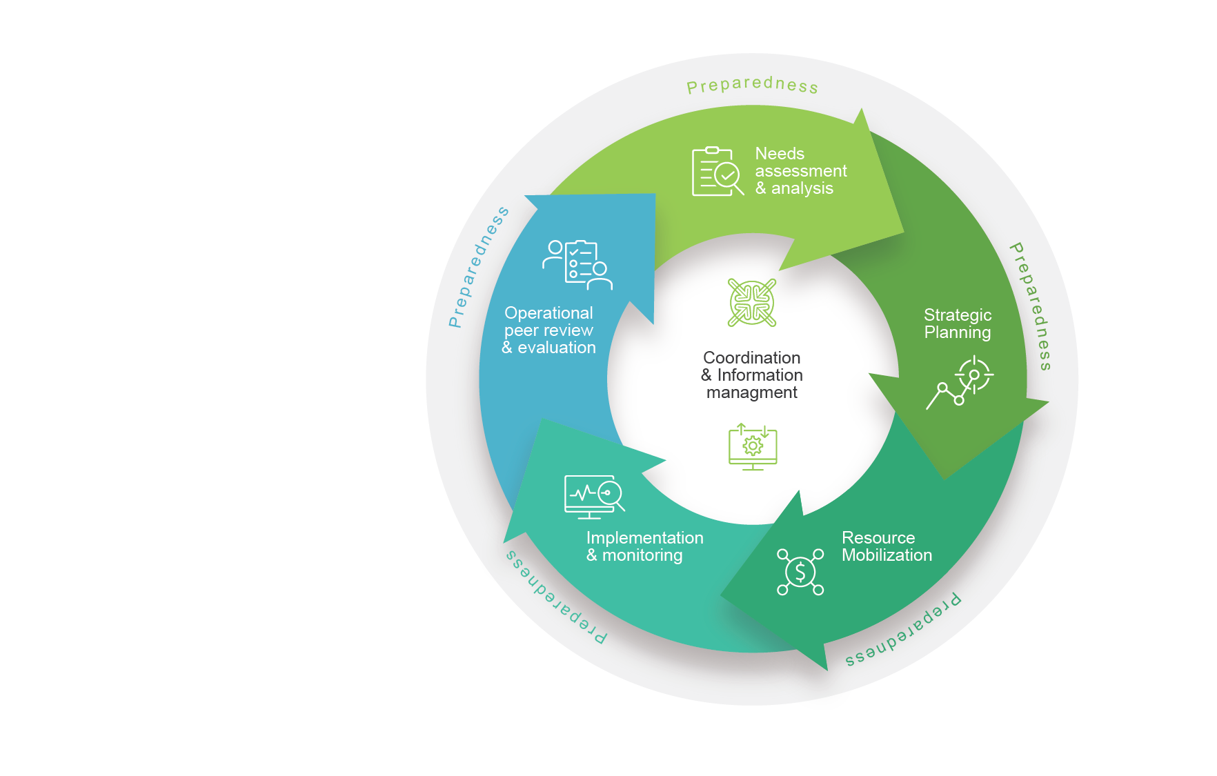
What is the Humanitarian Programme Cycle (HPC)?
Orientation on Cluster Approach
Notes:
The humanitarian programme cycle (HPC) is a coordinated series of actions undertaken to help prepare for, manage and deliver humanitarian response. It consists of five elements coordinated in a seamless manner, with one step logically building on the previous and leading to the next. Successful implementation of the humanitarian programme cycle is dependent on effective emergency preparedness, effective coordination with national/local authorities and humanitarian actors, and information management.

Slide 17
1. Global Level
The GNC
WHO’S WHO in the Nutrition Cluster
At global level, the GNC has 50 partners and observers representing International Non-Governmental Organizations (INGOs), National Non-Governmental Organizations (NNGOs), research and development groups, academic institutions, and UN agencies.
The GNC has been directly supporting sectoral coordination and intersectoral collaboration in more than 60 countries and our open access resources have been accessed by more than 120 countries.
8

Slide 18
WHO’S WHO in the Nutrition Cluster
2. Global Level​ The GNC – Coordination Team
The Global Nutrition Cluster Coordination Team (GNC-CT) provides leadership and stewardship for coordination and functions as the secretariat for the Global Nutrition Cluster. The GNC-CT is staffed by UNICEF and housed within UNICEF Geneva.​
​ The GNC-CT represents the GNC partners in global fora and provides strategic leadership, global guidance and operational support to country nutrition clusters while linking stakeholders and ensuring timely information, knowledge sharing and effective communications.
9

Slide 19
Global Nutrition Cluster
Coordination Team (GNC – CT)
Support to Nutrition cluster/sector​ coordination mechanisms​ at country level
The GNC-CT is led by a Global Cluster Coordinator and consists of two units:
A) The Partnership, Programmes, and Advocacy Team - focuses on strategic leadership, evidence generation, knowledge management, engagement with partners at global level, capacity strengthening, and technical guidance, including guiding the Humanitarian Process Cycle (HPC).
B) The Rapid Response Team - provides operational support to country-level nutrition coordination mechanisms through in-country and remote support as requested. Support includes strengthening nutrition coordination, information management, nutrition information system (NIS)/ assessments, inter sectoral collaboration, preparedness, NiE and the delivery of different capacity strengthening activities.
10

Slide 20
WHO’S WHO in the Nutrition Cluster
3. Global Level
GNC Programme Team (GNC-PT)
Historically, the nutrition community has lacked an overarching platform in how to provide strategic direction to address technical capacity gaps at the country level.
As a result, the GNC Programme Team was established as a partnership of NGOs, UNICEF and the GNC, to provide programme support to Nutrition Clusters and partners, including:
Access to high-quality information, capacity strengthening resources, guidance and learning;
Where guidance is limited, timely access to interim consensus-driven guidance, including guidance on program adaptation;
Access to experienced nutrition technical specialists to answer questions, or to provide more in-depth support (remote or in-country).
11

Slide 21
In-depth
Support
Fast and highly specialized in-country or virtual support
Areas include:
French/Spanish/English/Arabic Coordination
Nutrition Information Systems and assessments
Information Management
Nutrition in Emergencies Programmes
Mechanisms for support
In-depth support is provided through various mechanisms
Rapid Response Team (RRT) - coordination and IM
Standby Partners Agreement (SBP)
Request SBP support here
In-depth NiE programme support
GNC Consultant Roster
Click here to learn more and request consultant support
UNICEF internal surge and stretch assignments
Capacity
Strengthening
Support for country, regional and global levels, for various profiles and capacity stages
E-learning and skill boosting platform
GNC Learn
Information Management
Nutrition Cluster Coordination
Nutrition in Emergencies
Preparedness
ICSC
Mentoring programme
Blended Coordination Training
Soft skills training (through Humanitarian Leadership Workshop)
To learn more about the support we provide, visit our Remote/in-country Support page on our website or scan the QR code.

Slide 22
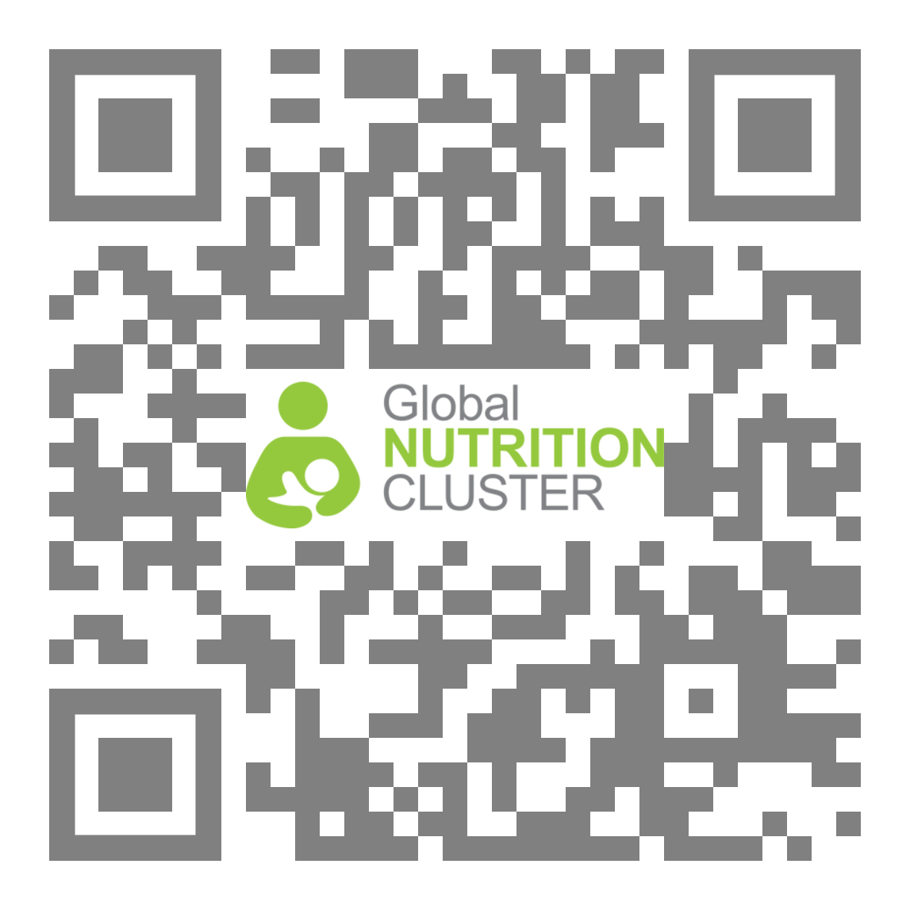
The COVID-19 pandemic is limiting mobility in all countries therefore the GNC-CT will endeavour to limit all face-to-face interactions and increase the modalities and opportunities for remote support, for the foreseeable future.
Guidance and tools readily available online, including but not limited to:
Coordination and information management toolkits
Coordination and information management checklists
Nutrition in emergencies technical checklists
Checkout the website http://www.nutritioncluster.net/
© UNICEF/UN0311097/Verweij

Slide 23
WHO’s WHO of the Nutrition Cluster
1. National Level Nutrition Cluster (NC)
Made of NC-CT, NGOs, UN agencies, GVT officials, CSO, private sector…
This slide has to be adapted and filled in by the country
Orientation on Cluster Approach

Slide 24
WHO’s WHO of the Nutrition Cluster
2. National Level NC – Coordination Team
Nutrition Cluster Coordinator (NCC)
IMO
Deputy
This slide has to be adapted and filled in by the country
Orientation on Cluster Approach

Slide 25
WHO’s WHO of the Nutrition Cluster
3. National Level Cluster Lead Agency: UNICEF
Defining the NC coordination team structure.
Recruiting and managing NC-CT human resources.
Administrative support for the NC-CT
Provider of last resource
…ensure that humanitarian actors build on local capacities and maintain appropriate links with Government and local authorities.
This slide has to be adapted and filled in by the country
Orientation on Cluster Approach

Slide 26
WHO’s WHO of the Nutrition Cluster
4. National Level Strategic Advisory Group
Technical Working Group, Taskforce…
This slide has to be adapted and filled in by the country
Orientation on Cluster Approach

Slide 27
WHO’s WHO of the Nutrition Cluster
Sub-national Level Coordination hubs (map preferably)
Nutrition Coordination team
Nutrition Cluster Coordinator
IMO
…
This slide has to be adapted and filled in by the country
Orientation on Cluster Approach

Slide 28
Want to know more?
https://www.nutritioncluster.net/
https://www.humanitarianresponse.info/
IASC. (2015). Cluster Coordination Reference Module.
UNICEF. (2015). Cluster Coordination Guidance for Country Offices
Add more national cluster resources
© UNICEF/UN0311097/Verweij

