Slide 1
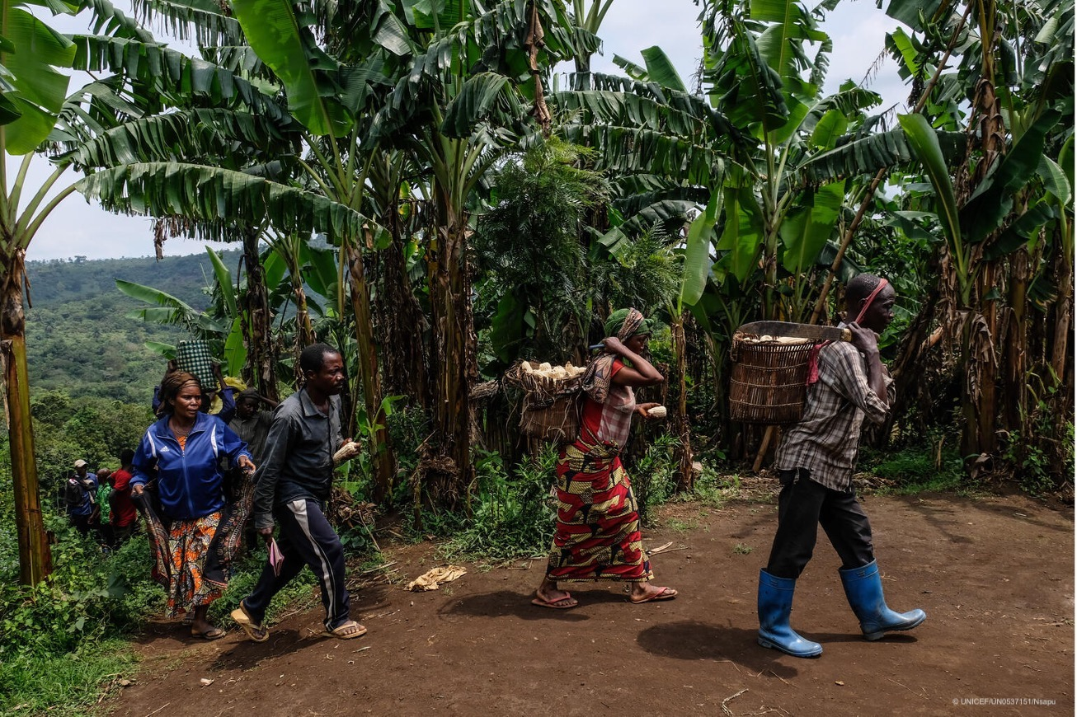
WCARO Regional Call​
DRC
19 September 2023
DRC

Slide 2
Agenda
Welcome and introduction – GNC-CT
Coordination experiences in DRC –
Successes, challenges / gaps and the way forward
Key points
Q&A
DRC

Slide 3
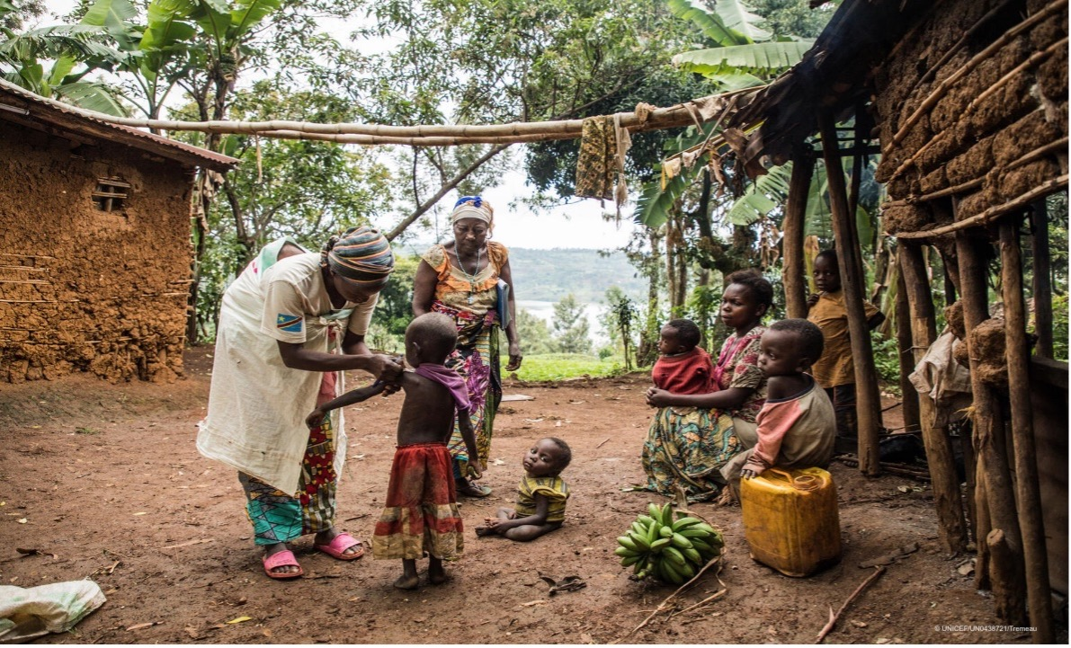
Introduction

Slide 4
Introduction
Importance of regional level calls
Purpose of this session – Coordination & IM success in DRC (national and subnational)
Importance of coordination
DRC

Slide 5
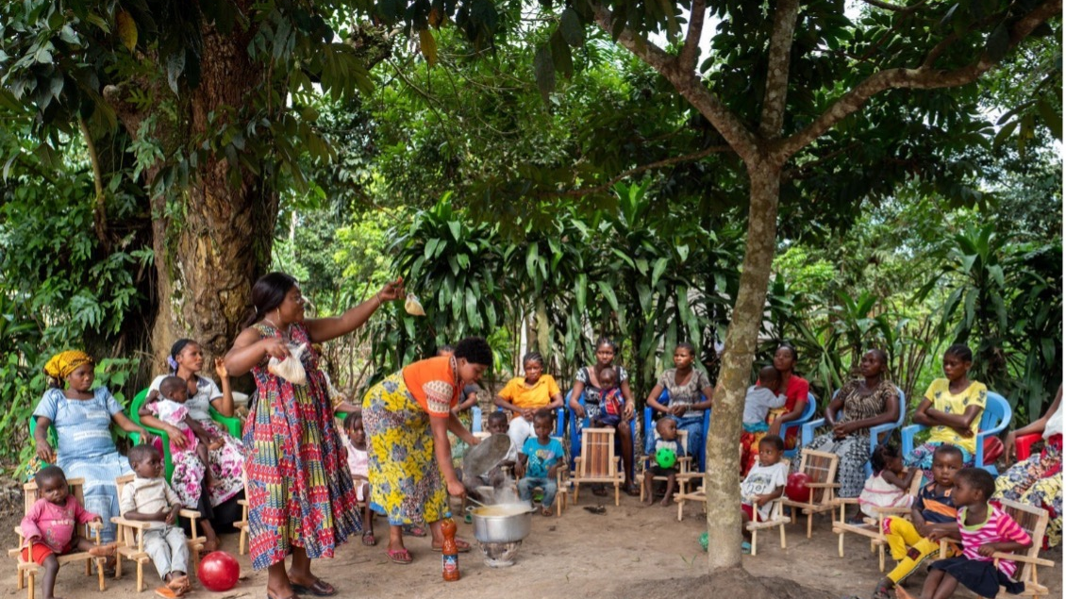
DRC
A more coordinated response

Slide 6
The Structure
National coordination based in Kinshasa (UNICEF, COOPI, PRONANUT)
Five (5) sub-national offices with a coordinator, an INGO/NNGO and PRONANUT co-leadership each
Two (2) Information Management Officers (national + East)
DRC
Notes:
Maximum 6 bullet points between 24 – 28 size font
Aligning with GCCU recommendations

Slide 7
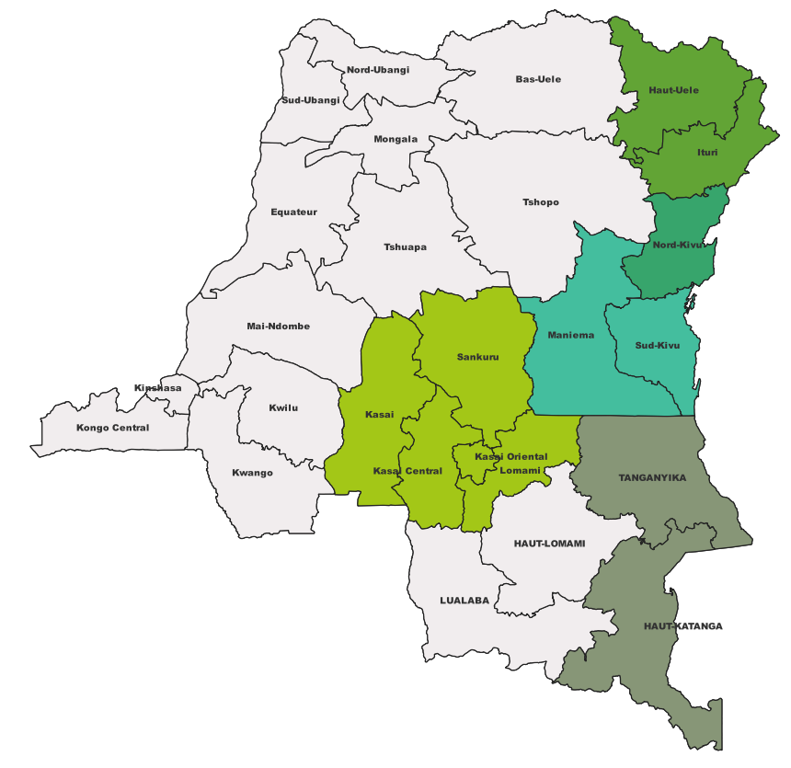
Structure of the Nutrition Cluster
National and sub-national levels
COHP Bunia
Ituri, Haut-Uele.
COHP Goma
North-Kivu.
IMO East
National Coordination
UN lead-agency: UNICEF
Co-lead IONG: COOPI
National co-lead: PRONANUT
COHP Bukavu
South-Kivu, Maniema.
National IMO
Relais humanitaire Kananga
Kasai, Kasai-Central, Kasai-Oriental, Lomami, Sankuru.
COHP Kalemie
Tanganyika, Haut-Katanga.
DRC
Notes:
1 COORDINATION NATIONALE
5 COHPS: Bunia, Goma, Bukavu, Kalemie
1 RELAIS HUMANITAIRE: Kananga
INFORMATION MANAGERS (IMO): 1 NATIONAL: Kinshasa; 1 EST: Goma
Au niveau de chaque COHP, le PRONANUT agit en tant que co-lead avec une ou plusieurs ONG nationales ou internationales.

Slide 8
Past response efforts
Historical coordination:
UNICEF + Co-lead at national level (2006-2018). In 2018, PRONANUT became the co-lead of coordination. Five subnational coordinators from 2020.
Technical working groups (GTT ANJE-U and GTT PCIMA) were established in 2018.
A dedicated IMO was introduced in 2019, two since 2020.
DRC
Notes:
Maximum 6 bullet points between 24 – 28 size font
Support prior to dedicated coordination – including gaps / challenges
If another slide is needed, duplicate this slide
De 2006 – 2018:
Coordination uniquement avec l'équipe coordination nationale (Unicef et Co-lead)
PRONANUT comme partenaire comme les autres acteurs
Au niveau province: facilitation de la coordination dans les bureaux terrains par les officiers nutrition UNICEF
Fin 2018:
point focal PRONANUT comme co-lead de la coordination
mise en place de groupes techniques de travail: GTT ANJE-U et GTT PCIMA
IMO dedié au cluster en 2019
Challenges:
Irregularité des reunions de coordination de la reponse des acteurs sur le terrain
Confusion des interventions UNICEF et
Difficulté pour la disponibilité des données
Manque de visibilité sur les activités des partenaires presents dans les provinces et sans coordination à Kinshasa
2020-2022:
Mise en place de la coordination sectorielle en lien avec l'architecture de la coordination humanitaire
5 coordinateurs dans les provinces du Kasaï Oriental, Kasaï central, Ituri, Nord Kivu et Tanganyika
2 IM

Slide 9
Past response efforts
Challenges
Irregular coordination meetings among field actors.
Lack of visibility on partner activities in provinces without coordination in Kinshasa and confusion with UNICEF interventions.
Data availability and lack of analysis issues.
DRC
Notes:
Maximum 6 bullet points between 24 – 28 size font
Support prior to dedicated coordination – including gaps / challenges
If another slide is needed, duplicate this slide

Slide 10
Coordination & IM successes
Coordination:
Partners adhere more to guidelines and the national protocol.
Better coordination of the response: regular meetings, orientation of partners.
Information Management:
Data collection, analysis and using;
Data used to vehiculate messages, advocacy and resource mobilization;
Regular data and information sharing with partners;
DRC
Notes:
share experience on coordination structure that has improved quality of coordination
Points on IM successes
Include added value
to better programming and to coordinate the response

Slide 11
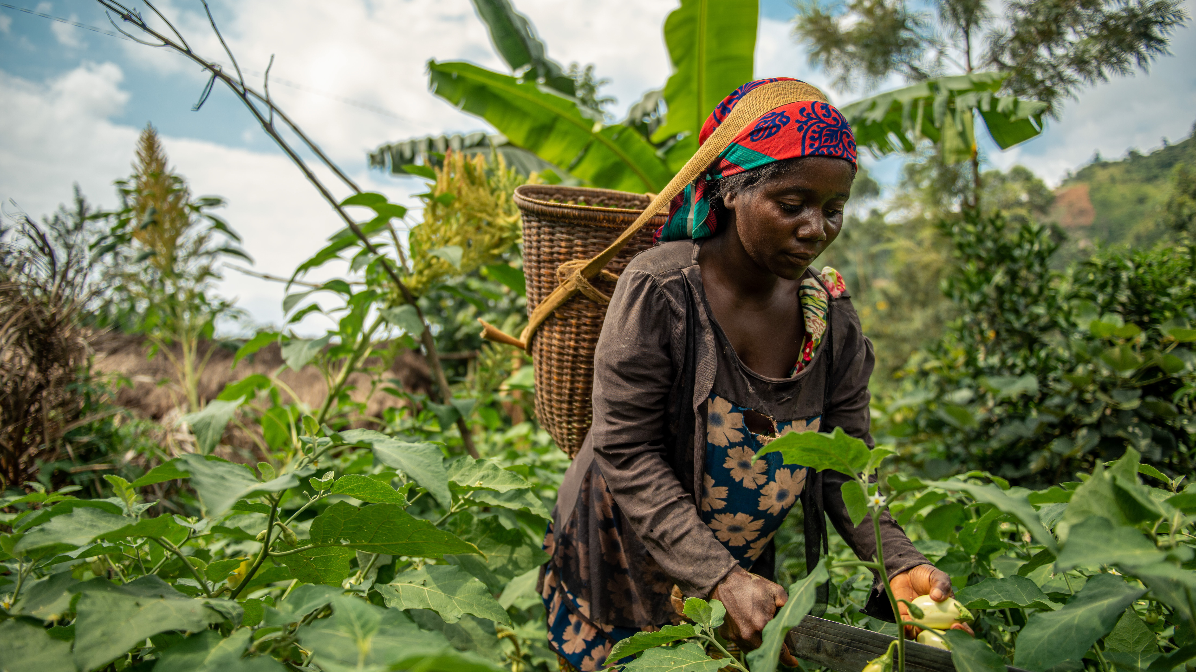
Gaps, challenges & the way forward

Slide 12
Gaps & Challenges
Maintaining the current coordination structure requires resources;
Huge needs and low funding capacity for intervention;
Limited capacity for flexibility on stock;
Limited availability of recent datasets
DRC
Notes:
List no more than 6 bullets of any gaps and challenges
(funding human resources and cluster activities)
Project-based funding in the country
analyses (SMART, IPC, etc.) to produce needs assessments and plans.

Slide 13
The Way Forward
Secure sustainable funding
Prioritize high-impact interventions and mobilize resources effectively.
Advocate for flexible funding
Establish a data-sharing system with agencies and partners
DRC
Notes:
List no more than 6 bullets of the way forward and how these gaps / challenges are being addressed or will be addressed.
Add any "needs" here – (duplicate this slide if more room is necessary)
Facilitate monitoring, analysis and guidance of stakeholders via coordination and tools;
Strengthen partners' capacities (e.g., on NiE and cluster approach, cross-cutting themes, intervention package, etc.);
Develop the nutrition emergency response strategy by finalizing emergency response plans and updating the cluster's current guidelines;
Strengthen joint supervision of interventions with cluster members and qualitative analysis of the response;
Plan and coordinate data collection and analysis.
through donor engagement and long-term commitments.
to create contingency funds for rapid responses.
for up-to-date information. Strengthen data collection and analysis capacities.

Slide 14
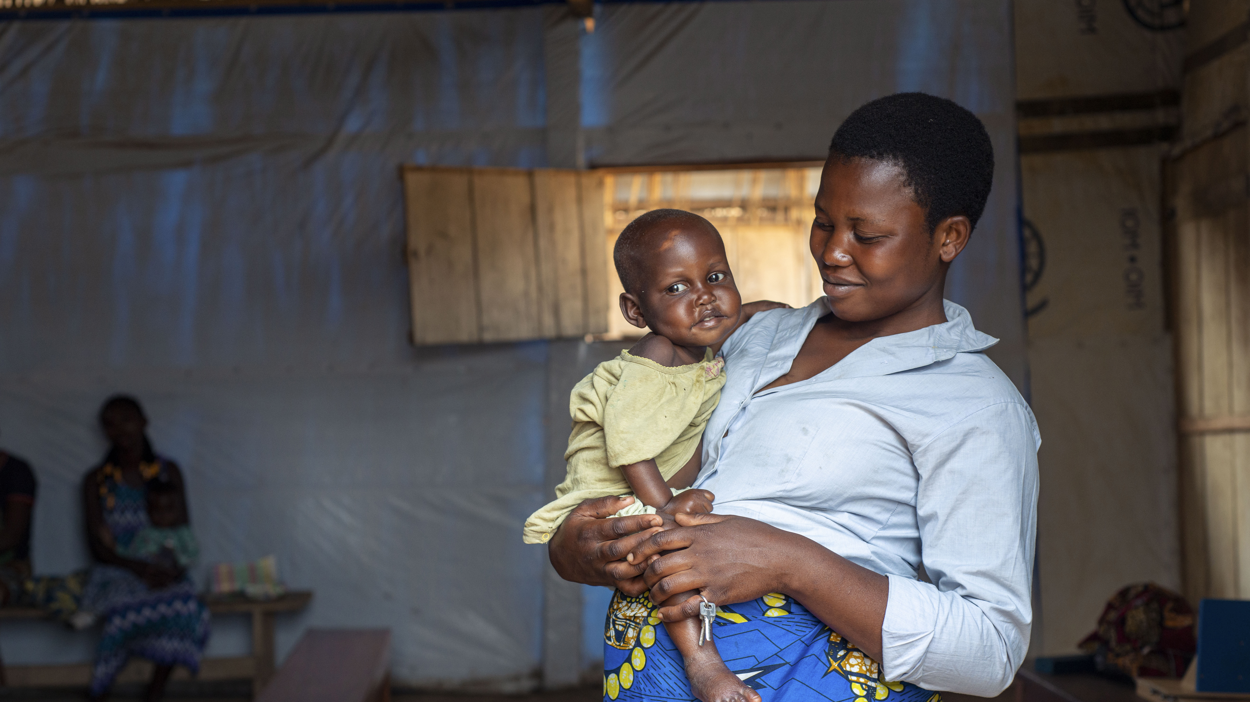
Key points
Having strong coordination at the national and subnational level affects the quality of the overall emergency response and leads to more effective coordination activities that saves lives.

Slide 15
Key Points
Decentralized coordination team close to the intervention area to interact with partners;
Capacity building for partners;
Revitalization of the Cluster as a platform;
Regular multi-/bi-lateral meetings;
Development of technical documents and guidance for partners;
Collect, analyze and use data
DRC
Notes:
List no more than 6 bullets of highlights or key points on how dedicated NCC / IM/ cluster team has improved the DRC NC response during emergencies
Example: Without a dedicated NCC....
to exchange and coordinate;
with partners to better coordinate;
to guide interventions and to inform stakeholders.

Slide 16
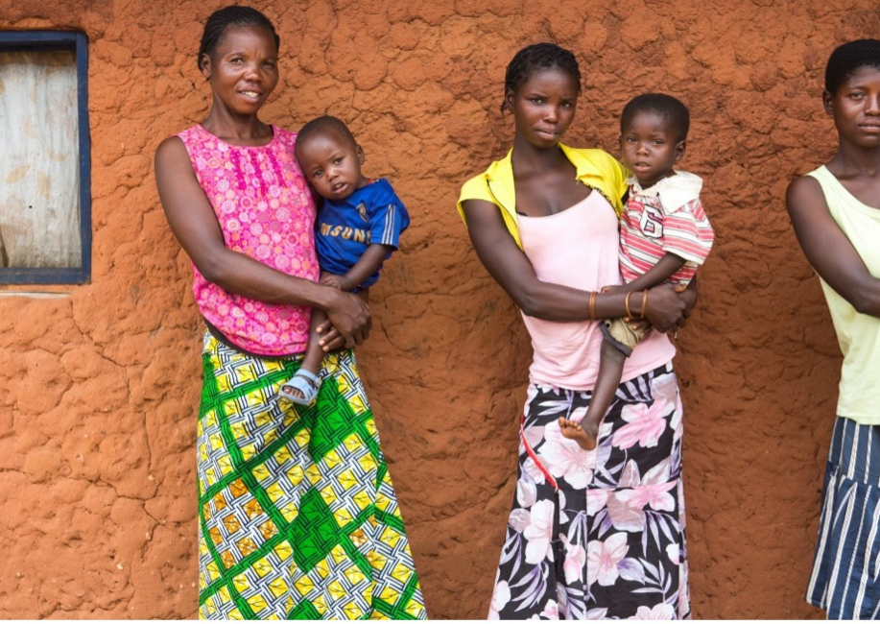
Thank you
Notes:
Insert own photo

