Slide 1


GNC Partners Call​
Emergency Nutrition Response in
< Sudan >
9th May 2023

Slide 2
Current situation in SUDAN
Fighting has continued despite the repeated call for cease fire in Khartoum (capital city) and spread to other states ( North, South, Central and West Darfur, North Kordofan, Northern)
About 528 of people had been killed (OCHA flash appeal 2nd May)
Over 334,000 IDPs and 123,000 have fled to other countries (Egypt, Chad, Ethiopia, South Sudan)
About 61% of the health facilities not functional in Khartoum and almost all West Darfur of not functional as of 4th May
Social services (health, water supplies, school disrupted), poor connectivity, homes destroyed or looted in hotspot areas.
Cost of living (water, food, fuel) have increased by 40-60% and some have doubled
Crimes incidences has increased in some of the cities
Eastern part of the Sudan calm (Red Sea, Kassala, Gadareef, Blue, While River Nile)

Slide 3
Current situation in SUDAN and forecast
15.8M – Pop needed humanitarian assistance in 2023.
Nutrition services have been suspended/interrupted: Only 67 of SCs; and 84% of OTP and 31% of the TSFP) were operational as of 2nd May: Rest pending updates
About 50,000 SAM cases (two-month) and about 1700 SAM (One month) with medical complications were on treatment by time of conflict
Forecast:
Ceasefire/continuing fighting-
People with acute food Insecurity estimated to increase by 2-2.5M mainly in the Darfur/RS.
Acute malnutrition is projected to deteriorated further in the hotspot areas and states receiving IDPs with an overall range of 10-30%
Increased costs of interventions /operational costs among partners
Increase in IDP- may reach to over 800,000 as per UNHCR projections in 2-3months.
Light HRP revision between 5-16th May for 3-6months

Slide 4

SUDAN Nutrition Cluster Dashboards
NUMBER OF
PARTNERS
46
Achievements per activity:

Slide 5
Strategic Nutrition Priorities
Sustaining the ongoing life saving nutrition services, SCs, OTP, TSFP and MYCN-IYCF-E
Provision of living serving interventions in IDPs
Resumption of nutrition services in hotspot areas once security allows (Khartoum and WD)
Initial rapid assessment of the scale of needs and partners capacity mapping
Procurement and replenishment of supplies in the nutrition sites
Strengthening monitoring (monthly-weekly reporting of evolving situation and responses in hotspot/IDP sites
Strengthening sector coordination and information management (National and sub and national level)
Development of the response plan and additional funding requirements (Flash appeal) pending decision by the HCT
Advocating with stakeholders and donors to fund the response
Accountability to Affected Population (AAP)

Slide 6
Gaps in Resources
    Human Resources
      Partners to mobilize staff to support those evacuated or relocated
      Recruiting additional staff partners expanding services to new IDPs sites
    Financial Resources
      HRP requirement for 2023: 190.9 M
      Funding secured by end of April 37.8M (19.8%)
      Operational costs for SCs, OTP and TSFP by both agencies and NGOs increasing considerably
      Flash appeal being prepared in under the OCHA guidance and in collaboration with partners
    Supplies
      WHO: 3014 SAM kits module – worth US$ 5M in 6months was needed
      UNICEF: 235,709 RUTF ctns, F-100 and F-75 gaps was about US$ 20m before the conflict + additional to be estimated
      WFP: 950 MT received in Port Sudan in May: Others were expected: 720 MT in May and 1200MT of RUSF in May/June. These supplies were enough to run TSFP across the county until November 2023.

Slide 7
Challenges in achieving strategic priorities
Security and Access of partners to the nutrition sites in the affected areas
Replenishing supplies in nutrition sites to partners and supported by the SMOH (need ad hoc modality of supporting delivering supplies SMOH). Some partners have just one month supplied remaining
Limited availability of cash among partners to support the ongoing activities
Difficulties in paying staff Salaries/incentives by Partners
Increased operational costs to support the ongoing /new life saving nutrition services
Hiking of prices for basic needs (Food, Water, doubling of transportation costs etc)
Limited internet connectivity and mobile phones- presenting challenges to communicate with staff and partners
Replenishment of partners looted office equipment and assets in particularly in hotpots
Bureaucratic and access impediments (travel notifications, number of check points)
Dysfunction nutrition information system-last update was in Feb 2023.
Limited supervision of nutrition responses by partners

Slide 8
Three key asks from GNC and partners
Advocating to partners HQs for surge capacity
Advocating for additional funding to support IDPs/Returnees/Refugees, increased operational costs, unit costs for response
Support to coordination at national and information management:
  A dedicated IMO to support the increasing demand for updates for nutrition information management, mapping from partners and stakeholders.
  Roving or deputy sector coordinator to support sub- national coordination

Slide 9
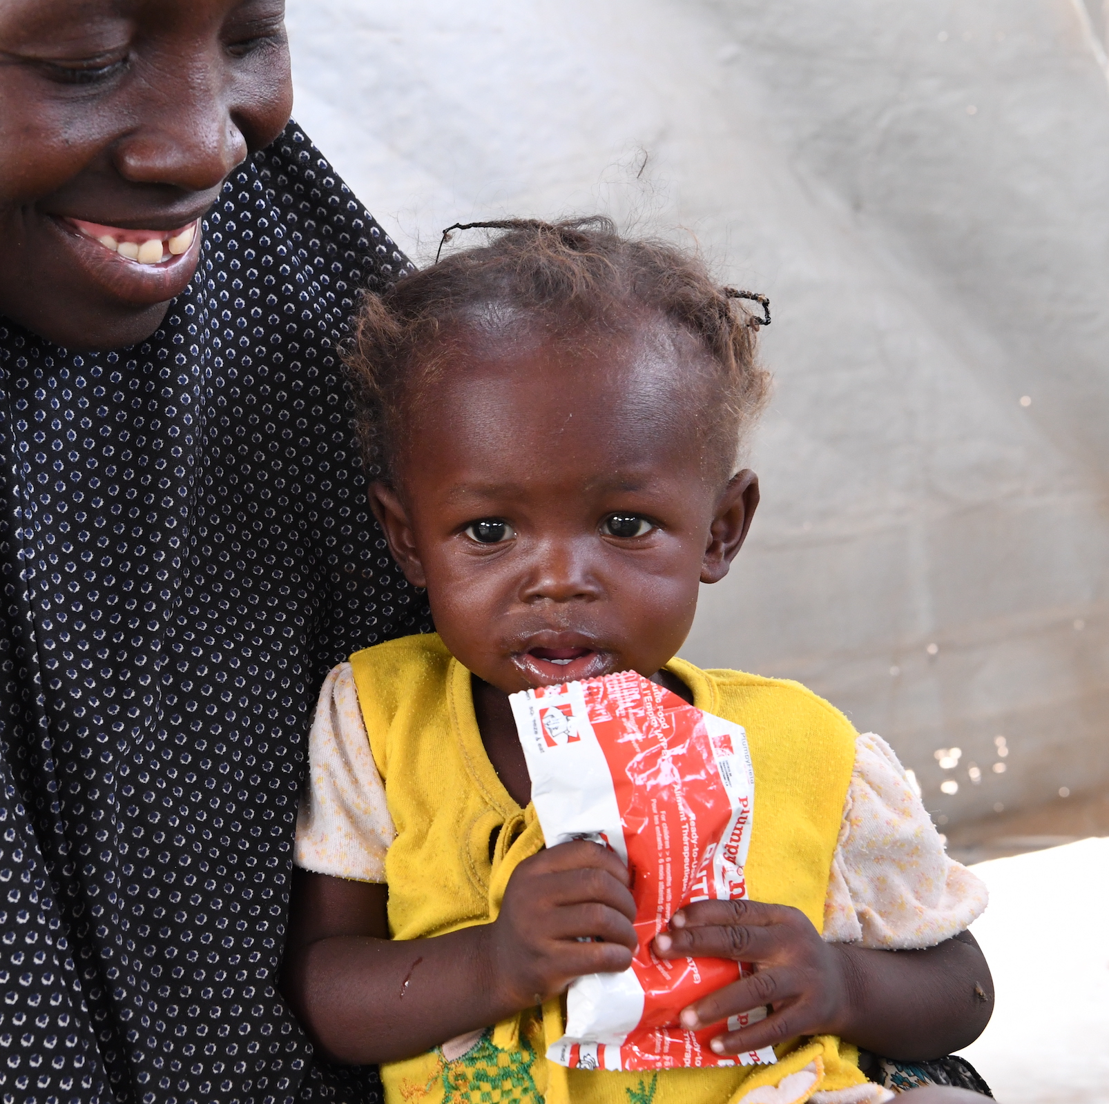

Thank you
Notes:
Insert own photo

