Slide 1
KoBoToolbox

Slide 2
What is KoBoToolbox ?

Slide 3
Poll
Are you familiar with Kobo Tool box
Yes
No
When Last time you fill KoBoToolbox Report?
One day
One week
One month
Non

Slide 4
KoBo Toolbox is a free open-source tool for mobile data collection.
It allows to collect data in the field using mobile devices such as mobile phones or tablets, as well as computers.
There are two separate instances of KoBoToolbox for humanitarians and other users: kobo.humanitarianresponse.info and kf.kobotoolbox.org
The adaptation of KoBo Toolbox for humanitarian use was a joint initiative between OCHA, Harvard Humanitarian Initiative (HHI) and the International Rescue Committee (IRC).

Slide 5
Why KoBo ?
It is a ready-to-use all-in-one platform for developing, storing, managing and sharing forms, as well as managing and sharing collected data.
It is based on OpenDataKit (ODK). KoBo Toolbox is fully compatible and interchangeable with ODK Collect and XLSForm, but delivers more functionality such as an easy-to-use formbuilder, question libraries and integrated data management. It also integrates other open-source ODK-based developments such as formhub and Enketo.
It is being continuously improved and optimised particularly for the use of humanitarian actors in emergencies and difficult field environments, in support of needs assessments, monitoring and other data collection activities.
It is free. All humanitarian actors can create accounts on the dedicated server and use them without limitations on data or time. There is no need to install any server, but if there is a need, organisations can install it on their own servers.

Slide 6
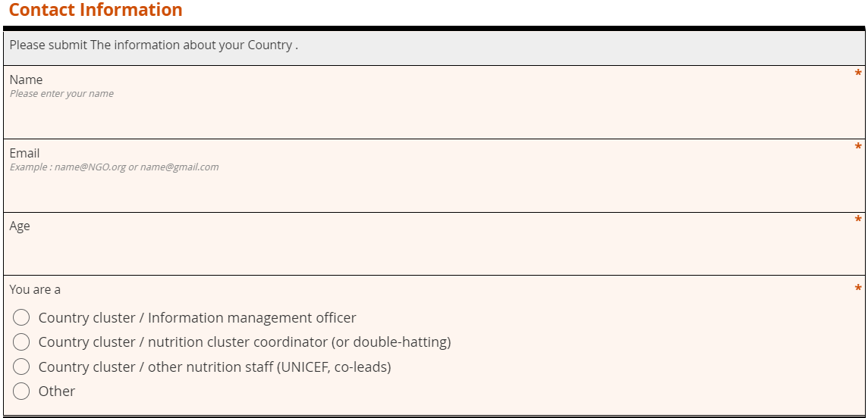
Get Started
Creating a form
Name [text]
Email [text]
Age [number]
You are [Select one]
Country cluster / Information management officer
Country cluster / nutrition cluster coordinator (or double-hatting)
Country cluster / other nutrition staff (UNICEF, co-leads)
Other
https://kobo.humanitarianresponse.info/accounts/login
Username: gnc
Password : 123

