Slide 1
2.6 Information Management

Slide 2
Objectives of the Session
By the end of this session, participants will be able to:
Describe the importance of Information Management in cluster coordination
Present local products
Present the product schedule for your country

Slide 3







What is information Management
Strategic Decision-Making
Right Information
Right place and time
Right person
Core IM Activities
Data
collection
Data
analysis
Mapping
Reporting &
dissemination
Notes:
Information management is an effective tool in supporting emergency response. Used in coordination, information management can provide decision makers with the best available picture of emergency situations on which to develop or modify their strategies. Information management is a continuum, running alongside strategic development and monitoring. The process starts with the gathering of raw data. These datasets are collated and turned into information on which to build knowledge and an understanding of the emergency. That information needs to then be disseminated widely and rapidly. Partners providing the raw data will see the benefit of receiving useful information, and will provide more data.

Slide 4

IM in clusters provides
Evidence-based, transparent basis for decision-making
Common understanding of situation
Systematic approach in chaotic situation.
= improved effectiveness
= improved accountability
Notes:
Adopting a structured approach to planning and decision making is important so that information needs are clear.
Regular communication will help build networks and relationships, and gather up-to-date information.
Sharing information promotes a common understanding - if I provide good info you will come back; need to share it with all
It’s about Added Value.
Of all of those words are their any which are more important?
Yes – EVIDENCE BASED. This is vital if SOF is to be effective.

Slide 5
IM & AAP
Adapting IM tools and processes to include qualitative data from affected communities
  SMS for community level data collection and feedback
  Common platforms to consolidate feedback data
  Common approaches to perception surveys and focus groups
Triangulate and validate other data and identify gaps or issues in the response
Define key information needs and products to support effective decision-making
Making use of the data and analysis for decision making is the responsibility of the cluster, not IM
Notes:
NCC Handbook Chapter 3.1.2
Increasing examples of adapting IM tools and processes to include qualitative data from affected communities
SMS for community level data collection and feedback
Common platforms to consolidate feedback data
Common approaches to perception surveys and focus groups
If used well, this can help triangulate and validate other data and identify gaps or issues in the response
IM can support clusters to define key information needs and products to support effective decision-making
But making use of the data and analysis is the responsibility of the cluster, not IM

Slide 6
Role of Partners
Cluster Partners
Contribute to information exchange
Agree and adhere to common definitions, indicators, standards
Contribute to analyses: interpret collectively information/data (in e.g. TWiG)
Contribute to cluster outputs
Notes:
It is the job of the coordinator to interpret the data, not the IMO. The IMO can look for problems, outliers and may be familiar with Nutrition in Emergencies but might also not have programmatic knowledge. Its not their role to interpret what the data means for programming.
The IMO and CC can work together at multiple points in the program cycle to make sure the best decisions are being made e.g. when assessment questions are chosen and database parameters established, as well as agreeing on how to present information for best effect. You are a team.
If partners are not providing data correctly or on time for reporting, and this happens repeatedly, its key for dialogue to be had on why its happening to try and resolve it.

Slide 7
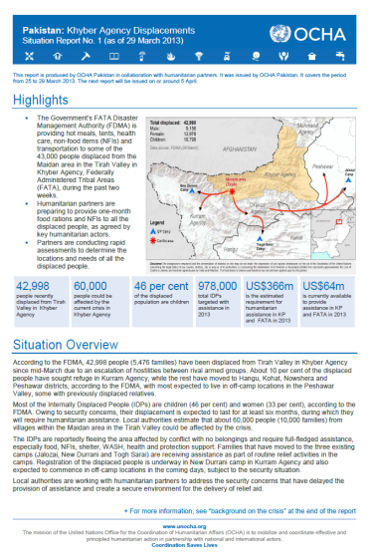
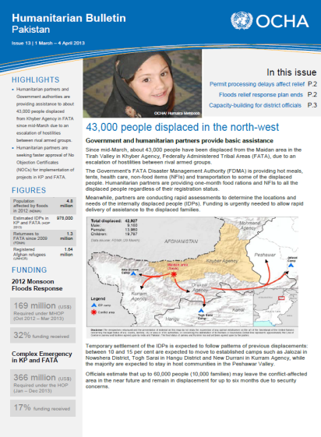
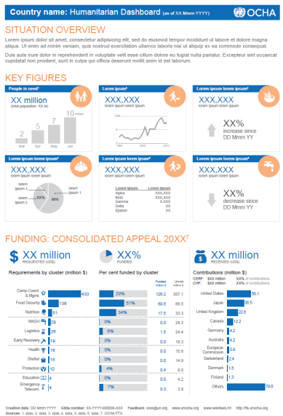
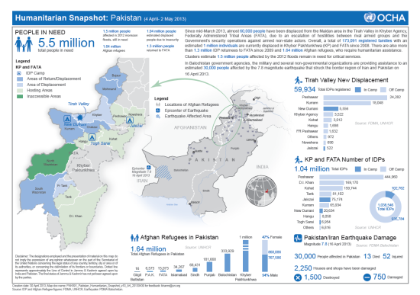
Four core products from OCHA
Humanitarian Dashboard
Graphic focused tool showing progress against cluster-level targets and funding requirements, and other key facts
Humanitarian Snapshot
Info-graphic presenting several key themes using data and geo-referenced information with a map and other visuals.
Humanitarian Bulletin
Regular report in chronic emergencies. Presents advocacy priorities and supports them with data and analysis of trends.
Situation Report
Published in acute crises to give situation overview and cluster-by-cluster needs, response, gaps and constraints.
Notes:
These are the common products that clusters contribute to with data from partners that reflect progress, gaps ect linked to the HRP across sectors.

Slide 8
Local Products
Notes:
NCC Handbook Chapter 3.1.2
Increasing examples of adapting IM tools and processes to include qualitative data from affected communities
SMS for community level data collection and feedback
Common platforms to consolidate feedback data
Common approaches to perception surveys and focus groups
If used well, this can help triangulate and validate other data and identify gaps or issues in the response
IM can support clusters to define key information needs and products to support effective decision-making
But making use of the data and analysis is the responsibility of the cluster, not IM

Slide 9
Local schedule
Notes:
NCC Handbook Chapter 3.1.2
Increasing examples of adapting IM tools and processes to include qualitative data from affected communities
SMS for community level data collection and feedback
Common platforms to consolidate feedback data
Common approaches to perception surveys and focus groups
If used well, this can help triangulate and validate other data and identify gaps or issues in the response
IM can support clusters to define key information needs and products to support effective decision-making
But making use of the data and analysis is the responsibility of the cluster, not IM

Slide 10
IM toolkit and Indicators Registry
Notes:
Introduce the GNC IM toolkit, checklist and Indicators Registry noting that we will explore them as we go through group work

Slide 11
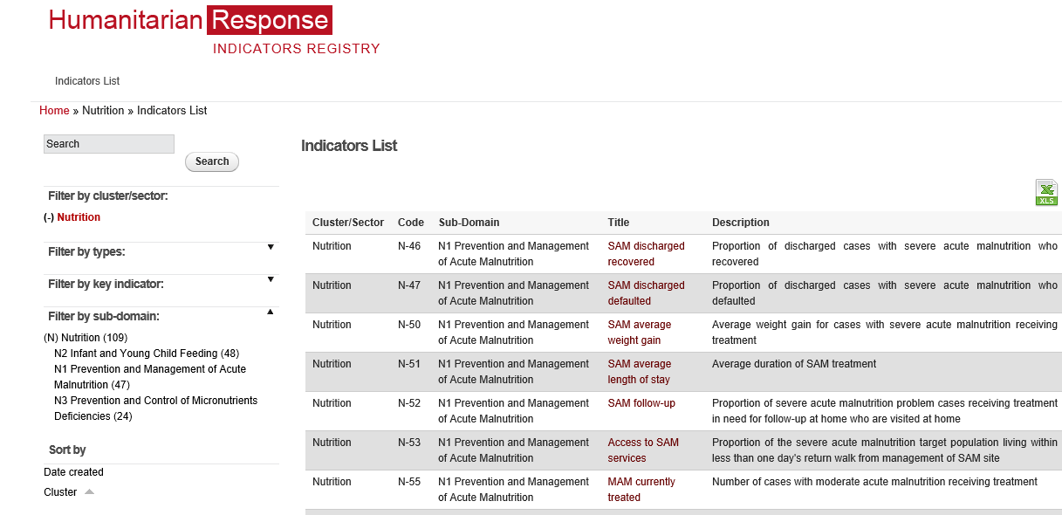
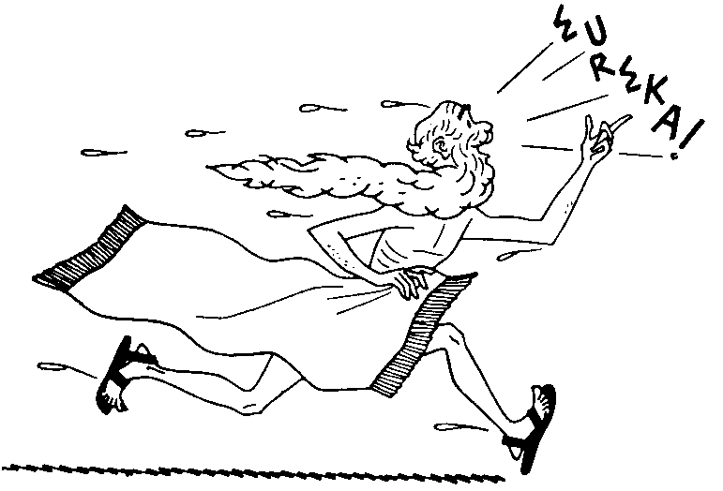
Nutrition Indicators
Repository of baseline, output,
outcome, process indicators
related to nutrition
Repository on
Nutrition Indicators
Notes:
https://ir.humanitarianresponse.info/indicators/cluster/nutrition
Demonstrate on computer to participants

Slide 12
Nutrition Indicators
Notes:
https://ir.humanitarianresponse.info/indicators/cluster/nutrition
Demonstrate on computer to participants

Slide 13
Repository of Nutrition Indicators
https://ir.hpc.tools/en/applications/ir/indicators/global-clusters/9
NOTE:
The GNC Operational Framework for AAP includes several sample indicators around community engagement that NC can adapt and use.

Slide 14
Key Messages
Information management supports every stage of the humanitarian programme cycle.
It improves effectiveness and accountability
The GNC website provides IM templates and guidance on structure and content of a country nutrition cluster website
The NCC, partners and IM officer have all specific roles in IM
If used effectively, IM tools and products can support more effective and accountable collective responses
Notes:
NCC Handbook Chapter 3.1.2

