Slide 1
2.1 Preparedness

Slide 2
Objectives of the Session
By the end of this session, participants will be able to:
Explain the role of preparedness in the HPC
List some activities that partners can undertake to support preparedness

Slide 3
Humanitarian Programme Cycle

Slide 4
Emergency Response Preparedness

Slide 5
Emergency Response Preparedness
Led by the RC/HC and HCT
Role of the partners:
Risk analysis and monitoring
Minimum preparedness actions by the agency that contribute to the overall cluster preparedness
Advanced preparedness actions and contingency planning by the agency that contribute to the overall cluster preparedness

Slide 6
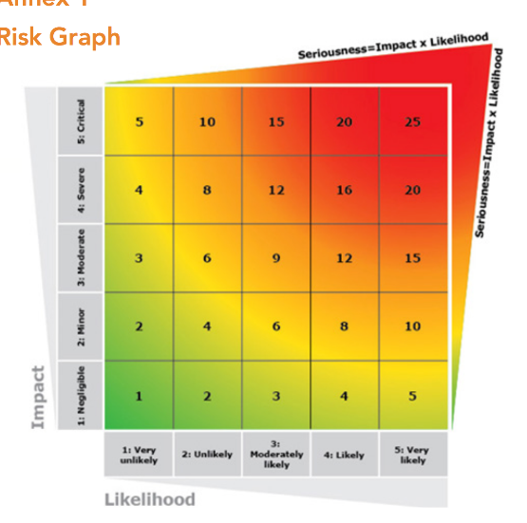
The Risk Analysis Matrix in the ERP
Notes:
- INFORM takes some time to develop: 6m+
- ERP provides a short-term solution
- Risk matrix
- Intended to be done with small group of people based on expert knowledge
- Not quantitative, but can get consensus on type and scale of risks

Slide 7
1. Risk Analysis and Monitoring
A clear and common understanding of the risks which may trigger a crisis significant enough to require a coordinated humanitarian response is fundamental to the entire ERP process.
It involves analysis of risks (hazards, likelihood and impact), development of contingency plans for higher-level risks.
Notes:
At the global level, cluster leads are responsible for:
up-to-date assessments of the overall needs for human, financial, and institutional capacity;
reviews of currently available capacities and means for their utilisation;
links with other clusters, including preparedness measures and long-term planning, standards, best practice, advocacy, and resource mobilisation;
taking action to ensure that required capacities and mechanisms exist, including rosters for surge capacity;
training and system development at the local, national, regional, and international levels.

Slide 8
2. Minimum Preparedness Actions
A set of activities that every country team must implement in order to establish a minimum level of emergency preparedness
Not risk or scenario-specific and usually do not require significant additional resources to accomplish.
Includes establishment of coordination and management arrangements, preparing for joint needs assessments, response monitoring, information management.
Notes:
At the global level, cluster leads are responsible for:
up-to-date assessments of the overall needs for human, financial, and institutional capacity;
reviews of currently available capacities and means for their utilisation;
links with other clusters, including preparedness measures and long-term planning, standards, best practice, advocacy, and resource mobilisation;
taking action to ensure that required capacities and mechanisms exist, including rosters for surge capacity;
training and system development at the local, national, regional, and international levels.

Slide 9
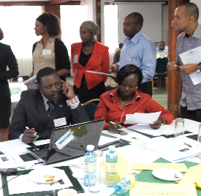
3. Advanced Preparedness Actions and Contingency Planning
Two sets of complementary activities that should be initiated together to plan for specific risks when risk analysis and monitoring indicate moderate or high risk.
APAs are risk-specific and are designed to advance HCT readiness.
A CP sets out the initial response strategy and operational plan to meet the humanitarian needs during the first three to four weeks of an emergency.
Notes:
At the global level, cluster leads are responsible for:
up-to-date assessments of the overall needs for human, financial, and institutional capacity;
reviews of currently available capacities and means for their utilisation;
links with other clusters, including preparedness measures and long-term planning, standards, best practice, advocacy, and resource mobilisation;
taking action to ensure that required capacities and mechanisms exist, including rosters for surge capacity;
training and system development at the local, national, regional, and international levels.

Slide 10
Discussion Questions: Preparedness
What can the partners do to identify, and prepare for risks or sudden changes in the context?
Working in groups, try to come up with examples of actions the partners can take as part of its preparedness.

Slide 11
Reinforcing AAP in Preparedness
Compile secondary sources on nutritional status and identify vulnerable groups
Identify pre-existing knowledge, resources, capacities of local actors
Map preferred communications channels, community feedback and participation preferences
Use learning from previous interventions to pre-plan for most appropriate and relevant nutrition responses
Invest in capacities and compentencies of local communities and partners
Preferably, this is already happening before a crisis

