Slide 1
2.5 Implementation and Monitoring

Slide 2
Objectives of the session
By the end of this session, participants will be able to:
Link planning to implementation and monitoring
Explain the role of the partners in implementation
Summarise the importance of monitoring
List ways to improve cluster monitoring
Use the repository of nutritional and AAP indicators

Slide 3
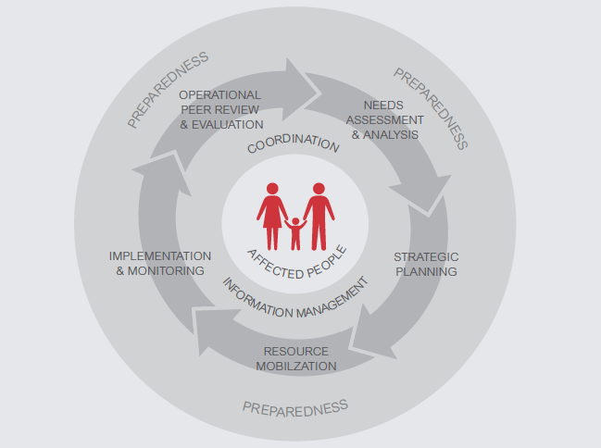
HPC

Slide 4

Implementation
Needs Assessments
Humanitarian Needs Overview
Humanitarian Response Plans
Cluster Strategies / Priorities
3W/4W – Partner plans
Implementation

Slide 5
Challenges
What are some of the main challenges for partners related to implementation?

Slide 6
Challenges
How can partners...
Increase collaboration and reduce competition?
Promote use of technical and quality standards?
Encourage common approaches to participation and feedback?
Adapt plans and interventions to changing situations?
Encourage joint approaches amongst partners?
Promote integrated approaches with other clusters?
Share information?

Slide 7
Group Work
In groups, think of at least 3 suggestions on how the Nutrition Cluster can:
Promote consistent quality programming
Identify and address gaps in coverage
Consider cross-cutting issues
Integrate feedback from communities into decision-making

Slide 8
Planning for Implementation
Use cluster response planning processes to define:
Implementation modalities
Intervention strategies
Joint implementation of activities
Coordination with other clusters
Engagement of local actors
Information needs
Key information needs
Responsibilities for data collection and analysis
Sharing information with communities, partners and other stakeholders
Community Engagement
Strategies for community participation in implementation
Analyzing feedback and complaints
Responsibilities for responding to feedback and complaints

Slide 9
Implementation and AAP
Use cluster meetings to regularly analyse:
Changes to the context or situation
Access and protection, PSEA or other issues
Gaps or other issues affecting implementation
Concerns around quality and consistency
Feedback from affected communities
Capacity building gaps
Good practices and opportunities for learning.

Slide 10
Monitoring
What is it?
Monitoring is the systematic and continuous process of collecting and using information throughout the programme cycle for management and decision-making
Do you agree?

Slide 11
Why do we monitor?
Monitoring helps us to know if we are doing:
The right things?
At the right time?
The right way?
For the right people?
If the answer is yes…
How do we continue and scale-up?
If no…
What do we need to change and improve?

Slide 12
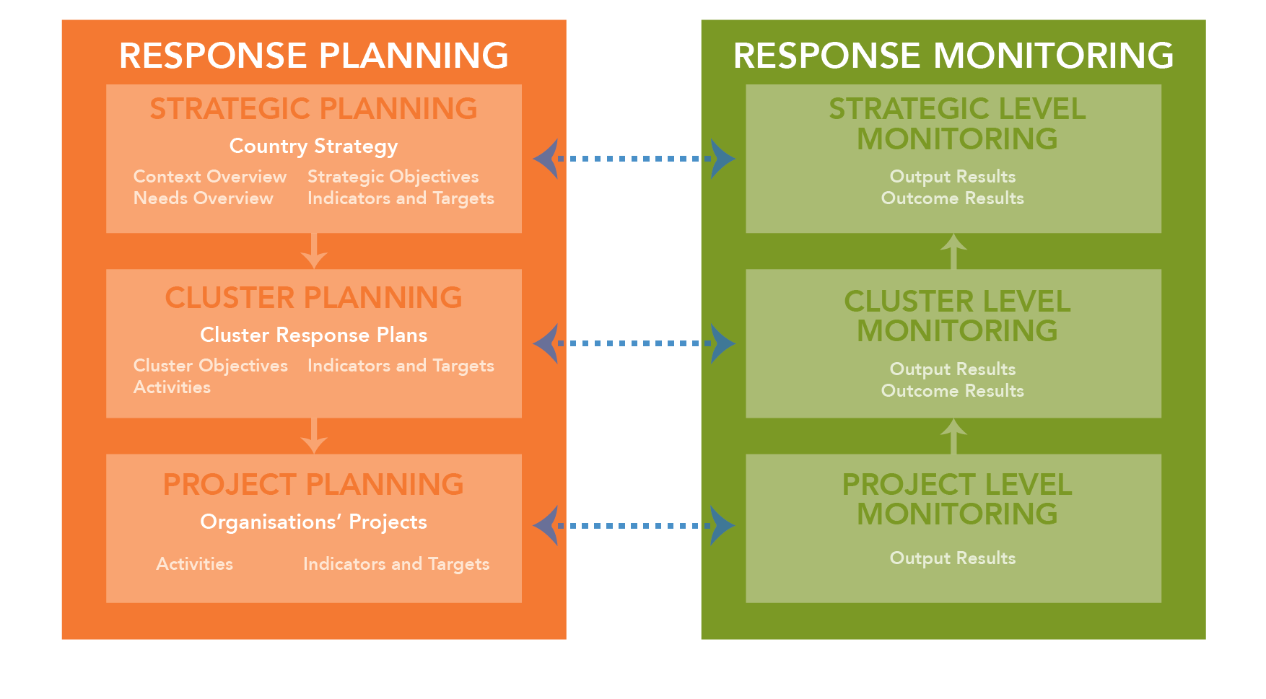
Types of Monitoring
IMPLEMENTATION

Slide 13
What should we monitor?
To know (with evidence!) if our collective responses:
  Are appropriate and relevant
  Are timely and effective
  Strengthen local capacities and avoid negative effects
  Are based on communication, participation and feedback
  Provide safe, accessible complaints and response mechanisms
  Are coordinated and complementary
  Support continuous learning and improvements
  Are delivered by competent staff
  Use resources efficiently and effectively

Slide 14
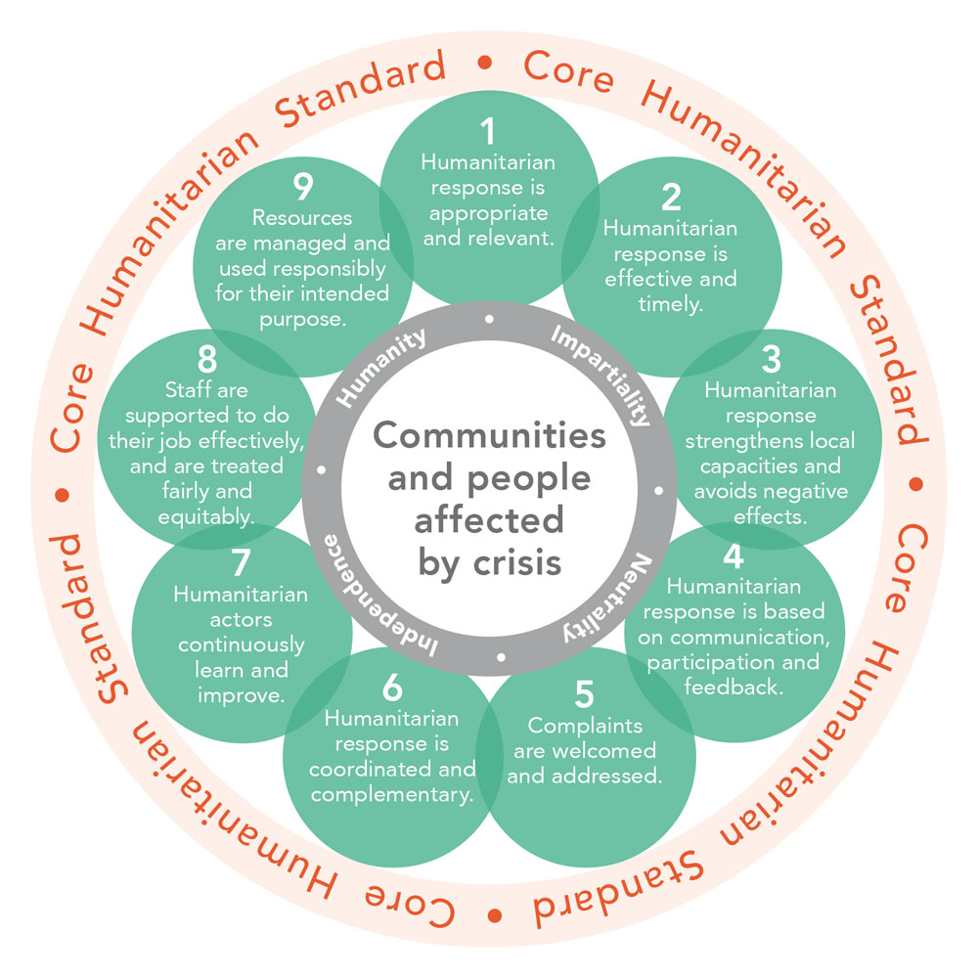
What should we monitor?

Slide 15

Why do we monitor?
Evidence base
Decision making
Accountability
  Communities
  Partners
  Donors
  Host government
  Global community
Principled action
Effectiveness

Slide 16
Other types of monitoring?
What other types of monitoring can clusters do?
Context and situational monitoring
Quality and consistency of interventions
Satisfaction and feedback of affected people
Cluster performance and working relations
Not all monitoring needs to be formal!

Slide 17
Role of the NC in Monitoring
Define the most important information they will need in order to make informed collective decisions.
This includes defining how monitoring data will be collected, analysed and shared.
The cluster can also define quality criteria for monitoring.
Important to remember that tools and approaches need to be adapted to the context, resources and capacities available
Use the SAG, create a monitoring TWiG or define indicators collectively with Cluster partners!!

Slide 18
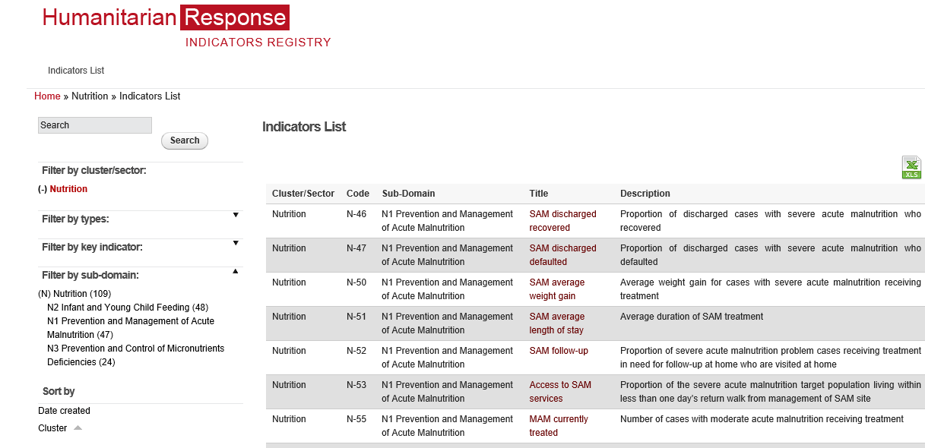

Nutrition Indicators
Repository of baseline, output,
outcome, process indicators
related to nutrition
Repository on
Nutrition Indicators
Notes:
https://ir.humanitarianresponse.info/indicators/cluster/nutrition
Demonstrate on computer to participants

Slide 19
Nutrition Indicators
Notes:
https://ir.humanitarianresponse.info/indicators/cluster/nutrition
Demonstrate on computer to participants

Slide 20
Repository of Nutrition Indicators
https://ir.hpc.tools/en/applications/ir/indicators/global-clusters/9
NOTE:
The GNC Operational Framework for AAP includes several sample indicators around community engagement that NC can adapt and use.

Slide 21
Group Work
In small groups
Develop 1 people-centred indicator and 1 technical indicator to help measure and understand if the cluster is addressing the priority needs of affected populations.
We will use the CHS as a framework.

Slide 22
What should we monitor?
To know (with evidence!) if our collective responses:
  Are appropriate and relevant
  Are timely and effective
  Strengthen local capacities and avoid negative effects
  Are based on communication, participation and feedback
  Provide safe, accessible complaints and response mechanisms
  Are coordinated and complementary
  Support continuous learning and improvements
  Are delivered by competent staff
  Use resources efficiently and effectively

Slide 23

Awareness Test
Important to consider how feedback data will be aggregated and analysed, and how it will be used for decision-making
Don’t forget to feedback to communities on how issues are being addressed

Slide 24
Common Challenges
Collecting too much or too little data
Poor linkage (situation monitoring & standard indicator)
Inadequate participation of NC & affected communities
Duplication
Finding agreement (tools/approaches)
Adapting tools to context, available resources and capacities
Inadequate or wrong baseline data
One-off monitoring instead of continuous monitoring
Systematically collecting qualitative data on views of communities
Fostering joint approaches and aggregating data
MAKING SENSE OF THE DATA!

Slide 25
Monitoring and AAP
Try to reach early consensus on quality and AAP indicators
Try integrating these 6 simple questions into ALL of of your monitoring:
  What are the priority concerns for your community?
  Are you satisfied with the assistance received to date?
  Do you think assistance is provided fairly in the community?
  Do you feel safe in your community?
  Do you know what assistance is available to you?
  Do you feel you can influence decisions about assistance?
Determine the most appropriate tools for the context
  SMS and mobile phone data collection (U-report)
  Key informant interviews, focus group sessions
  Hotlines, help desks, or collection boxes
  Perception surveys
  Direct observation, community visits, etc.

Slide 26
Monitoring and AAP
Also consider how you will measure the performance of the cluster:
  % of projects/partners applying agreed technical standards
  % of projects with safe, accessible feedback and complaints mechanisms
  % of partners able to show how response strategies have been adapted based on monitoring data
  % of partners working joint approaches in the HPC
Important to consider how monitoring and feedback data will be aggregated and analysed, and how it will be used for decision-making
Don’t forget to feedback to communities AND partners on how issues are being addressed

Slide 27
Key Messages
Different types of monitoring involve programmatic, situational, thematic and geographical level.
Monitoring at the Nutrition Cluster level captures the implementation of the cluster’s response strategy and partners’ collective contribution to the overall Nutrition Cluster response.
The current repository for nutrition contains over 100 baseline, output, outcome and process indicators, as well as CODs and FODs.
Notes:
Monitoring and evaluation take place at two levels – at the level of individual agency programmes and at the level of the Nutrition Cluster – and systems must be developed for each, the two systems complement each other.
Standard measurements and indicators should be agreed within the Nutrition Cluster for individual agencies to use in monitoring their own programmes, in order to facilitate overall analysis of the response.
Monitoring at the Nutrition Cluster level captures the implementation of the cluster’s response strategy and partners’ collective contribution to the overall Nutrition Cluster response. Thematic, geographic and situation monitoring are complementary processes.
Nutrition Cluster partners may undertake evaluations of their own portfolios of programming (if they have programming in more than one cluster) or of their nutrition programmes specifically, in order to determine their impact and to reorient programming as needed.
Lesson learning through formal or informal processes is one mechanism for generating knowledge about what worked well, what did not work and what could be done better next time. This knowledge can be fed back into the Nutrition Cluster in order to take action to improve performance.

