Slide 1
1.3 Accountability to Affected People (AAP) in Humanitarian Coordination

Slide 2
Objectives of the Session
In this session we will look at:
The main concepts around AAP
Key AAP policies and standards for clusters
Specific Nutrition Cluster AAP guidance

Slide 3
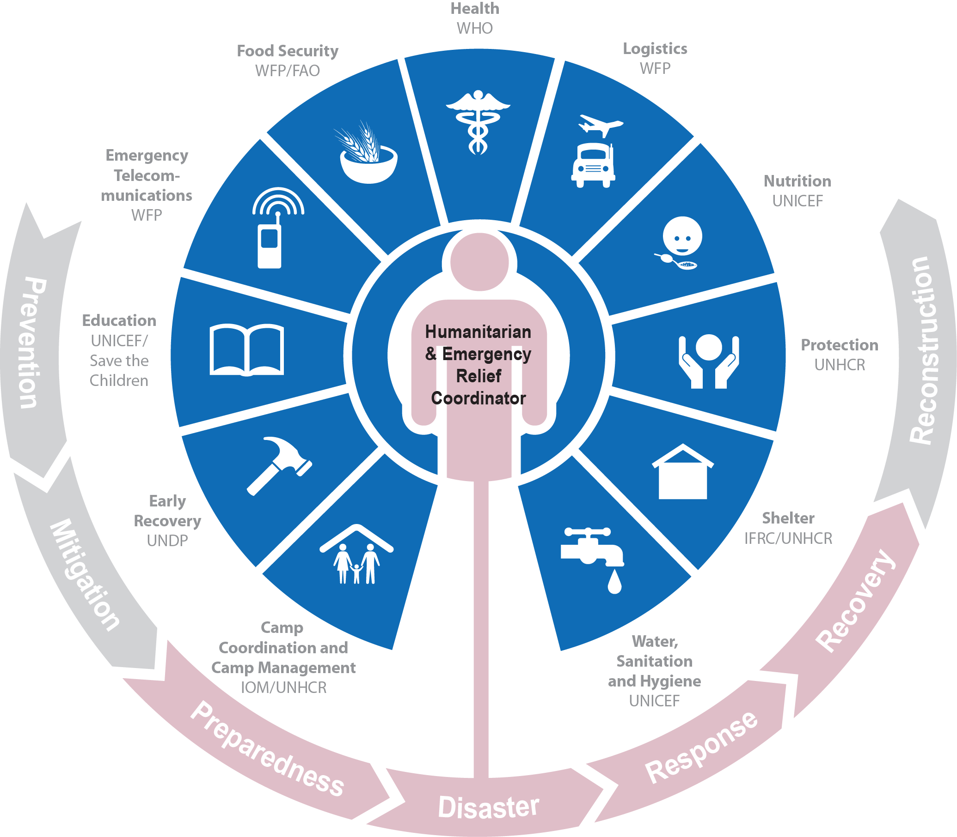
AAP is at the centre of the cluster approach
Notes:
The cluster approach was proposed as one way of addressing gaps and strengthening the effectiveness of humanitarian underpinned by a partnership approach. It ensures clear leadership, predictability and mutual accountability in international responses to humanitarian emergencies by clarifying the division of labour among organizations and better defining their roles and responsibilities within the different sectors of the response. It aims to make the international humanitarian community better organised and more accountable and professional, so that it can be a better partner for the affected people, host governments, local authorities, local civil society and resourcing partners.
However, the cluster system relies on an understanding it is not the only humanitarian coordination solution. In some cases, the cluster approach may co-exist with other “non-cluster” coordination modalities – whether national or international – or an alternative sectoral approach may be preferable. An indiscriminate application of all clusters in every emergency may waste resources and reduce opportunities for governments to exercise their primary responsibility to provide humanitarian assistance to people in need. Developing complicated coordination arrangements should be avoided; not all clusters need to be activated in every response.
Clusters are also responsible for mainstreaming cross-cutting issues throughout the sectoral response.
This is a dynamic approach that facilitates joint efforts, It supports the strategy and leadership of the national authority, and fills gaps where needed. It is a flexible approach, providing structure but also recognizing that each emergency is unique and systems must adapt to context.
It is not: It is not an attempt to undermine the government response, but strives to help strengthen government or existing coordination. It is not UN-centric; it depends on the active participation of all humanitarian members, e.g. UN agencies, the Red Cross/Crescent Movement and NGOs…. and of course….. The Government. It is not a “one size fits all” approach; In each emergency it is up to humanitarian actors on the ground, in consultation with relevant national authorities, to determine the priority sectors for the response, how the structures will be led and how the group will work together to meet humanitarian goals.
No matter what modality is put in place, cluster or sector or working group, the logic of coordination remains sound, the rest of this course will focus on how coordination gets done in partnership with all the relevant actors.
What is it?
A dynamic approach that facilitates joint efforts
Supports the strategy and leadership of the national authority and fills gaps where needed
A flexible approach recognizing that each emergency is unique
It is a product of the IASC
What is it not?
It is not an attempt to undermine the government response, but strives to help strengthen government or existing coordination.
It is not UN-centric; it depends on the active participation of all humanitarian members, e.g. UN agencies, the Red Cross/Crescent Movement and NGOs… and of course….. The Government
It is not a “one size fits all” approach; In each emergency it is up to humanitarian actors on the ground, in consultation with relevant government counterparts, to determine the priority sectors for the response.
3

Slide 4
Putting People at the Centre
It’s about sustainable RESULTS that meet the affected people’s needs priorities and preferences
It’s about respecting and supporting affected people to exercise their RIGHTS and dignity.
People at the Centre
RIGHTS
RESULTS
RELATIONSHIPS
It’s about leveraging our RELATIONSHIPS with partners to address needs and support local capacities and resilience
Notes:
Make the link from the previous discussions on the evolution of humanitarian coordination back to the first exercise: coordination is about generating the best possible results for the greatest number of people in need.
The humanitarian system has constantly evolved in order to be more accountable to the people we intend to assist.
The systems and processes we have developed over time, like the Cluster Approach, are all aimed at improving the way we work, and to put people at the centre.
In this next part of the session, we will introduce some of the key guiding principles and policies that help us to better consider and address the needs, priorities and perspectives of affected people in humanitarian action.

Slide 5
Collective accountability
Evolution of the humanitarian system has been towards greater collective accountability
Shared responsibility to work towards for timely, relevant, appropriate, RESULTS that maximise coverage and minimise gaps.
People at the Centre
RIGHTS
RESULTS
RELATIONSHIPS
Shared responsibility to protect the RIGHTS and dignity of affected people, including the right to access, protection, quality, coordinated responses, participation and two-way communication.
Shared responsibility to promote effective and equitable RELATIONSHIPS between communities, aid provider and local national actors.

Slide 6
Humanitarian Principles
Humanity | Neutrality | Impartiality | Independence
Human suffering must be addressed wherever it is found. The purpose of humanitarian action is to protect life and heath and ensure respect for human beings. | Humanitarian actors must not take sides in hostilities or engage in controversies of a political, racial, religious or idealogical nature. | Humanitarian action must be carried out on the basis on need along, giving priority to the most urgent cases of distress and making no distinctions on the base of nationality, race, gender, religious belief, class or political opinions. | Humanitarian action must be autonomous from the political, economic, military or other objectives that any actor may hold with regard to areas where humanitarian action is being implemented.
Notes:
Briefly remind participants of the importance of being guided by Humanitarian Principles as the foundation for our responses to emergencies – and to coordination.
In particular, the participants can be asked to focus on the principle of impartiality:
What does acting without discrimination mean? Is it appropriate to focus on a single sub-set of the affected population at the expense of others (example, mothers and children?)
What about prioritizing actions based on the most urgent needs?
What does this mean when only parts of the region or population are covered (like those easy to access)?
What about when affected people themselves prioritize other interventions equality with, for example, nutrition interventions?

Slide 7
IASC Commitments to AAP (CAAP)
Leadership
Participation
Standards
Information & Feedback
Ensure AAP and PSEA are systematically integrated through appropriate incentives and mechanisms.
Support operationalization and mainstreaming of AAP and PSEA in humanitarian response.
Support collective approaches to communication and community engagement.
Regularly monitor, analyse and report on the views of affected people, identify trends from feedback, and share with decision makers.
Ensure communities’ views are reflected in strategic and operational decision-making.
Ensure participatory and inclusive approaches of AAP.
Partner equitably with local actors.
Adapt methods and tools to support engagement and communications.
Uphold key standards like the CHS and relevant technical standards.
Adapt operational frameworks to local contexts.
Notes:
Option: This slide can be used here or at the end of the presentation of functions to use it as a framework to review the action points from a people-centred perspective.
AAP is not only about communicate engagement and complain mechanisms.
If we do not understand the context we cannot understand the best approach can be to support affected people
Finding the consistency in the approach by applying and identify standards.
Present a slide on the REVISED version of the IASC Commitments to AAP
The revised CAAP is based on four elements, with a strong emphasis on collective, coordinated actions, reinforcing the importance of clusters:
Leadership
Put in place appropriate incentives and mechanisms to ensure Accountability to Affected Populations (AAP) and Protection from Sexual Exploitation and Abuse (PSEA) are systematically integrated at country and programme level. (Examples: access to funding?)
Support operationalization and mainstreaming of AAP and PSEA in humanitarian response.
Information and Feedback
Support collective approaches to communication and community engagement such as coordinated information provision and inter-agency community-based feedback and complaints mechanisms.
Regularly monitor, analyse and report on the views of affected people, identify trends from feedback and share with decision-makers.
Close the feedback loop by ensuring communities’ views are reflected in strategic and operational decision-making, adapting preparedness and responses and ensuring communities are informed accordingly.
Participation
Ensure participatory and inclusive approaches to enable women, girls, boys, and men of affected communities, to play an active role in decision-making which impact their lives.
Partner equitably with local actors and build upon their long-term relationship and trust with communities.
Continually adapt methods and tools to support engagement and communications with highly connected and increasingly mobile communities.
Standards
Uphold key standards such as the Core Humanitarian Standards and the Minimum Operating Standards on PSEA; the Best Practice Guide to establish Inter-Agency Community-Based Complaint Mechanisms (CBCM); and ensure they are complemented with relevant technical standards such as Sphere.
Adapt the related operational frameworks to the local context after consultations with local stakeholders and communities, ensuring community and individuals’ safety and protection are not compromised.

Slide 8
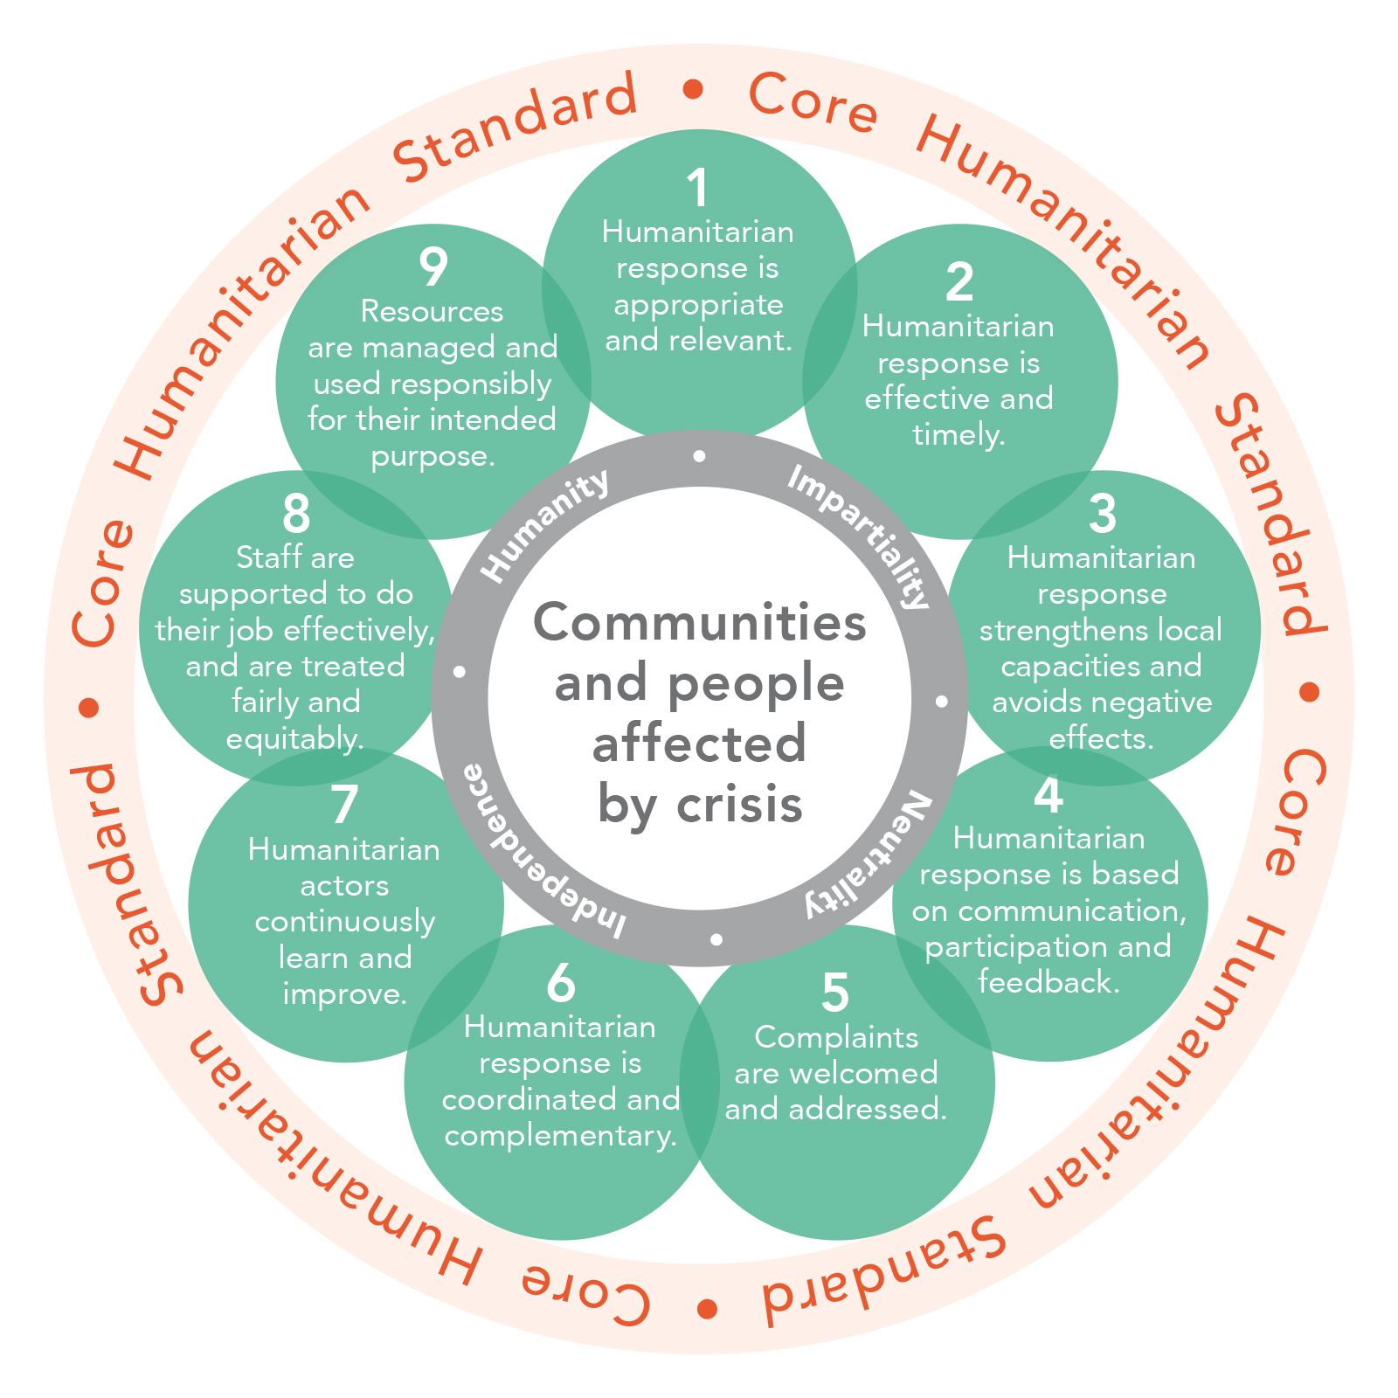
Core Humanitarian Standard for quality and accountability
Launched in 2014 and endorsed by many stakeholders in sector
Provides a common framework to consolidate technical, quality (like Sphere) and accountability standards
Built around 9 Commitments with Key Actions and Organizational Responsibilities
Notes:
The CHS is one of the ways we have col
Present CHS "flower slide" with the nine commitments.
Stress that affected people are at the center
Builds on Humanitarian Principles of Humanity, Impartiality, Neutrality and operational Independence
Integrates and consolidates many existing codes of conduct and standards around quality and accountability (HAP, Sphere, People In Aid, etc.).
Meant to provide a framework for related technical standards.
Developed in wide consultation with stakeholders, including aid providers, governments, donors, and affected communities.
Comprised of nine inter-related commitments, with related quality criteria, key performance indicators, key actions and organizational responsibilities.
Many organizations and cluster partners have already adopted the CHS and are now undergoing self-assessment and external verification and certification to show progress.
Clusters agreed to use the CHS as a framework to orient collective quality and accountability
Work is underway to adapt the key actions and indicators for coordination mechanisms and other networks and partnerships.
Core Humanitarian Standard - the 9 commitments
Remind participants that each of the nine commitments are inter-related: it is very difficult for aid providers to improve in one commitment without also working and improving in others.
Then go through the commitments in groups of three, highlighting what affected people can expect from aid providers.
If time, highlight some of the key actions most relevant to clusters and indicators .
The facilitators can stress that most or all of these actions should be done by individual agencies BUT clusters have a role to ensure coherence, common approaches, and joint actions.
Mention that e-learning courses, trainings, and other resources are available in several languages.
We should include what these are in the session brief to help future facilitators.
lectively articulated how we will implement our commitments to AAP in our work.

Slide 9
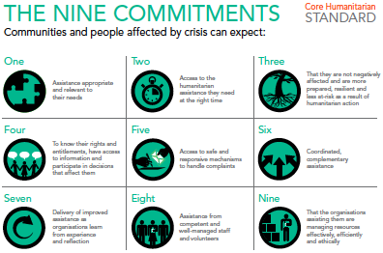
Notes:
So, if we want timely, relevant, appropriate and effective responses for affected people, and we want to strengthen their capacities and resilience, it means we need to think about how we engage with them.
Commitment Four is around making sure we have mechanisms in place to promote better two-way communications with affected people, and appropriate and equitable ways for them to participate in all phases of programmes. It is also about making sure we have mechanisms to listen to them, collect and analyse their feedback, and use this to help adapt programmes to better meet their needs. And it means closing the feedback loop, informing them about how we have acted on their concerns and suggestions.
Another central commitment is making sure we have good systems in place to register, track and respond to complaints. This is especially important around sensitive issues like sexual exploitation, corruption, or other unethical or illegal behaviour by our staff, partners or in the community. There are many specific responsibilities for UNICEF around this, and many tools to help make sure this is done in a timely, sensitive and appropriate manner.
Coordination is another area where UNICEF has a clear responsibility to make sure responses are coordinated to avoid duplication, gaps in the response, but also to ensure there is consistency in approaches between different actors or in different regions. Thi is about maximising the use of local, national and international resources so that we can best meet ALL the needs and priorities of affected people, not just the sectors or geographic areas where we have programming.

Slide 10
What can communities expect from us?
The CHS helps us to ensure that responses…
Are appropriate and relevant
Are timely and effective
Strengthen local capacities and avoid negative effects
Are based on communication, participation and feedback
Provide safe, accessible complaints and response mechanisms
Are coordinated and complementary
Support continuous learning and improvements
Are delivered by competent staff
Use resources efficiently and effectively

Slide 11
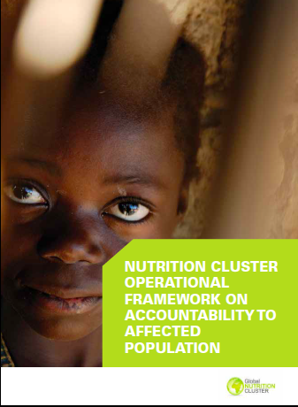
Applying the CAAP and CHS
Key Actions
Community Engagement
Indicators
Key Actions
Organizational Processes
Indicators
Notes:
Briefly present the GNC guidance on AAP in the HPC.
Stress to participants that the guidelines provide suggestions to help them think about how to integrate and apply AAP in the work of clusters.

Slide 12
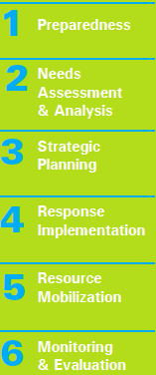
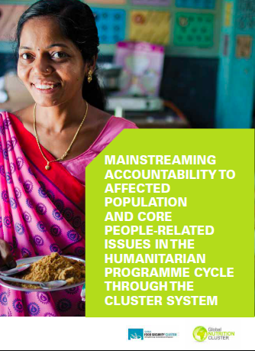
Applying the CHS in the HPC
Minimum Steps
Notes:
Most of the sessions over following days will look at each phase of the HPC, and they will be asked to link this back to AAP, so encourage them to reference these tools later.

Slide 13
Group work
In your group:
Looking at your allocated CHS commitment
Consider 3 ways working in coordination can support better AAP (rights and results) in Nutrition
You have 10min and then 2min each to present to the whole group
Notes:
Divide into 5 groups.
Give each group one of the CHS commitments
They get 10min to develop the 3 ways
2min to present in plenary (assuming 5 groups = 10min)
10min for others to make points and you to debrief and sum up.

Slide 14
Key Messages
Accountability is the collective responsibility of all aid actors to ensure results, rights and relationships
Humanitarian Principles underline the work of clusters and are a key component of our collective accountability
The IASC CAAP and the Core Humanitarian Standard provide a common framework for AAP
Additional Nutrition Cluster guidance reinforces collective approaches to AAP in nutrition in emergencies

