Slide 1
KoBoToolbox

Slide 2
What is KoBoToolbox ?

Slide 3
KoBo Toolbox is a free open-source tool for mobile data collection.
It allows to collect data in the field using mobile devices such as mobile phones or tablets, as well as computers.
There are two separate instances of KoBoToolbox for humanitarians and other users: kobo.humanitarianresponse.info and kf.kobotoolbox.org
The adaptation of KoBo Toolbox for humanitarian use was a joint initiative between OCHA, Harvard Humanitarian Initiative (HHI) and the International Rescue Committee (IRC).

Slide 4
When Last time you fill KoBoToolbox Report?

Slide 5
Why KoBo ?

Slide 6
Why KoBo ?
It is a ready-to-use all-in-one platform for developing, storing, managing and sharing forms, as well as managing and sharing collected data.
It is based on OpenDataKit (ODK). KoBo Toolbox is fully compatible and interchangeable with ODK Collect and XLSForm, but delivers more functionality such as an easy-to-use formbuilder, question libraries and integrated data management. It also integrates other open-source ODK-based developments such as formhub and Enketo.
It is being continuously improved and optimised particularly for the use of humanitarian actors in emergencies and difficult field environments, in support of needs assessments, monitoring and other data collection activities.
It is free. All humanitarian actors can create accounts on the dedicated server and use them without limitations on data or time. There is no need to install any server, but if there is a need, organisations can install it on their own servers.

Slide 7
KoBo supports the full data collection cycle
data collection
form design
analysis

Slide 8
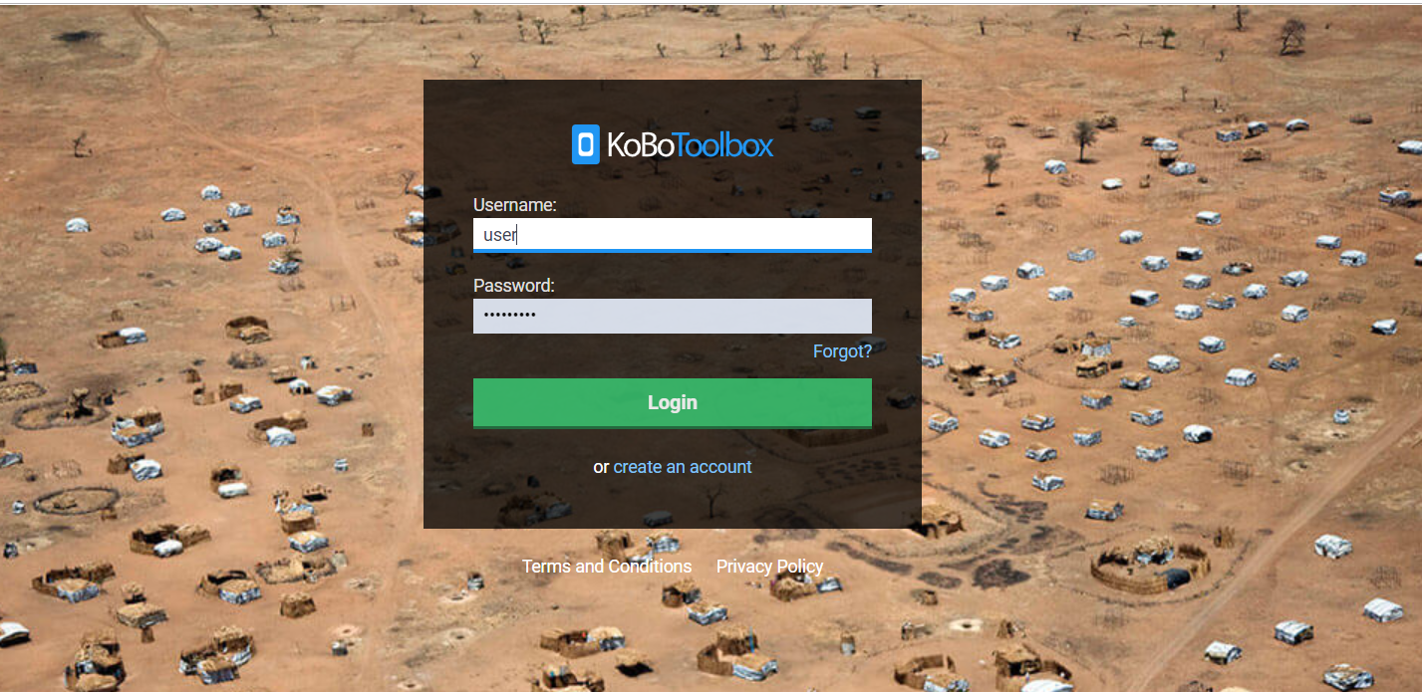
Get Started
https://kobo.humanitarianresponse.info
Creating a form
Question Types
Question Options
Form Style
Metadata
Deploying a form
Data Collection
Reporting
Download

