Slide 1
5.5 IM Checklist
INFORMATION MANAGEMENT

Slide 2
IMO ToR
 | Provides a global description of IMOs which can be adapted to the needs of the country
 | Sets out background, reporting lines, major tasks and responsibilities related to the six core competencies including competency to respond to gender and GBV. Also outlines required qualifications and experience, including on how to respond to gender equality, diversity and GBV. Includes competencies to handle corruption and take a strong stand against any form of system and rights violations.
 | Maintained by GNC

Slide 3
IMO Handover template
 | The tools helps to facilitate a smooth handover/transition of IM process, activities and functions from one person to another.
 | Includes handover documents, a description of processes and tools, responsibilities (who does what in the cluster), links with external stakeholders, lessons learned and challenges e.g. protection and prevention to PSEA and GBV Also provides recommendations for next steps
 | Existing IMO will use the document to hand over to a new person in the role.

Slide 4
NC IM Performance Monitoring Checklist
You can always find the latest IM checklist version at:
nutritioncluster.net/resources/im-checklist/.

Slide 5
IM Checklist
 | Assists the Country/Sub-national/Global NC to ensure the consistency and completeness in carrying out the IM function Helps to understand and prioritise actions needed to improve IM It is not a mechanism to evaluate the IMO personally!!!
 | Provides sets of monitoring questions to use for monitoring IM functions throughout the HPC Provides gender equality and GBV questions to IM to place a GBV prevention mechanism Could be used for internal or external audience
 | The use of the IM Checklist is optional and may be adapted and used by the NCC/IMO as needed Maintained and updated by the GNC-CT

Slide 6
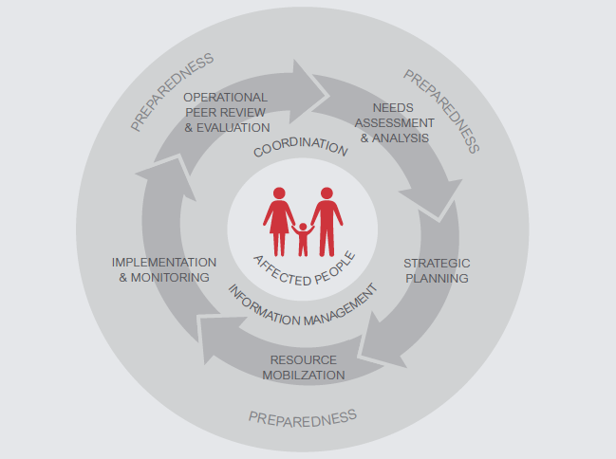
Features: IM Performance Monitoring Checklists
HR for the IM function
IMWG
Input to OCHA
Web-site
Infographics
Shared drive
E-mails
Meeting agenda
Meeting minutes
IM updates
Contact lists
Reporting
4W
IM Support for Needs Assessment
IM Support for HNO/HRP
M&E Framework
Gap analysis
Finance tracking
Could be a mechanism for internal or external audit
Notes:
Discuss variation between quick onset and protracted crises and clarify differences between them and what this means for preparedness, response and recovery.
Ask participants to look at the HPC Reference Module in their files
Big change is to put the emphasis back at country level to determine the time-line and mechanisms they will employ.
6

Slide 7
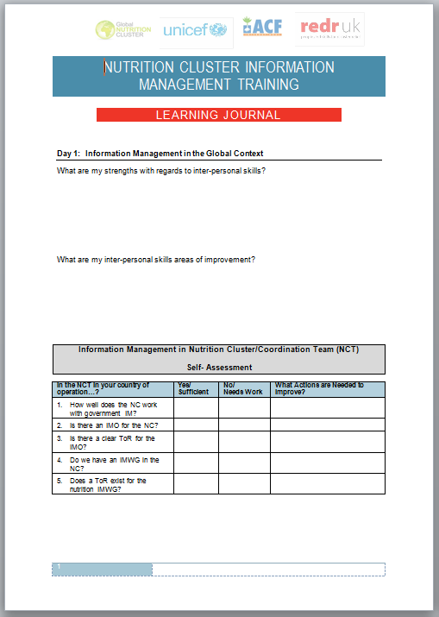
You have already started!
The Self-Assessment
sections of the Learning
Journal were based on the
IM Performance
Monitoring Checklist

Slide 8
HOMEWORK: AFTER THE TRAINING
Together with NCC, assess the IM system in your cluster against the checklist
Together with NCC, develop plan of action to improve your IM system
Share with GNC-CT in one month after the training (GNC-CT will use this information to identify areas of support needed)

