Slide 1
Day 5

Slide 2
Day 5 Agenda
Day 5
Coordination within Humanitarian Programmes
08:30-09:00 Course Review
09:00-10:30 5.1 Implementation and Monitoring
10:30-11:00 Break
11:00-13:00 5.2 CCPM
13:00-14:00 Lunch
14:00-14:30 5.3 CCPM Debrief
Workshop Evaluations and Action Planning
15:00 Close
2

Slide 3
5.1 Implementation and Monitoring

Slide 4
Objectives of the session
By the end of this session, participants will be able to:
Review implementation modalities and the role of NC
Summarise the importance of monitoring in NC work.
Link monitoring to strategic planning.
List ways that the NCC can improve monitoring practice.
How to use the repository of nutrition indicators and AAP indicators for monitoring.

Slide 5
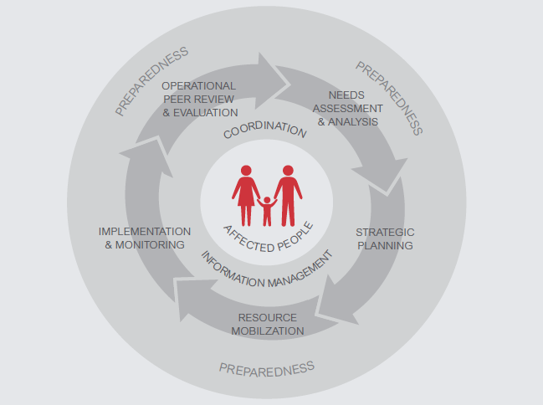
HPC

Slide 6
Implementation
Flash Appeals/HRPs sets out top-level SOs
NC Strategy and Cluster/Sector Response Plan prioritises most appropriate nutrition interventions based on solid analysis of needs;
NC planning 3/4W helps match resources to needs and identify gaps;
Individual partners responsible for implementing specific projects they commit to.

Slide 7
Implementation
But lots of challenges!
How to demonstrate link from project-level outputs to outcomes at HRP level?
How to promote consistent use of technical and quality standards?
How to encourage common approaches to community participation and feedback?
How to ensure flexibility in plans and interventions strategies to adapt to changing situations?
How to encourage joint approaches between partners to reduce costs, duplication, and increase quality and coverage?
How to integrate cross sectors?

Slide 8
Implementation and AAP
Use cluster response planning processes to promote:
Define information needs and monitoring approaches
Common approaches to community engagement, feedback and complaints
Joint implementation of activities
Use cluster meetings to regularly analyse:
Changes to the context or situation
Access and protection, PSEA or other cross-cutting issues
Gaps or other issues affecting implementation
Concerns around quality and consistency
Feedback and other information from affected communities
Capacity building gaps, good practices and opportunities for collaborative learning.

Slide 9
Monitoring
Monitoring is the systematic and continuous process of collecting and using information throughout the programme cycle for management and decision-making

Slide 10
Why do we monitor?
Evidence base
Decision making
Accountability
Communities
Partners
Donors
Host government
Global community
Principled action
Effectiveness

Slide 11
Monitoring
Various kinds of monitoring:
Context and situational monitoring
Implementation against HRP and cluster targets and objectives
Technical quality and consistency of interventions
Satisfaction and feedback of affected people
Cluster performance and working relations
NC should jointly define in the planning process the most important information they will need in order to make informed collective decisions.
This includes defining how monitoring will be done. Important to remember that tools and approaches need to be adapted to the context, resources and capacities available

Slide 12
Awareness Test

Slide 13
Relationship between Planning & Monitoring
Use the SAG, create a monitoring TWiG or define indicators collectively with Cluster partners!!
iMPLEMENTATION

Slide 14
Group Work
In groups, discuss:
What monitoring tools, processes or systems are available to the cluster
Are they working well?
What are the key challenges?

Slide 15
Common Challenges
Collecting too much or too little data
Poor linkage (situation monitoring & standard indicator)
Inadequate participation of NC & affected communities
Duplication
Finding agreement (tools/approaches)
Adapting tools to context, available resources and capacities
Inadequate or wrong baseline data
One-off monitoring instead of continuous monitoring
Systematically collecting qualitative data on views of communities
Fostering joint approaches and aggregating data
MAKING SENSE OF THE DATA!

Slide 16
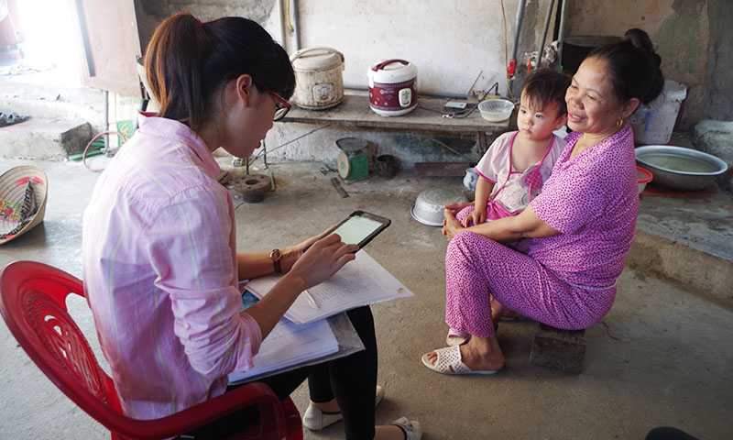
Monitoring in the Preparedness Phase

Slide 17
Role of the NCC and Partners
What things the NCC and NC partners can do to address the monitoring challenges specifically or improve Cluster monitoring generally?
What can you do to prepare for implementation and monitoring?

Slide 18
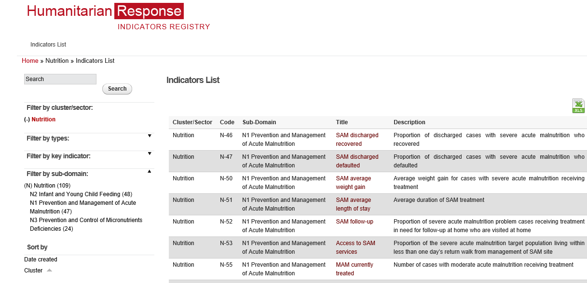
Nutrition Indicators
Repository of baseline, output,
outcome, process indicators
related to nutrition
Repository on
Nutrition Indicators
Notes:
https://ir.humanitarianresponse.info/indicators/cluster/nutrition
Demonstrate on computer to participants

Slide 19
Repository of Nutrition Indicators
https://ir.hpc.tools/en/applications/ir/indicators/global-clusters/9
NOTE:
The GNC Operational Framework for AAP includes several sample indicators around community engagement that NC can adapt and use.

Slide 20
Monitoring and AAP
Clusters should try to reach early consensus on monitoring tools and indicators for participation, satisfaction, and other feedback (including complaints)
Many different tools and approaches:
SMS and mobile phone data collection (U-report)
Key informant interviews, focus group sessions
Hotlines, help desks, or collection boxs
Perception surveys
Direct observation, community visits, etc.
Important to consider how feedback data will be aggregated and analysed, and how it will be used for decision-making
Don’t forget to feedback to communities on how issues are being addressed

Slide 21
Some ideas
Integrate these five simple questions in monitoring tools:
What are the priority concerns for your community?
Do you feel safe in your community?
Are you satisfied with the assistance received to date?
Do you think assistance is provided fairly in the community?
Do you feel you can influence decisions about assistance?
Questions can be adapted and simplified, but capture some key dimensions of AAP and complement other monitoring data.
The results can flag issues that will require further investigation and analysis – for example: timeliness of responses, protection issues, etc.
No need for large-scale samples – a targeted sample done regularly can often provide enough data to highlight where things are going well, and where improvements are needed and changes over time

Slide 22
Key Messages
Different types of monitoring involve programmatic, situational, thematic and geographical level.
Monitoring at the Nutrition Cluster level captures the implementation of the cluster’s response strategy and partners’ collective contribution to the overall Nutrition Cluster response.
The current repository for nutrition contains over 100 baseline, output, outcome and process indicators, as well as CODs and FODs.
Notes:
Monitoring and evaluation take place at two levels – at the level of individual agency programmes and at the level of the Nutrition Cluster – and systems must be developed for each, the two systems complement each other.
Standard measurements and indicators should be agreed within the Nutrition Cluster for individual agencies to use in monitoring their own programmes, in order to facilitate overall analysis of the response.
Monitoring at the Nutrition Cluster level captures the implementation of the cluster’s response strategy and partners’ collective contribution to the overall Nutrition Cluster response. Thematic, geographic and situation monitoring are complementary processes.
Nutrition Cluster partners may undertake evaluations of their own portfolios of programming (if they have programming in more than one cluster) or of their nutrition programmes specifically, in order to determine their impact and to reorient programming as needed.
Lesson learning through formal or informal processes is one mechanism for generating knowledge about what worked well, what did not work and what could be done better next time. This knowledge can be fed back into the Nutrition Cluster in order to take action to improve performance.

