Slide 1
Day 4

Slide 2
Day 4 Agenda
2

Slide 3
4.1 Resource Mobilization Humanitarian Financing, Supply and Human Resources

Slide 4
Objectives
Describe the importance of resource mobilisation within the Humanitarian Programme Cycle.
Distinguish between three components of resource mobilisation: finance, supply and human resources.
Identify the roles, responsibilities and accountabilities of partners in resource mobilization.
Explain how an HRP, cluster plans and flash appeals are financially resourced.
Relate capacity development and surge mechanisms to the delivery of quality emergency response.

Slide 5
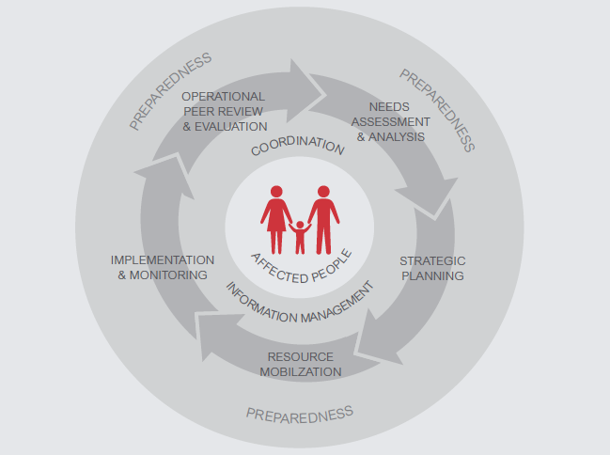
Humanitarian Programme Cycle

Slide 6
Group Work: Humanitarian Financing
Report back from the Humanitarian Financing Groups
Group 1
Why is this type of resource important?
What funds do you know of that are used to finance the HRP and Cluster Plans?
How can we prepare for this type of resource mobilisation?
Group 2
What is the role of the NCC with regard to financing?
And the partners?
How can we prepare for this type of resource mobilisation?

Slide 7
Humanitarian Financing
Financing of strategic objectives and cluster plans through…
Agency-specific resource mobilisation
Central Emergency Response Fund (CERF)
Country-based Pooled Funds
Private sector / civil society
National governments
bilateral donations
multilateral donations
NOTE: Financing is per SO (budget per SO!)

Slide 8
CERF (Central Emergency Response Fund)
Rapid Response Grant and Grant for Underfunded Emergencies;
Disbursed by OCHA only to UN agencies and IOM;
Grant to jump start critical operations and fund life-saving operations based on Flash Appeal / HRP objectives;
Cluster in consultation with partners identify priority areas for funding, including funds for cluster coordination;
Cluster Coordinator ensures the inclusion of nutrition cluster interventions in the CERF application submitted by CLA on behalf of UN partners;
NGOs can receive funds as implementing partners of UN agencies.
Notes:
It is administered by the Emergency Response Coordinator (ERC) in consultation with CLA agencies and HCs.
Note that the bar on NGOs receiving funds directly from CERF is not OCHA’s idea.
It came from a block of Member States in the General Assembly , and probably relates to a general uneasiness among some Member States governments about the role of NGOs in relief and development.
Perhaps it should be reviewed when the CERF is evaluated – the GA change amend its own resolutions.

Slide 9
Examples of Life-Saving activities for the Nutrition Sector
ACTIVITIES | CONDITIONS
Nutrition screenings and surveillance to identify areas of urgent need, assess deterioration in the nutritional situation, and identify acute malnutrition. | Context of specific emergency response
Provision of life saving emergency food rations to the general population, or for specific vulnerable groups | Only when general food ration quality and/or distribution is inadequate for needs and as a temporary measure to prevent further deterioration of the nutrition situation and loss of life.
Provision and management of IYCF-E | When many infants are without breastfeeding mothers; uncontrolled distribution of BMS; Compromised privacy for BF (displacement, conflict, etc.)
Management of SAM and MAM, including treatment, community mobilisation and access to services s (i.e. community-based management of acute malnutrition) | Support for treatment of SAM/MAM should be provided wherever cases exist. Supplementary feeding should be considered where levels of acute malnutrition reach emergency thresholds.

Slide 10
Country-Based Pooled Funds (CBPFs)
CBPFs are multi-donor humanitarian financing instruments established by the Emergency Relief Coordinator (ERC).
Replacing all other country-level funds including ERF and CHF.
Managed by OCHA at country-level under the leadership of the HC.
Donor contributions are un-earmarked and allocated by the HC through an in-country consultative process.
Based on needs at the country level and can go to all partners (UN, NGO, etc.)
Four principles underpin the use of CBPFs:
Inclusiveness, ie localisation.
Flexibility
Timeliness
Efficiency

Slide 11
Role of the SAG
Prioritisation of projects submitted by cluster partners is done according to agreed criteria that are defined in relation to each funding process and linked with the Nutrition Cluster response strategy of the Flash Appeal / HRP
The prioritisation and vetting process is often conducted through a smaller group of people, such as the Strategic Advisory Group (SAG) or a Project Review Committee (PRC).
Needs to occur in a timely manner, often to meet very short deadlines.

Slide 12
Role of the Cluster Coordinator
Ensure effective coordination of all cluster partners in funding discussions/decisions, thus representing cluster needs, not the agency needs;
Have an overview of funding requirements with inputs from partners through Financial Tracking System (FTS)
Submit vetted projects (for example for CBPFs allocation)… transparently
Effectively communicate needs that are clearly related to the Cluster strategic objectives.
Notes:
NCC has overarching responsibility to ensure that the Cluster mobilizes the funding necessary to address priority needs for nutrition in emergencies. The NCC needs to have overview of funding requirements to fulfill the strategic response plan.

Slide 13
Resource Mobilisation and AAP
Strong evidence of needs, and information on the priorities of affected people, increases the credibility of funding requests
More donors looking for participation and engagement of affected people as criteria for funding decisions – what can the NC do to support this in proposals?
Specifically include budgets for community engagement activities and request flexibility to adapt programmes
Showing the added value of collaborative and joint approaches can also help successful proposals.
Transparency with partners and communities about available funding and priority allocations helps build trust and manage unrealistic expectations

Slide 14
Key Messages
Resource mobilisation is informed by all elements of the HPC.
The Nutrition Cluster often needs to rank and prioritise its projects and activities in relation to fundraising.
Clear information about the funding mechanism, consultative development of the prioritisation criteria and process, and documentation of the outcomes can help to promote participation in fundraising.
Communicating back to partners and communities on resource allocations and priorities helps build trust and manage expectations

Slide 15
Group Work: Supply
Report back from the Supply Group
Group 1
Why is this type of resource important?
Define what are most frequently the needed supplies in nutritional emergencies?
How can we prepare for this type of resource mobilisation?
Group 2
What is the role of the NCC with regard to these supplies?
And the partners?
How can we prepare for this type of resource mobilisation?

Slide 16
Supply
The procurement, transport and distribution of commodities necessary for programme implementation to meet the affected population’s needs.

Slide 17
Overall responsibility for NCC
Coordinate between Nutrition Cluster partners…
to ensure that overall supply and equipment needs for the emergency response are regularly identified…
and that the Nutrition Cluster as a whole can identify and address any pipeline issues (‘stock-out’, temporary gaps, etc.).

Slide 18
Practically, this means the NCC…
Based on Flash Appeal/HRP, identifies supply needs and updates planning figures (e.g. case load calculation).
Promotes national and international standards for nutrition supplies and equipment.
Facilitates information exchange on type/quantity of supplies/equipment.
Anticipates import procedures and requirements.
Notes:
NCC Handbook Chapter 8.3

Slide 19
Practically, this means the NCC…
Is aware of product characteristics and challenges (shelf life, storage conditions, etc.) and facilitates the planning for preposition and delivery of supplies
Effectively coordinates among common suppliers (e.g. WFP, UNICEF) and inter-cluster linkages.
Can you give examples of which clusters the NCC liaises with and for what supplies?
Notes:
NCC Handbook Chapter 8.3
INTER CLUSTER LIAISON ON E.G. HEALTH CLUSTER – VIT A (POST NATAL FOR WOMEN, VACCINATION CAMPAIGNS); FOOD SECURITY CLUSTER – FOOD RATIONS AND OTHER FOOD / FOOD PREPARATION RELATED COMMODITIES

Slide 20
And the Role of NC Partners?
Share information with the NCC to ensure that overall Nutrition Cluster needs for stocks of supplies and equipment are identified. This includes information on expected pipeline breaks, risks of shortage, etc
Note: Some agencies have their own independent supply/equipment pipelines and do not necessarily participate in joint supply planning via the Nutrition Cluster. However, these agencies are still encouraged to share!
Willingness to make temporarily available supplies to other organisations (‘lending’)

Slide 21
Which supplies?
Supplies:
To treat and/or prevent SAM and MAM;
To treat and/or prevent micronutrient deficiencies (iron/folate, sprinkles, UNIMAP, vit.A, etc);
To address needs for IYCF-E (hygiene kits, baby-kits, BMS, baby-tents, etc);
Anthropometric equipment.

Slide 22
Key Messages
The NCC is responsible for coordination between Nutrition Cluster partners to ensure that overall supply and equipment needs for the emergency response are regularly identified and that the Nutrition Cluster as a whole can identify and address any pipeline issues
Both the NCC and the NC partners have important complementary roles to play in the SUPPLY process.
There are various ways to improve the caseload calculations; we will look at some shortly.

Slide 23
Group Work: People
Report back from the People Group
Group 1
Why is this type of resource important?
Why is capacity development and capacity building an element of quality response to emergencies?
How can we prepare for this type of resource mobilisation?
Group 2
What is the role of the NCC with regard to capacity development?
And the partners?
How can we prepare for this type of resource mobilisation?

Slide 24
People
Capacity
ability of individuals, institutions and societies to perform functions, solve problems, and set and achieve objectives in a sustainable manner.

Slide 25
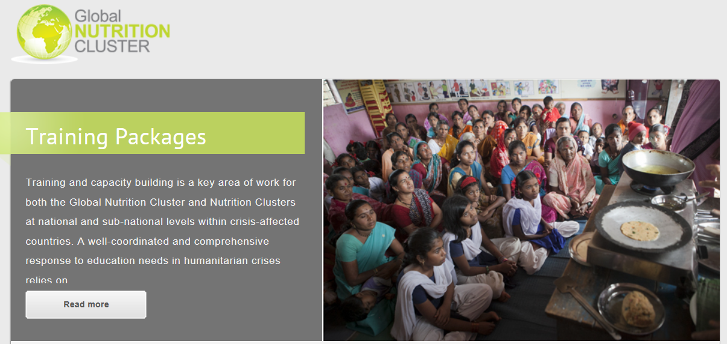
GNC Capacity Building Initiatives
Harmonised Training Package;
In-service Training / Pre-Service Training –NutritionWorks, UNICEF, other partners;
GNC Cluster Coordination Training;
GNC Country-level partners’ Training;
GNC Country-level partners’ Orientation;
GNC IM Training
All tools and resources are available at:
http://www.nutritioncluster.net

Slide 26
NCC’s Role in Capacity Building
Capacity mapping
Establish mechanisms to prioritise capacity building/development needs
Integrate capacity building into the HRP
Liaising with other clusters on capacity building
Identify and address any gender imbalances
Implementation of capacity building plans
Update and revise capacity building to reflect relevant needs

Slide 27
Surge Mechanisms
Internal UNICEF surge capacity
UNICEF surge stand-by rosters
GNC RRT: coordination and information management
GNC Technical RRT: Assessments, CMAM, IYCF-E and BCC
Short-term consultants and temporary appointments
Stand-by Partner Programme (SBPP)

Slide 28
Capacity Building and AAP
Consider alternative ways to build local capacity beyond trainings or hiring international staff:
Coaching and mentoring between partners
Co-financing staff costs of local partners to strengthen implementation and management capacity
Long-term financial support for staffing to ensure continuity and more sustainable local capacity
Think of ways to build community capacity to support implementation and management of nutrition activities:
Supporting community structures and organisations for CMAM
Using community members for nutritional status monitoring
Using communications and engagement to strengthen longer-term knowledge, awareness and practices around nutrition

Slide 29
Key Messages
Capacity building activities need to be based on a clear assessment of available capacity – don’t forget to look at local actors first!
Also take time to identify gaps and needs within the cluster member agencies including the national authority.
There are a variety of options for capacity building activities – try to think of innovative and alternative approaches than just training
Capacity building is a critical component of quality assurance for the Nutrition Cluster response and effective transition from the cluster response to nutrition sector coordination.

