Slide 1
3.5 Resource Mobilisation & IM Tools: Part 2: Human Resources
INFORMATION MANAGEMENT

Slide 2
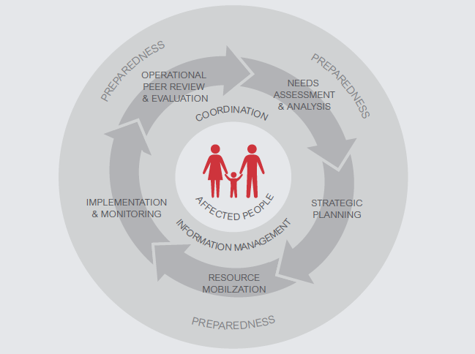
The HPC

Slide 3
IMO Role in Resource Mobilisation stage of the HPC
IMO responsibilities include support to the NCC in resource mobilisation by ensuring availability of the up-to-date information on:
Financial Resources
Human Resources
Supplies

Slide 4
What GNC IM Tools inform the Resource Mobilisation stage?
HRP tips
Financial tracking
Capacity mapping
Caseload targets & supplies
IM Checklist

Slide 5
What is capacity?

Slide 6
Capacity
ability of individuals, institutions and societies to perform functions, solve problems, and set and achieve objectives in a sustainable manner.

Slide 7
Group 1
Why is capacity development and capacity building an element of quality response to emergencies?
Notes:
See Handbook chapter 8.3.1
Also see box 8.5 in Handbook

Slide 8
Group 2
What is the role of the IMO with regard to identifying capacity gaps
Notes:
See Handbook chapter 8.3.1
Also see box 8.5 in Handbook
Facilitator can continue asking what the role of the IMO is with regard to capacity gaps such as response to GBV and protection issues that are countered by the affected people.

Slide 9
Group 3
How do clusters prepare for this type of resource mobilisation?
Notes:
See Handbook chapter 8.3.1
Also see box 8.5 in Handbook

Slide 10
Capacity mapping tool
INFORMATION MANAGEMENT

Slide 11
What GNC IM Tools inform the Resource Mobilisation stage?
HRP tips
Financial tracking
Capacity mapping
Caseload targets & supplies
IM Checklist

Slide 12
Capacity mapping tool
 | The Capacity Mapping tool is used to assist the NC/government to identify existing capacity and gaps to respond to the critical issues (GBV and protection) where women and the marginalized people are mostly affected
 | Stores information on each partner including:
 | The data is entered by partners (gov’t, NGOs, UN, Red Cross/Red Crescent and then validated by IMOs. IMOs are responsible for the analysis of the data of each component to identify gaps and capacity needs.
Contact information
Implementation capacity
Staff capacity
Supplies
Administration
Analysis

