Slide 1
3.4 Strategy Development

Slide 2
Learning Objectives
Identify the features of a Flash Appeal and Humanitarian Response Plan (HRP) and explain their functions.
Describe the role of the cluster in developing a Flash Appeal and HRP
Describe the different processes for developing and costing a response to sudden-onset or protracted crises.

Slide 3
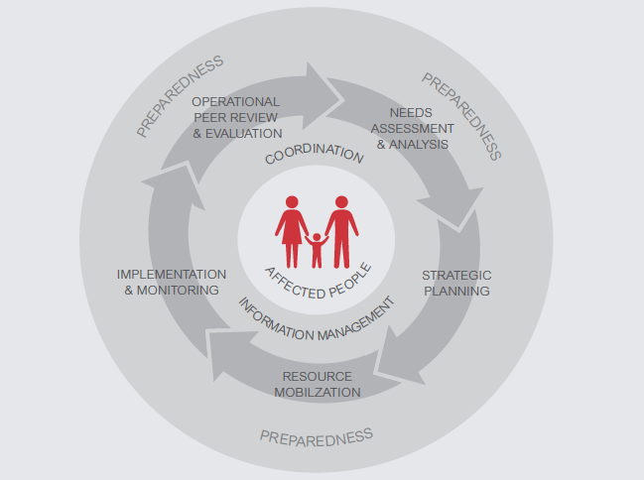
The HPC

Slide 4
Flash Appeal
A concise, top-line analysis of the scope and severity of the humanitarian crisis
Sets out priority actions and preliminary requirements for the response, normally only for 3-6 months
Issued three to five days after a sudden onset emergency, or if/when a significant and unforeseen ‘spike’ in needs or a change in the context in protracted or slow onset crises
Project-based with financial requirements – used as a fundraising tool. Can be revised as new information emerges.
A Flash Appeal may sit separately to an existing country HRP.
Large-scale sudden onset disasters which have issued a Flash Appeal are required to issue a HRP for that emergency within 30 days.

Slide 5
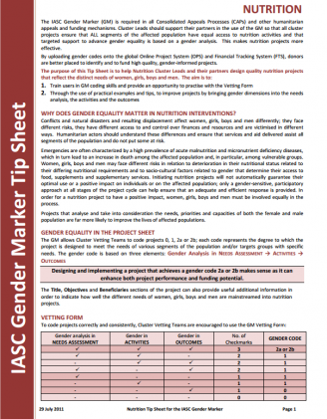
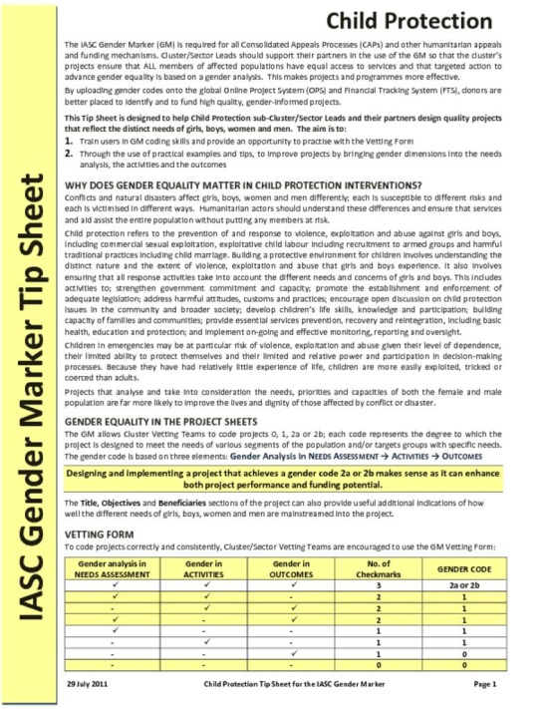
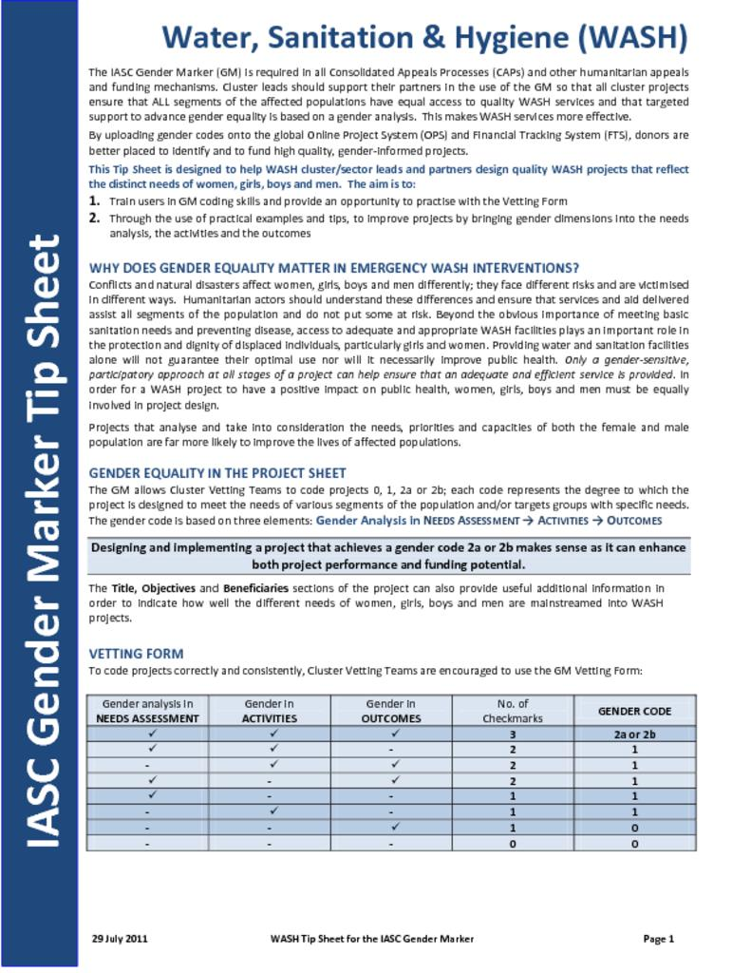
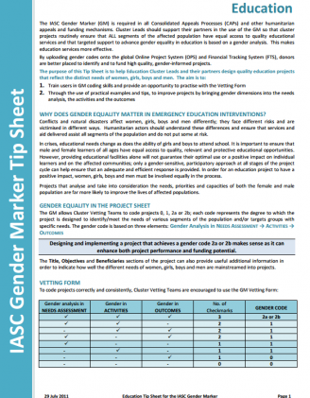
Flash Appeals
Developed by HCT with inputs from clusters
Specific project proposals with costs developed by partners
NCC should ensure nutrition, AAP gender, age, protection, etc. are included in proposals and funding criteria
NCC also supports integration into HRP when needed

Slide 6
Humanitarian Response Plan
Why?
  Sets overall direction and strategic objectives of response
  Communicates what will be done by clusters to respond, informed by assessed need.
When?
  In most countries with protracted emergencies, it is a yearly or multi-year plan.
  Following sudden onset emergencies, and HRP should be revised/developed within 30 days.
  It follows needs assessments and an updated HNO (occasionally MIRA) – it responds directly to these needs.
Who?
  HC/HCT lead strategic development and sets priorities
  Clusters and organisations contribute to development of the plan
  OCHA supports the planning process by consolidating data, agreeing planning figures, drafting and finalising the plan.
  The inter-cluster coordination group supports these efforts
What?
  Consists of two parts: a country strategy and cluster/sector response plans.
  The overall strategic objectives (SO) are set by the HC
  Clusters contribute to the SOs through cluster objectives and response plan

Slide 7
Secondary data
Needs analysis
Capacity mapping
1. Identify gaps
2. Review the priority needs
3. Establish the scope or boundaries
4. Take into account those needs being addressed by others.
5. Determine the target caseload
6. Describe the response priorities
Advocacy and communication
Resource mobilisation
Implement plan
Monitor and review

Slide 8
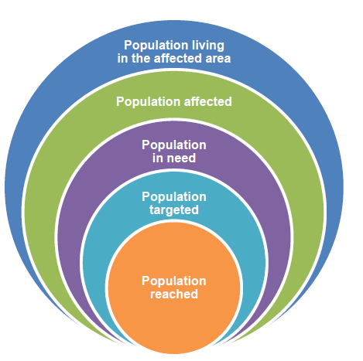
Response Analysis

Slide 9
Response Analysis
Analysis
This is a key point in the process to determine what the cluster can actually do in terms of defining priorities, target and reach
It is also a critical moment to define the most appropriate interventions strategy based on needs, capacities and resources
Primary consideration is to maximise quality and coverage, and minimise gaps and duplication
Also very important to consider how affected people’s needs and priorities will be addressed as well as protection, gender, and other other cross-cutting issues
Whenever possible, clusters should make use of local actors, experts and communities themselves to test and validate assumptions

Slide 10
Optional
In the original training this is an optional slide, but the types of questions in MIRA could be a good reminder of the analysis phase.
Also could include some additional IM references around analysis?
Useful for analysis
Notes:
Know what you need to know…
Outlines the broad information requirements on context, risks and vulnerabilities, trends
Aligns information needs from different sectors
Structures the reporting of the findings
Requires agreement on the scope and objective of an assessment
Know how you will find the answers…
Helps identify information sources for secondary and primary date
Supports collation of secondary and primary data
Helps identify key information gaps

Slide 11
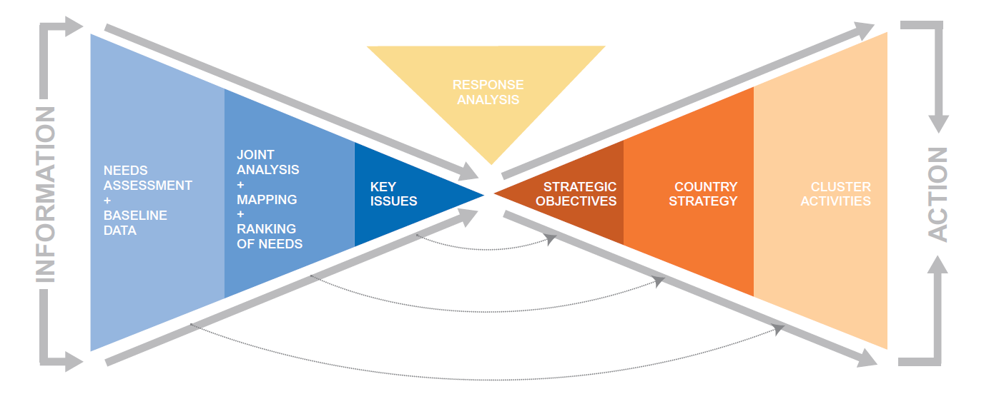
Development of the HRP

Slide 12
Strategic and Cluster Objectives
Country strategy
The HC and HCT formulate the country strategy
It is defined by the strategic objectives for the response and explains how the objectives will be fulfilled.
The objectives will, as much as possible:
  - be governed by the needs and priorities specified in the HNO
  - be SMART (specific, measurable, attainable, relevant and time-bound)
  - be results-based, which is to say they will describe the desired outcomes
Cluster plans
Cluster plans will be prepared after the country strategy,
They specify what the clusters will do to contribute to the strategic objectives.
They should be specific about their activities, planned outputs and targets.
Notes:
Country strategy
The HC and HCT formulate the country strategy, relying on a broad consultation. The strategy will be guided by the context.
The country strategy will be defined by the strategic objectives for the response and explain how the humanitarian community intends to fulfil those objectives. The objectives will, as much as possible:
- be governed by the needs and priorities specified in the HNO
- be SMART (specific, measurable, attainable, relevant and time-bound)
- be results-based, which is to say they will describe the desired outcomes
Cluster plans
Cluster plans will be prepared after the country strategy,
They specify what the clusters will do to contribute to the strategic objectives.
They should be specific about their activities, planned outputs and targets.
Country strategy
The HC and HCT formulate the country strategy, relying on a broad consultation. The strategy will be guided by the context.
The country strategy will be defined by the strategic objectives for the response and explain how the humanitarian community intends to fulfil those objectives. The objectives will, as much as possible:
- be governed by the needs and priorities specified in the HNO
- be SMART (specific, measurable, attainable, relevant and time-bound)
- be results-based, which is to say they will describe the desired outcomes
Cluster plans
Cluster plans will be prepared after the country strategy,
They specify what the clusters will do to contribute to the strategic objectives.
They should be specific about their activities, planned outputs and targets.

Slide 13
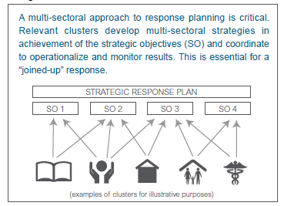
HRP Structure
HUMANITARIAN RESPONSE PLAN

Slide 14
Costing of Cluster Response Plan
Project-based costing:
The clusters/sectors identify humanitarian activities, with indicators and targets in line with the strategic objectives and present them in the cluster/sector response plans of the HRP.
All cluster/sector members submit their projects, including project budgets, through the online project system (OPS) database.
The SAG or the Project Review Committee (PRC) vets projects according to an agreed timeline and criteria, and all projects are subsequently submitted to the HC for final approval.
The total sector budgets are calculated as the sum of the approved project budgets. The total budget, as listed in the HRP and financial tracking service (FTS), is the sum of all sector budgets.
Main responsibility for costing lies with cluster partners which the responsibilities for vetting process lies with the Clusters, the SAG or the PRC.

Slide 15
Costing of Cluster Response Plan
Activity-based costing:
Activity-based costing for humanitarian appeals refers to a method of estimating overall resource needs for a humanitarian response plan (HRP), using average costs per sectoral activity, per person served, or per item delivered in line with the humanitarian needs overview (HNO) and the country’s strategic objectives.
The costs per sector are determined on a unit cost per person per type of activity; sectors identify humanitarian activities, with indicators and targets, and present these in the sector response plans.
Cluster/sectors must decide whether activities/services identified are grouped by intervention area (e.g. higher level outputs) and costed at this level, or whether smaller supporting activities under each intervention area (e.g. training, facilities repair, service operation) are costed separately.
For each planned activity, an estimate budget is established, using an activity-based costing method, and these sector budgets form the total HRP budget. Projects are not vetted, nor registered in OPS.
The responsibility for costing lies with the clusters, less with the cluster partners, however, the agreement on standard costs to be applied has to be agreed by all, which in the case of nutrition is not possible as for a number of interventions, there are no standardized costs.

Slide 16
What is the role of a NCC in drafting the HRP?
How could a NCC ensure Cluster partners are engaged in this process?
Discuss

Slide 17
Making It Work
Constraints
Essentials
Plans become outdated
Inaccurate
Differing mandates & capacities of partners
Seen as biased in favor of particular agencies/CLA
Unrealistic
Donor pressure might influence contents
Equitable representation on advisory group (SAG or other structure, such as a Steering Committee)
Evidence-based decisions
Regular consultation
Continuous review and modification
Flexible, realistic and appropriate
Notes:
Pressure from CLA to select & prioritise their own projects
Pressure to select and prioritise cluster partner projects
Pressure from HC to be ‘fair’
Possible “competition” with other cluster priorities
Donor pressure/different perception of needs from donors

Slide 18
Key Messages
Flash Appeal and HRP are strategic planning documents for a humanitarian response.
They both designed to address priority needs in a coordinated manner led by the HC and supported by OCHA and the clusters/sectors.
Both are based on assessed, analysed and prioritized need.
Clusters are instrumental in bridging the operational and the strategic.
Cluster coordinator will need to be an advocate for the needs and priorities of affected people, and of partners to ensure resources are allocated and distributed consistently with the principle of impartiality.
Notes:
These two documents both fall into the category of strategic planning for a humanitarian response. Their usage differs according to the level of depth and details, and the speed with which they are developed. Their monitoring frameworks and reporting/IM products also differ. But they are both designed to address priority needs in a coordinated manner led by the HC and supported by OCHA and the clusters/sectors.
The two types of response plan each has multiple purposes and audiences including implementation, monitoring, resource mobilisation and advocacy. Both are based on assessed, analysed and prioritized need.
Clusters are instrumental in bridging the operational and the strategic. The cluster coordinator will need to be a champion of the system and provide support and inputs to cluster partners, the ICCM, OCHA and the HCT.
More importantly, the cluster coordinator will need to be an advocate for the needs and priorities of affected people, and of partners to ensure resources are allocated and distributed consistently with the principle of impartiality.

