Slide 1
2.6 Case Study: Supply Caseload

Slide 2
Objectives
Recognise the importance of explaining definitions and methodology for calculating supply caseload with all partners.
Consolidate knowledge and practice on procedures for estimating caseloads for nutrition in emergencies interventions
Establish and agree on data when estimating caseloads.

Slide 3
Group Work: Caseload Estimation
In your group, estimate the caseload for SAM and MAM treatment activities (20 minutes).
Find relevant information / data in the background documents so far received.
Take decisions on which information / data you will use for your calculations and justify your choice.
Your objective is to identify the nutrition cluster’s target caseload.

Slide 4
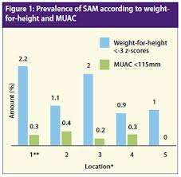
Caseload Estimations for SAM and MAM
Population size (under-5)
(Latest) SAM, MAM (or GAM) prevalence
Correction factor (allows for estimation of incidence)
Expected coverage

Slide 5
Example Estimating SAM Caseload
Population | 121,400
Proportion 6-59 months | 17.3 |  | 21,002
SAM prevalence | 1.34 | 0.0134 | 281
Correction factor | 2.6
Coverage | 100 | 1
Expected caseload |  |  | 732
Notes:
2.6 correction factor for SAM
1.5 correction factor for MAM
(fixed values)

Slide 6
Example Estimating MAM Caseload
Population | 121,400
Proportion 6-59 months | 17.3 |  | 21,002
MAM prevalence | 5.1 | 0.051 | 1071
Correction factor | 1.5
Coverage | 100 | 1
Expected caseload |  |  | 1607
Notes:
2.6 correction factor for SAM
1.5 correction factor for MAM
(fixed values)

Slide 7
Caseload Micronutrient Deficiencies
Some tips:
Micronutrient deficiencies:
For 6-59 months (15-20% population)
For Pregnant women (2.4% of population)
For Lactating women (2.6% of population)
Prevalence estimates ideally from national data/Unicef
Notes:
http://pfeda.univ-lille1.fr/Infos/1999/0327wfpE.htm

Slide 8
Caseload IYCF-E
Some tips
IYCF-E:
For 6-59 months (15-20% population)
For 0 – 6 months
For 6 – 23 months
For Pregnant women (2.4% of population)
For Lactating women (2.6% of population)
Prevalence estimates ideally from national data/Unicef
Notes:
http://pfeda.univ-lille1.fr/Infos/1999/0327wfpE.htm

Slide 9
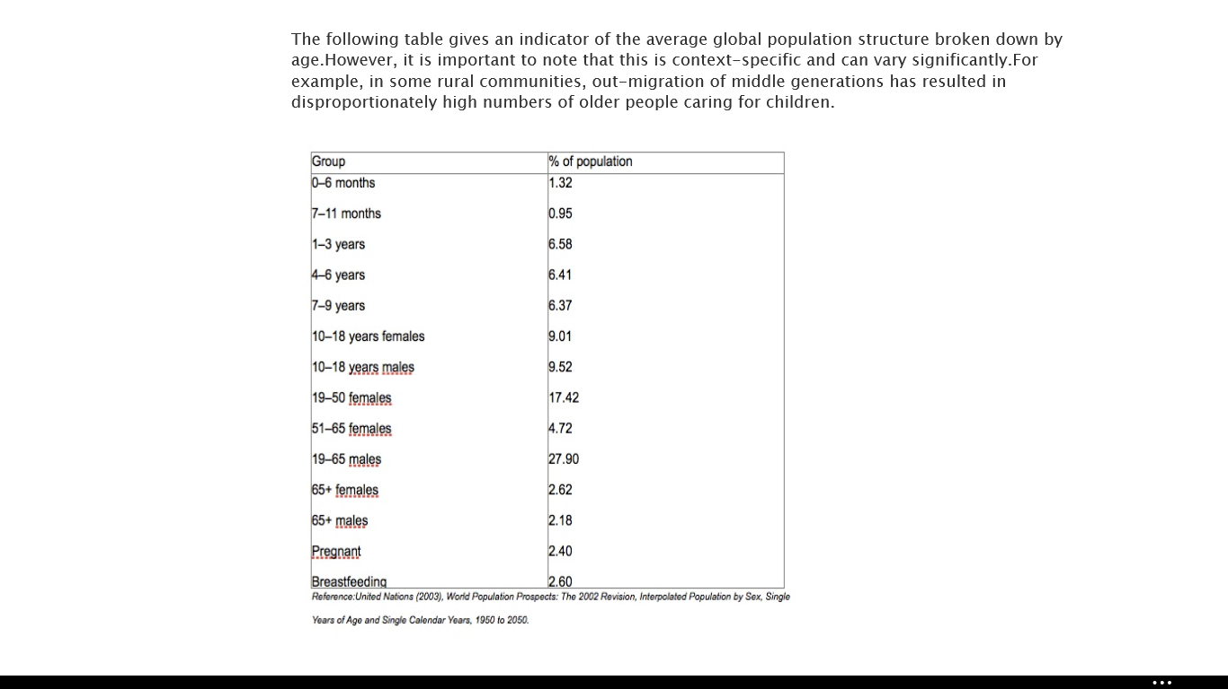
http://www.spherehandbook.org/en/appendix-6/

Slide 10
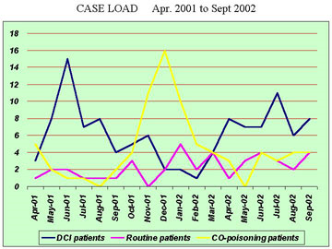

Slide 11
Key Messages
Always involve partners in calculation of People in Need, your caseload and targets.
Agree on definitions and methodology to calculate the caseload with all partners.

