Slide 1
2.5 Needs Assessment & Analysis
and IM Tools
INFORMATION MANAGEMENT

Slide 2
Humanitarian Programme Cycle

Slide 3
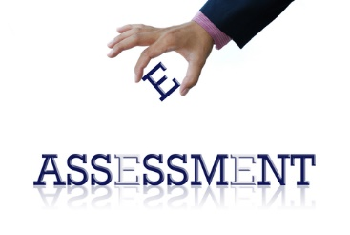
The Assessment Framework
The Assessment Framework looks at assessment coordination over time based on “phases” following a crisis.
These phases are indicative
They may vary depending on the context

Slide 4
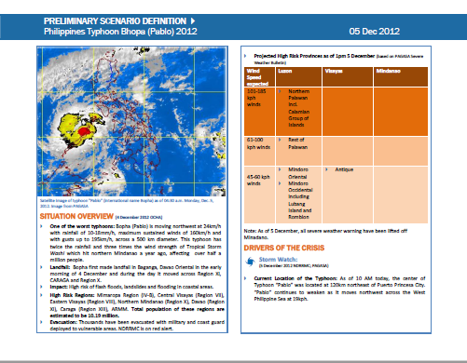
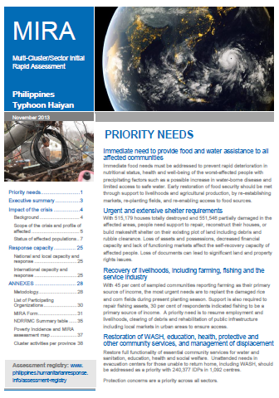
Needs Assessment and Analysis framework for
rapid onset emergencies
PHASE 0
PREPAREDNESS
PHASE I
INITIAL ASSESSMENT
PHASE II
MIRA
PHASE III
IN-DEPTH ASSESSMENTS
PHASE IV
IN-DEPTH ASSESSMENTS
Before the crisis
Within 72 hours
Week 1 – 2
Week 3 and +
Second month and +
OUTPUTS:
Compiled pre-crisis data
Humanitarian Dashboard
Assessment preparedness plans
OUTPUTS:
Situation Analysis
Strategic Statement (within 5 days)
Humanitarian Dashboard
OUTPUTS:
MIRA report
Humanitarian Dashboard
OUTPUTS:
Sector / cluster reports
Humanitarian Dashboard
Humanitarian Needs Overview
OUTPUTS:
Sector / cluster reports
PDNA & Recovery Framework
Humanitarian Dashboard
Notes:
Phase I and II are supported by the MIRA methodology
Phases III and IV are supported by Cluster-specific assessment methodologies
If some of the outputs are unknown by the audience, the facilitator can opt for extending this session with slides added after the key messages.

Slide 5
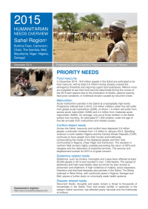
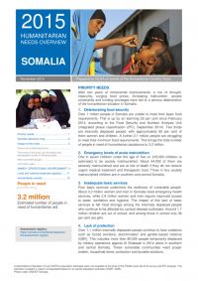
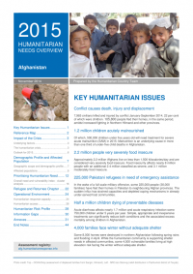
Needs Assessment and Analysis framework for
protracted/slow onset emergencies
PREPAREDNESS e.g. include age/sex data
IN-DEPTH ASSESSMENTS
ongoing
ongoing
OUTPUTS:
Compiled pre-crisis data
Humanitarian Dashboard
Assessment preparedness plans
OUTPUTS:
Sector / cluster reports
Humanitarian Dashboard
Humanitarian Needs Overview
Notes:
Phase I and II are supported by the MIRA methodology
Phases III and IV are supported by Cluster-specific assessment methodologies
If some of the outputs are unknown by the audience, the facilitator can opt for extending this session with slides added after the key messages.

Slide 6
What are the sources of
nutrition information
that can be used during Needs Assessment and Analysis phase of the HPC?
Notes:
At the global level, cluster leads are responsible for:
up-to-date assessments of the overall needs for human, financial, and institutional capacity;
reviews of currently available capacities and means for their utilisation;
links with other clusters, including preparedness measures and long-term planning, standards, best practice, advocacy, and resource mobilisation;
taking action to ensure that required capacities and mechanisms exist, including rosters for surge capacity;
training and system development at the local, national, regional, and international levels.

Slide 7
What is your role as an IMO in the Needs Assessment & Analysis phase of the HPC?
Notes:
At the global level, cluster leads are responsible for:
up-to-date assessments of the overall needs for human, financial, and institutional capacity;
reviews of currently available capacities and means for their utilisation;
links with other clusters, including preparedness measures and long-term planning, standards, best practice, advocacy, and resource mobilisation;
taking action to ensure that required capacities and mechanisms exist, including rosters for surge capacity;
training and system development at the local, national, regional, and international levels.

Slide 8
Nutrition Cluster IMOs have specific roles and responsibilities regardless of the phase –
To collect and collate assessment reports, disseminate to partners following the analysis and validation conducted by the Assessment TWIG or a cluster coordination team
Also to establish the surveys database for the cluster

Slide 9
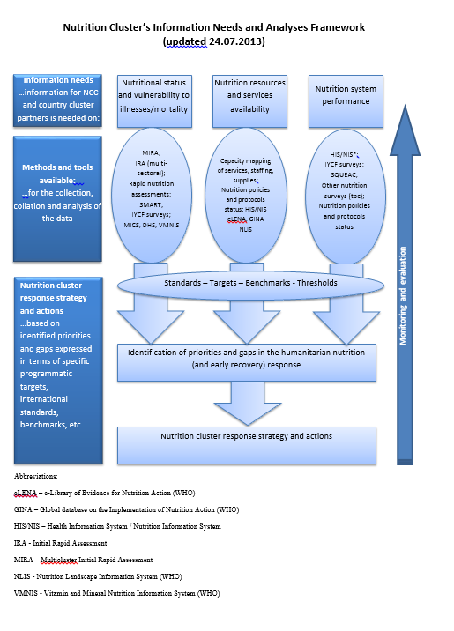
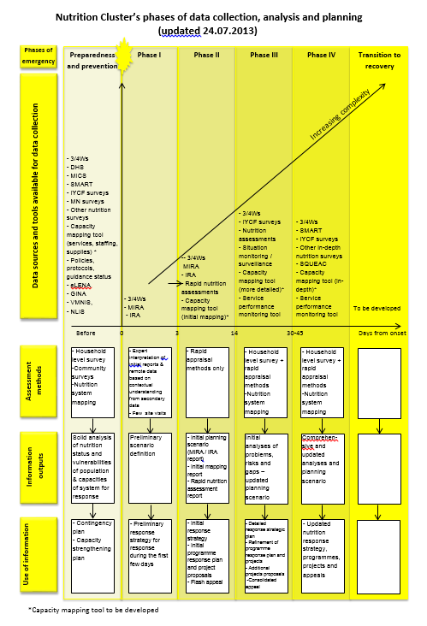

Slide 10
Large-scale national surveys
Such as Demographic and Health Surveys (DHS) or Multiple Indicators Cluster Surveys (MICS).
Good for providing baseline data and monitor long term trends of nutrition status among the affected population
Limitations in emergencies:
Conducted every 3 to 5 years, acute malnutrition increases rapidly and could be missed
Costs
Notes:
Representative, national level population based surveys, such as the demographic and health surveys (DHS) or the United Nations Children’s Fund (UNICEF) multiple-indicator cluster surveys (MICS) are generally conducted every three to five years. Nutrition information is collected with regional and national level prevalence estimates of wasting, underweight and stunting reported for children aged 6-59 months. Anthropometric data on women may also be collected in some surveys and body mass index (BMI) is reported. The scale and the frequency of these surveys predicate that they are used primarily for long-term monitoring rather than a functional tool for emergency settings. However, they provide useful baseline data for comparison of estimates of acute malnutrition, stunting and underweight at regional levels as well as other health and nutrition indicators, such as immunization coverage, care practices and mortality (death) data. This information is generally available on the DHS or MICS websites and is usually stored with the National Bureau of Statistics for DHS or UNICEF for the MICS reports.
The cumbersome nature of large scale DHS or MICS type surveys makes them difficult to repeat frequently. However, it is possible to use small-scale, lighter, surveys over wider geographical areas, to provide data for nutrition surveillance on a more frequent basis. In Tajikistan, Action Against Hunger used a series of yearly surveys conducted at a provincial level to monitor acute malnutrition. These surveys were conducted using the same methodology each year and provided comparable data collected by conducting them at roughly the same time of year in the same geographical areas. This data was then consolidated to provide estimates of the prevalence of acute malnutrition at national level.
Despite the usefulness of this particular surveillance activity, the two main limitations of surveys conducted with frequencies of one year or more are 1) the chance that acute malnutrition increases rapidly and could be missed in the period between surveys and 2) there are still considerable costs involved in conducting these small-scale surveys. This type of surveillance therefore has a limited role in early warning. Thus, although small-scale surveys are cheaper to conduct than DHS or MICS this is out weighted by the need to repeat the small-scale surveys more frequently when using them to monitor acute malnutrition over multiple geographic areas. In parts of the world where multiple repeated surveys are still being used in surveillance (such as Sudan) they require considerable funding by donors.

Slide 11
Example nutrition status MICS 2003-2009

Slide 12
Repeated small-scale surveys
The most common method used to assess the nutrition situation in emergencies providing prevalence of all forms of malnutrition and often mortality, food security, health, WASH indicators
To be comparable they should be conducted in the
same geographical area and
at the same time of year/ same season
Notes:
Small-scale random sample nutrition surveys are the most common method used to assess the nutrition situation in emergencies. A single, ad-hoc small-scale survey has the ability to provide data to justify nutritional interventions by estimating the current anthropometric status of the population. When it comes to nutritional surveillance such surveys should be conducted in the same geographical area and at the same time of year/ same season. Thus the specific intention to repeat these surveys is what makes them most useful in surveillance. Nutrition surveys are designed to provide representative prevalence estimates of rates of acute malnutrition of children 6 to 59 months in a given population. Mortality rates can provide a clear idea of the severity of the situation. In addition, information to assess the underlying causes of acute malnutrition is collected, including public health status, immunization coverage, food security and care practices. Such surveys require a certain level of technical expertise and can be very costly, with average estimates of US$10,000 to 15,000 per survey based on experiences from East Africa, although these costs have been rising in recent years. International standards for conducting such surveys have been agreed upon. Consequently, the confidence in, and demand for, the data tends to be very high. Small-scale surveys are frequently used as a source of information in emergency nutrition surveillance systems. Tulane University School of Public Health and Tropical Medicine and the United Nations Children’s Fund, ‘Nutrition Information Project for the Horn of Africa Working Session Report’, Tulane University and UNICEF, New Orleans, 2007.
Other systems that also use small-scale surveys for nutritional surveillance include the Action Against Hunger lead nutrition sentinel site surveillance in South Sudan. This uses a series of surveys based on the Lot Quality Assurance Survey (LQAS) methodology. LQAS allows for small sample sizes and provides a method to classify whether a binary yes/no outcome is at or above a critical threshold level. While this approach cannot detect significant differences in prevalence of acute malnutrition it does have some merit in that it can give warning when the prevalence of acute malnutrition exceeds a certain threshold in the observed population. For further information on the LQAS methodology, see the Food and Nutrition Technical Assistance (FANTA-II) guide on “Alternative sampling designs for emergency settings” (2009).

Slide 13
Clinic-based monitoring
As component of Health Information System: in-service or community-based growth monitoring (WFA) in MCH programs.
Limitations and bias:
Capacity for identifying nutrition crisis
Captures younger children
Population attending clinics may not be representative
Notes:
Clinic-based monitoring of the nutritional status of children is one method that can be applied both in emergency and non-emergency situations.
Not representative because
Sick children might come more often (and have different features perhaps, i.e. perhaps more often undernoursihed)
Wealthier people might attend more often
Those that have easier physical access might attend more often
In an emergency, information from established HIS can be very useful and often may be the only avai
available information about nutrition in the early days of an emergency.
In many emergency settings, NGOs establish links with a local MCH clinic to provide training, equipment and incentives to MCH staff to routinely assess the nutritional status of all children who visit. This can be a useful way of monitoring the nutrition situation as well as identifying acutely malnourished cases who can be referred to the nearest appropriate selective feeding programme

Slide 14
Sentinel sites
Monitoring of a set of indicators in selected communities or service-delivery sites
Range from technically sophisticated large-scale to simple community-based monitoring of several key indicators.
Aim to produce trends in the nutrition situation in identified vulnerable areas in order to provide an early warning of deterioration
Can be inexpensive but questions around analysis of data and representativeness.
Notes:
Sentinel site surveillance refers to the monitoring of purposively selected communities or service-delivery sites, such as a health centre, in order to detect changes in context, programme or outcome variable. Communities are purposively selected for a number of reasons, such as vulnerability to food insecurity in times of stress. Sentinel sites can range from health centres to villages to districts. Sentinel site surveillance can involve technically sophisticated large-scale assessments with collection of multiple indicators at the site level or simple community-based monitoring of several key indicators. The objectives are to monitor trends in the nutrition situation in identified vulnerable areas in order to provide an early warning of deterioration. Community-based surveillance also has the potential advantage of empowering the community, being relatively inexpensive and particularly useful in emergencies where insecurity prevents representative sampling.

Slide 15
Rapid nutrition assessments / Rapid screenings
They are an important source of information especially at the onset of an emergency to determine the magnitude and severity of a crisis.
Information may not always be representative but results can provide a basis for determining whether a more detailed assessment is required to establish the actual prevalence of acute malnutrition or whether an emergency response is required.
Notes:
Rapid nutrition assessments are conducted to get a quick snapshot of the nutrition situation. Depending on the context, different indicators can be used, such as weight-for-height or MUAC. Agencies have developed a variety of tools that can be modified according to the context and the type of information considered to be appropriate. Although the information may not always be representative and thus not statistically valid, the results from a rapid assessment, even of a small sample of children, can provide a basis for determining whether a more detailed assessment is required to establish the actual prevalence of acute malnutrition or whether an emergency response is required. For this reason rapid assessments are an important source of information especially at the onset of an emergency to determine the magnitude and severity of a crisis.

Slide 16
Program / services statistics
Indicators such as admissions, cure, defaulting and case-fatality rates provide a measure of:
programme quality
trends in acute malnutrition
the most vulnerable groups
seasonal trends in the nutrition situation, assuming reasonable coverage and access
help to identify the underlying causes of malnutrition, such as morbidity (illness) patterns.
Notes:
In nutrition emergencies a component of the response will be selective feeding for acutely malnourished children. These usually include therapeutic care for the severely malnourished and supplementary feeding for moderately malnourished cases. For details see Modules 12 and 13. In selective feeding programmes, statistics are collected on admissions, cure rates, defaulter rates and case fatality rates. These indicators provide a measure of programme quality as well as act as a source of information on the trends in acute malnutrition. By including these indicators in a nutrition surveillance system they can provide useful information on the most vulnerable groups (by profiling the type of individual admitted, e.g., children under two years of age, adolescents, their location, etc.). They can also help to identify the underlying causes of malnutrition, such as morbidity (illness) patterns. Monitoring the trends in admissions (assuming reasonable coverage and access) can provide additional information on seasonal trends in the nutrition situation (e.g., during the pre-harvest rains the numbers of cases admitted to the feeding programmes may increase). One challenge is that NGOs have established different admission criteria for selective feeding programmes, which makes it difficult to compare data between centres. However, monitoring rates of cure, case fatality and defaulting can still contribute to an understanding of the nutrition situation. Additional care should also be taken when the number of centres reporting from month to month varies. In this case useful trends can be acquired by using a mean (average) admission rate per month.

Slide 17
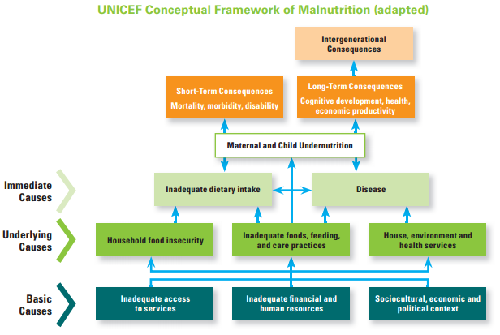
Remember to collect information on immediate and underlying causes (from other sectors such as WASH, Health, Food Security)!!

Slide 18
What GNC IM Tools inform the Needs Assessment & Analysis?
HIR
Key datasets
Map templates
Capacity mapping
Caseload targets & supplies
Surveys database
IM Checklist

Slide 19
What GNC IM Tools inform the Needs Assessment & Analysis?
HIR
Key datasets
Map templates
Capacity mapping
Caseload targets & supplies
Surveys database
IM Checklist

Slide 20
Surveys database
 | The Surveys database is an adaptable Excel database tool which is used in the Needs Assessment and Analysis phase of the HPC. It was created to improve efficiency of analysis by bringing data from several surveys into one tool.
 | The database includes four worksheets: 1) Anthropometric nutrition 2) Infant and young-child feeding, 3) Micronutrient deficiencies, and 4) Coverage. Each sheet is organised in a similar way with sections for who, when, where, survey quality and what.
 | The Surveys Database would likely be maintained and managed by a focal point for assessments in the CLA or IMO or a chair of the Nutrition Information Working Group, Assessment Working Group It is not recommended that it is filled-in directly by cluster partners.

Slide 21
Survey database activity instructions
In your group, you have 20 minutes to practice completing the Survey database tool.
Extract data from your assigned report and enter it into the database.
Facilitators are available to help if you need support.
For the debrief, please share:
Two examples of when you could have used this tool (in the past) to enhance information management in your cluster and what would have been the impact
Two constraints your group would anticipate in using this tool (in the future) and how these might be overcome.

