Slide 1
Integrated Programming
Health

Slide 2
Session Learning Objectives
By the end of this session, participants will be able to:
Describe the critical role health plays in nutrition outcomes
Identify specific activities for the integration of health and nutrition interventions
Notes:
Introduce the learning objectives

Slide 3
Why is Health Critical to Nutrition
Malnourished children suffer from frequent illness due to impaired immunity. SAM children are nine times more likely to die from common childhood infections such as pneumonia, diarrhoea, malaria, and measles, MAM children are 4 times more likely to die.
Poor breastfeeding and complementary feeding practices are a leading cause of ill-health among young children.
Notes:
Introduction
Start the session off by asking the participants to beehive (talk in small groups of two or three) and discuss ‘Why is health critical to nutritional outcomes?’. Allow 5-10 minutes, judging when the discussion has ended. Take comments from the groups and consolidate using PPT 3 (Why is health critical to nutrition).

Slide 4
Health situation in X country
KEY HEALTH INDICATORS
Crude Death Rate (CDR)17
Under Five Death Rate (U5DR)
Low birth weight
Fertility rate
DISEASES
Diarrhoea
Dysentery
Malaria/fever
Acute Respiratory Infection (ARI)
HIV/AIDS prevalence
Cholera or Acute Watery Diarrhoea (AWD)
Measles
SERVICES & UNHEALTHY ENVIRONMENT
Routine measles vaccination coverage
Routine polio vaccination coverage
Routine vitamin A supplementation coverage
Campaign measles vaccination coverage
Campaign polio vaccination coverage
Campaign vitamin A supplementation
Measles vaccination coverage from surveys
Polio vaccination coverage from surveys
Vitamin A supplementation coverage from surveys
Coverage of all basic vaccinations from surveys
Skilled attendant at delivery
Health seeking behaviour
Needs to be adapted before training!
Notes:
Country Information
Share the country information on Health, PPT 11-12. Invite thoughts from the participants on the implications of this for nutrition outcomes in the country.

Slide 5
Health response in X country
At HH Level
IEC through home visits by CHVs, normal deliveries by village midwives, and referral.
At Community Level
Limited curative care, IEC, FP (condoms) through CHWs
Limited curative care, including IMCI, ANC/PNC, EPI, FP (short-acting methods), IEC through mobile teams.
At Primary Health Care (PHC) Level
Health Unit: Limited curative care including IMCI, ANC/PNC, EPI, FP (short-acting methods), IEC. Fill the gap in non-communicable disease (NCD) prescriptions
Health Center: Curative care (outpatient department - OPD), including IMCI, TB and others, ANC/PNC, FP, EPI, NCD management, normal deliveries at selected facilities, essential newborn care, and basic laboratory / investigation services.
At Secondary Health Care Level
Curative care, including OPD and inpatient. Round-the-clock emergency trauma care. IMCI, TB, NCD. ANC/PNC, Normal and complicated deliveries.
Basic emergency obstetric and newborn care (BEmONC), comprehensive emergency obstetric and newborn care (CEmONC), essential newborn care, management of sick and newborns with low birth weight. Laboratory and radiology.
Needs to be adapted before training!
Notes:
PPT 2.4

Slide 6
Improving Nutrition Through Health
Priority objectives to improve nutrition through the health sector:
Reduce micronutrient deficiencies.
Reduce anemia in pregnant and lactating women and children 0-24 months.
Promote good feeding and nutritional care practices, including exclusive breastfeeding for the first 6 months of life.
Treat and prevent illness.
Reduce low birth weight.
Improve reproductive health and family planning.
Treat moderate and severe acute malnutrition in children.
Suggested by World Bank Group (2013)
Notes:
To establish the link between Health and Nutrition, go through slide 6 (Improving nutrition through health).

Slide 7
Task: Health and Nutrition Integration
Discuss how to integrate health and nutrition. Use examples to illustrate your ideas if possible. Prepare a flipchart to be presented to the rest of the group.
Notes:
To establish the link between Health and Nutrition, go through slide 6 (Improving nutrition through health). Then explain that we will go into an activity where the participants will explore how to integrate health and nutrition on different levels. Before you begin, ask for some ideas on how health and nutrition could be integrated. Flipchart the responses to get an overview. Some things to cover are:
Build on existing platforms. ​
Target the first 1,000 days ​
Integrate nutrition interventions into the essential package of basic health services​
Work at both the community and facility level​
Include home visits ​
Engage men and empower women. ​
Align with national and local priorities. ​
Respond to community needs ​
Ensure a regular supply of commodities (medicines, contraceptives, RUTF, etc) and provide a private space for services. ​
Ensure adequate staff experience, training, and incentives
Explain that the participants will now be looking at the integration of health and nutrition at different levels, and identify key actions. To their support they have the WHO health system strengthening framework for nutrition. Set the task (PPT 7) and divide the group into four groups;
Household level
Community level
Primary healthcare
Secondary healthcare
Ask each group to consider how to integrate health and nutrition within the area they have and take notes on a flipchart. Name examples is necessary, and walk around the groups to ensure they are on track. After 15 minutes, ask each group to present back. Consolidate using slide 7 – 10 (Minimum Package of Intervention). Ensure you cover these points:
Household Level:
Health education to create awareness of health and well-being
Sanitation, access to adequate and safe water and proper waste management
Prevention of communicable diseases and use of ORS
Health/hygiene promotion activities-
Hand washing, food and personal hygiene,
use of insecticide treated nets
Indoor residual spraying
Prevention of overcrowding
Promotion of health seeking behavior, child and maternal nutrition etc.
Recognition of danger signs and immediate remedies such as tepid sponging to reduce fever
Community Level
Integrated management of childhood illness- To provide treatment for: Malaria; Pneumonia, Diarrheal diseases
Integrated management of adult illness e.g. treatment and prevention of TB (DOTS), HIV/AIDs and other chronic diseases
Health measures for the prevention and control of communicable disease- supported by establishment and use of EWARS
Child health services like immunization services, screening for malnutrition, micro nutrient supplementations and deworming
Health promotion on Reproductive health (including the use of basic FP methods) and mental health and psychosocial support
Maternal nutrition- screening for malnutrition and use of micronutrient for pregnant women
Community-based management of acute malnutrition (CMAM)
Primary Health Care Level:
Child health care- health education, Immunizations and care based on Integrated Management of Childhood Illnesses (IMCI) guidelines or other national guidelines
New born care- according to Integrated Management of Pregnancy and Childbirth (IMPAC) guidelines
Emergency assessment and triage in all PHC facilities
Screening for malnutrition and referral to appropriate services
Treatment of Severe Acute Malnutrition (SAM) at Outpatient Therapeutic Points
Provision of Reproductive and Maternal health services
Treatment of injuries and referrals
Basic mental health care and care for psychosocial problems
Referrals
Secondary Health Care Level:
Preventive services and health promotion- Those carried-our at PHC level plus circumcision, Post-exposure prophylaxis (PEP), PMTCT
Curative Services: among others
Surgeries for general injuries and other emergencies
Internal medicine- Provide of care for NCDs and medical emergencies, care and treatment for TB, HIV/AIDS
Pediatrics- Provision of care for Pediatric emergencies, Stabilization center (SC) care, neonatology and child friend initiative
Gynecology and obstetrics care- ANC, gynecological emergencies, Comprehensive emergency obstetrics care (CEmOC)
Clinical support services (Medical imaging, Laboratory services, Rehabilitation, Sterilization)

Slide 8
Minimum Package of Interventions- Household Level
Health education
WASH
Prevention of communicable diseases and use of ORS
Health/hygiene promotion activities
Promotion of health seeking behavior, child and maternal nutrition etc.
Recognition of danger signs and immediate remedies
Notes:
Household Level:
Health education to create awareness of health and well-being
Sanitation, access to adequate and safe water and proper waste management
Prevention of communicable diseases and use of ORS
Health/hygiene promotion activities-
Hand washing, food and personal hygiene,
use of insecticide treated nets
Indoor residual spraying
Prevention of overcrowding
Promotion of health seeking behavior, child and maternal nutrition etc.
Recognition of danger signs and immediate remedies such as tepid sponging to reduce fever

Slide 9
Minimum Package of Interventions- Community Level
Integrated management of childhood illness
Integrated management of adult illness
Health measures for the prevention and control of communicable disease
Child health services
Health promotion on reproductive health and mental health and psychosocial support
Maternal nutrition
Community-based management of acute malnutrition (CMAM)
Notes:
Community Level
Integrated management of childhood illness- To provide treatment for: Malaria; Pneumonia, Diarrheal diseases
Integrated management of adult illness e.g. treatment and prevention of TB (DOTS), HIV/AIDs and other chronic diseases
Health measures for the prevention and control of communicable disease- supported by establishment and use of EWARS
Child health services like immunization services, screening for malnutrition, micro nutrient supplementations and deworming
Health promotion on Reproductive health (including the use of basic FP methods) and mental health and psychosocial support
Maternal nutrition- screening for malnutrition and use of micronutrient for pregnant women
Community-based management of acute malnutrition (CMAM)

Slide 10
Minimum Package of Interventions- Primary Health Care Level
Child health care
New born care (Integrated Management of Pregnancy and Childbirth (IMPAC) guidelines)
Emergency assessment and triage in all PHC facilities
Screening for malnutrition and referral to appropriate services
Treatment of Severe Acute Malnutrition (SAM) at Outpatient Therapeutic Points
Provision of Reproductive and Maternal health services
Treatment of injuries and referrals
Basic mental health care and care for psychosocial problems
Referrals
Notes:
Primary Health Care Level:
Child health care- health education, Immunizations and care based on Integrated Management of Childhood Illnesses (IMCI) guidelines or other national guidelines
New born care- according to Integrated Management of Pregnancy and Childbirth (IMPAC) guidelines
Emergency assessment and triage in all PHC facilities
Screening for malnutrition and referral to appropriate services
Treatment of Severe Acute Malnutrition (SAM) at Outpatient Therapeutic Points
Provision of Reproductive and Maternal health services
Treatment of injuries and referrals
Basic mental health care and care for psychosocial problems
Referrals

Slide 11
Minimum Package of Interventions- Secondary Health Care Level
Preventive services and health promotion
Curative Services: among others
Surgeries
Internal medicine
Pediatrics
Gynecology and obstetrics care
Clinical support services (Medical imaging, Laboratory services, Rehabilitation, Sterilization)
Notes:
Secondary Health Care Level:
Preventive services and health promotion- Those carried-our at PHC level plus circumcision, Post-exposure prophylaxis (PEP), PMTCT
Curative Services: among others
Surgeries for general injuries and other emergencies
Internal medicine- Provide of care for NCDs and medical emergencies, care and treatment for TB, HIV/AIDS
Pediatrics- Provision of care for Pediatric emergencies, Stabilization center (SC) care, neonatology and child friend initiative
Gynecology and obstetrics care- ANC, gynecological emergencies, Comprehensive emergency obstetrics care (CEmOC)
Clinical support services (Medical imaging, Laboratory services, Rehabilitation, Sterilization)

Slide 12
https://www.k4health.org/sites/default/files/miycn-fp-monitoring-and-evaluation-briefer_final_may2014.pdf
Notes:
Highlight the importance to monitor and evaluate this, as we have spoken about in the earlier sessions. Show slide 11, which shows an example of how to monitor . Invite thoughts and questions on the example. I don’t have any notes on this slide. Could someone advise on whether this was the final one that was decided to keep, or if we have access to something more accessible?
Still don’t have any input on this

Slide 13
Take Home Messages
Malnourished children suffer from frequent illness and are nine times more likely to die from common childhood infections.
Poor breastfeeding and complementary feeding practices are a leading cause of ill-health among young children.
No missed opportunity: Screen children and PLWs for malnutrition during health visits and screen for illness in nutrition programs
Notes:
Sum up the session and put anything outstanding on the Car Park.

Slide 14
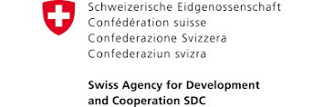
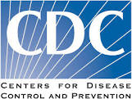
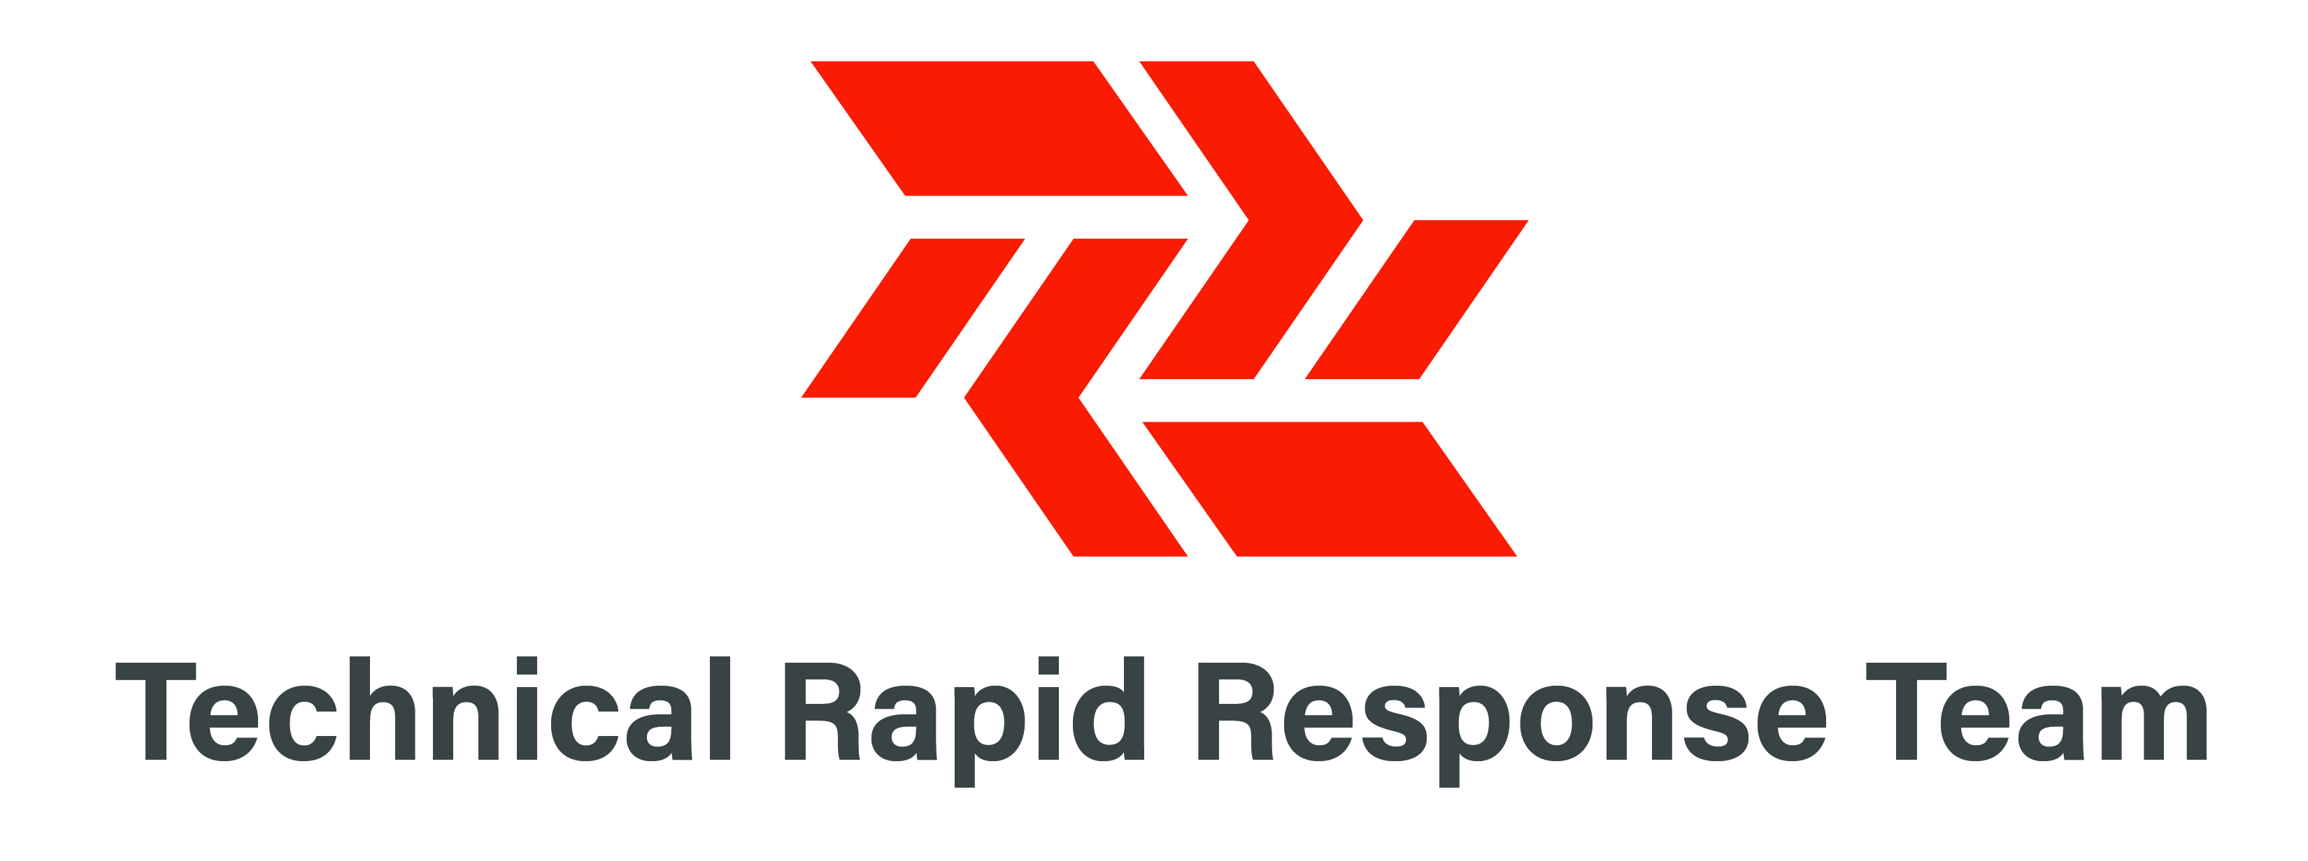
Acknowledgements
This training package was developed by the Intercluster Nutrition Working Group
This training package was funded by
This training package was developed with the technical support of

