Slide 1
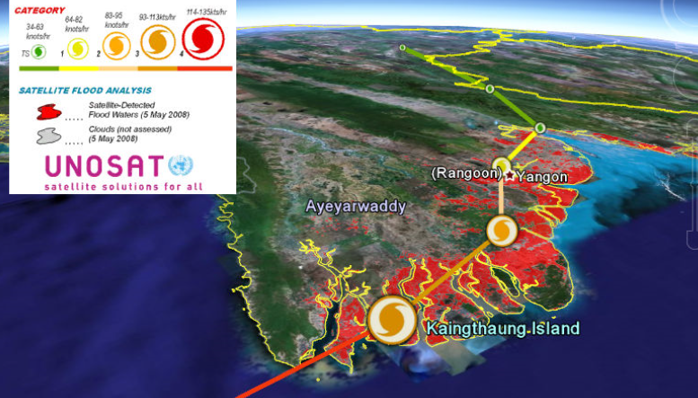
Myanmar Case Study Recap
Cyclone Revelia

Slide 2
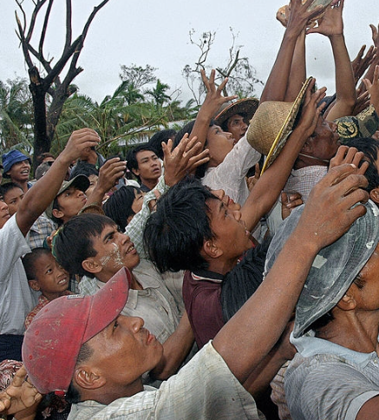
Scenario Update
Cyclone Revelia hit Myanmar 250 km West of Yangon with winds of up to 190 km/hour
Hundreds of thousands displaced
Humanitarian agencies struggling to meet needs
International airports and water ways in the Ayeyarwady delta severely damaged
Affected people extremely vulnerable to exposure and lack of food.
Partnering with the government may be challenging

Slide 3
2.4 Nutrition Cluster Coordination Meeting
Notes:
First – the facilitators ask 4 people to volunteer being today’s EYES (2 persons) and EARS (2 persons). They will be asked to observe and listen to the day’s events and give feedback at the end of the day for the EVALUATION.

Slide 4
NCC Meeting Objectives
The objectives of today’s Nutrition Cluster meeting are to:
understand the main priorities for nutrition in the context of the recent crisis
agree on the overall aim or goal of the nutrition cluster
discuss and agree upon the primary objectives of the Nutrition Cluster.

Slide 5
NCC Simulation Schedule
Time | Task
15 min | Scenario review and preparation
45 min | Nutrition Cluster Coordination Meeting
30 min | Small group feedback
 | Break
30 min | Plenary feedback

Slide 6
Small Group Meeting Debrief
Questions to consider in the meeting debrief:
What worked well and and what didn’t?
How could the meeting have been improved?
How did you decide what your group’s priorities were?
What personal lessons have you learned over the course of this meeting?
What will you do differently in the future?

Slide 7
Plenary Meeting Debrief
From a “people-centred” focus:
What can the cluster do to ensure the views and priorities of affected people are considered when setting priorities?
What about ways to engage with and promote local and national authorities and partners in the process?
How do we make sure that other needs, gaps and priorities are shared with and addressed by other clusters or actors?

Slide 8
Tips for AAP in NCC meetings
Not all meetings need to discuss AAP, but…
All cluster meetings and working groups can include quality and accountability as a regular agenda item for discussion
An AAP or community engagement working group may be a way to get practical ideas on what the cluster can do – and an opportunity to link with similar groups in other clusters
Building trust and a culture of continuous improvement in meetings can help encourage partners to share mistakes, look for advice on quality and accountability issues

