Slide 1
Integrated Programming
Water, Sanitation and Hygiene (WASH)

Slide 2
Session Learning Objectives
By the end of this session, participants will be able to:
Describe how WASH and Nutrition are interlinked
Describe how WASH contributes to nutrition outcomes
Identify specific WASH activities that can be integrated into nutrition, health, and FS interventions
Notes:
Introduction
Introduce the learning objectives.

Slide 3
What is WASH?
Notes:
In order to introduce WASH lightly, present the participants with the F-diagram images separated (either pre-printed or drawn by you based on the HO). Make sure there are no arrows with the images, but that these are separate. Give the participants no more than 3 minutes to complete this. If you have a large group you can divide them into two. Consolidate through settling the interconnection between Water, Sanitation and Health and summarising what WASH is.

Slide 4
WASH situation in X country
Needs to be adapted ahead of training!
ACCESS TO SAFE WASH
Access to a sufficient quantity of water
Access to improved sanitation facilities
Access to an improved source of drinking water
Notes:
PPT 2.3
Note: did not find anything on Hygiene practices in IPC

Slide 5
WASH response in X country
At household level
Distribution of jerry cans, water filters and consumable hygiene kits for HH with SAM children (NGOs)
Hygiene awareness (NGOs, CVs, CHVs)
At community level
Rehabilitation of water schemes in areas with high SAM prevalence & establishment of water management committees (NGOs, GARWSP, contractors)
Demand driven approach to latrine construction and solid waste management in areas with high SAM prevalence (NGOs, CVs, CHVs)
Hygiene promotion / community engagement in areas with high SAM prevalence (NGOs, CVs, CHVs)
At HF level
Ensure WASH facilities in health facilities and treatment centers (coordinated by health cluster but supported by WASH cluster and partners. NGOs, GARWSP, contractors)
Needs to be adapted ahead of training!
Notes:
PPT 2.3

Slide 6
WASH’s Impact on Nutrition
Mother’s time constraints for fetching water, less time to cook and care for her children
Notes:
WASH’s Impact on Nutrition
Carry out a think-pair-share activity. Ask participants to think independently what WASH’s impact is on nutrition (there can be many points) and take small notes. After a couple of minutes, ask them to turn to the person next to them and discuss what they found. Ask them to write each idea on a post-it and come and put it up on a flipchart at the front of the room. As they put the post-its up, encourage them to cluster them according to themes. When everyone has put their ideas up, summarise the themes and introduce the framework on PPT 5 (WASH’s Impact on Nutrition). Compare and contrast, drawing upon the participants’ ideas. Inadequate WASH conditions facilitate ingestion of fecal pathogens which leads to diarrhea, intestinal worms, and environmental enteric dysfunction, the three key pathways from poor WASH to undernutrition

Slide 7
Considerations for Integrating WASH and Nutrition
Strategically contributes to better nutritional (and health) outcomes.
Multiple levels of integration
Goals, capacities and enabling environmentare determinant factors
Positive outcomes of integration outweigh the costs
Gender analysis is crucial; fair recruitment and participation from both men and women
Notes:
Now ask participants to go back to their pairs and discuss what some key considerations could be for integrating WASH and Nutrition. After a few minutes, ask each pair to join another pair and compare what they came up with. After 5 minutes, ask them to share with the group and flipchart their responses. Ensure that all key points on the PPT 5 (Considerations for integrating WASH and Nutrition ) are covered.
The integration of WASH and nutrition (and health) is a strategic tool to enable the achievement of better nutritional (and health) outcomes. ​
There are many types and levels of integration- national, sub-national, between agencies, within an agency.​
The goals, capacities and enabling environment will help determine the appropriate level of integration.
The integration of WASH and nutrition (and health) is a strategic tool to enable the achievement of better nutritional (and health) outcomes. ​
There are many types and levels of integration- national, sub-national, between agencies, within an agency.​
The goals, capacities and enabling environment will help determine the appropriate level of integration.
INCORPORATE: The most appropriate interventions to include will be context specific. However, in many instances, promotion of hygiene practices, such as hand washing with soap, is feasible within nutrition programs and would reinforce important preventive health behavior.
Integration where appropriate. For example full integration of WASH in order to improve the nutrition of pregnant and lactating women and appropriate complementary feeding, may be more attractive for complete integration with WASH efforts in order to address the necessary food and hand hygiene, sanitation and water quality issues, whereas other nutrition interventions, such as micronutrient supplementation, may need only limited coordination

Slide 8
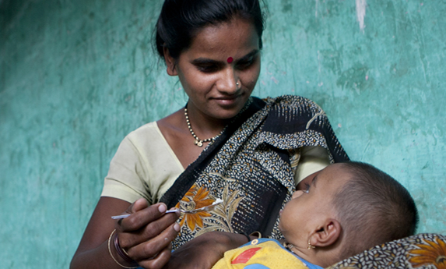
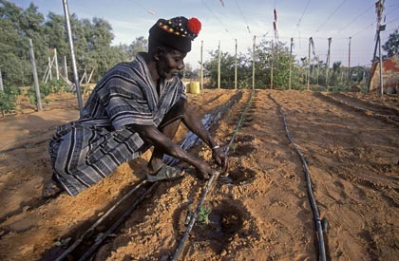
Task: Nutrition and WASH
Discuss the key actions for integration between WASH and your assigned sector, in order to reach nutrition outcomes.
Notes:
Explain that we will now look at the link between WASH and three sectors, in order to reach nutrition outcomes. Divide the participants into three groups, and assign them a sector each; Nutrition, Health, Food Security. Ask them to brainstorm key actions for integrating:
WASH and Nutrition for nutrition outcomes
WASH and Health for nutrition outcomes
WASH and Food Security for nutrition outcomes
Ask all participants to take notes on flipcharts. After 20 minutes, do a gallery walk, and walk between the different stations. Ensure that you invite other groups to give input and support to cover all the points on the PPT 8 (Integration of WASH and Nutrition for Nutrition Outcomes) , 9 (Integration of WASH And Health for Nutrition Outcomes) and 16, 17 (Integration of WASH and FSL for Nutrition Outcomes).

Slide 9
Integration of WASH And Nutrition for Nutrition Outcomes
Target WASH programs in areas of high nutritional need (geographic co-location).
Understand the situation: review existing data, policies and strategies.
Establish and build a working relationship between nutrition and WASH actors.
Engage nutrition and WASH actors in joint program design, planning, implementation, management (interdisciplinary team/steering committee), and consolidated reporting.
Train health and nutrition staff to promote and demonstrate key WASH practices in ongoing nutrition work.
Properly budget WASH staff and activities in nutrition proposals
Do not forget WASH points and sanitation facilities in nutrition centers

Slide 10
Integration of WASH and Health for Nutrition Outcomes
Disease prevalence can guide in the prioritizing of interventions, and might provide hints of what transmission routes can be blocked with WASH interventions.
Preventing WASH related diseases such as diarrhea and malaria will significantly contribute to improved health and nutrition outcomes.

Slide 11
Waterborne diseases and Worm Infestation
Caused by poor sanitation
Diarrhea and intestinal worm infestation can
impair nutritional status through:
Loss of appetite,
Malabsorption of nutrients and
Increased metabolism
WASH response
Improved sanitation (safe disposal of feces)
Hygiene promotion (hand washing)
Treatment and safe storage of drinking water
Provision of soap
Provision of clean water
Food hygiene
Promotion of exclusive breastfeeding for infants <6 months
Promotion of continued breastfeeding of the sick child
Hygienic preparation of complementary foods for children aged six months and above to reduce the risk of diarrhoea, AWD, and cholera infection.
,

Slide 12
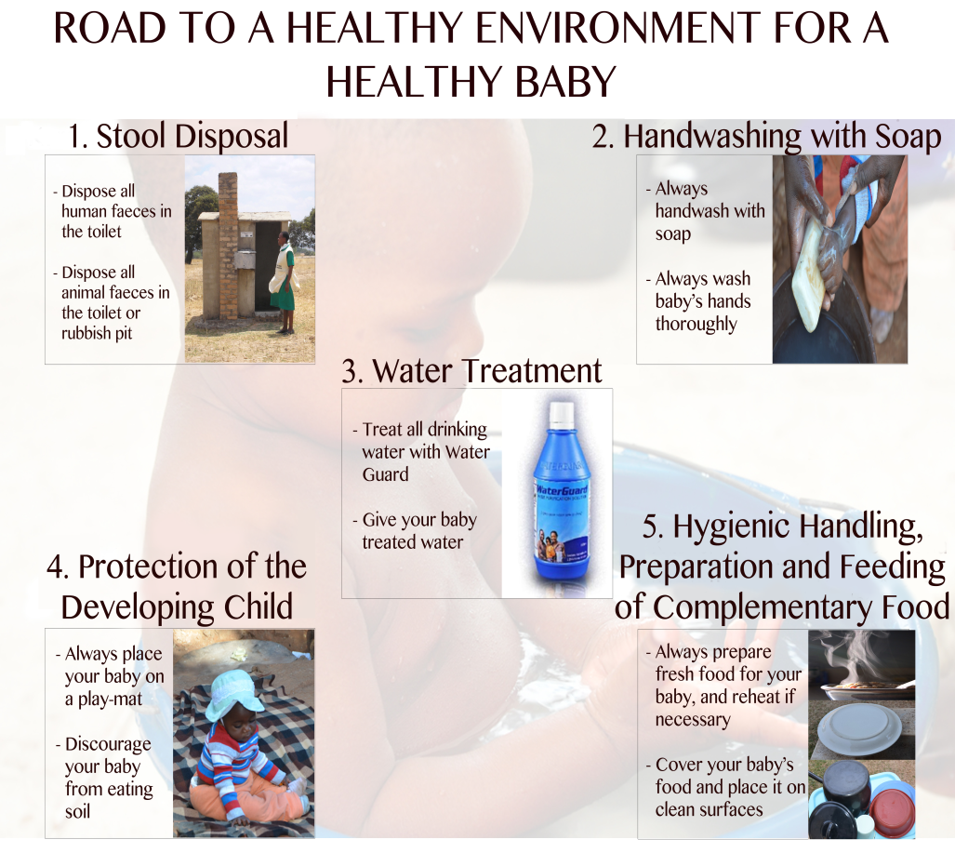
Baby WASH
Stockholm World Water Week 2014
Notes:
Supporting
This is an example to show that to address the issue of environmental enteropathy the various studies that are ongoing in a few countries to assess the share of stunting to poor sanitation include education and communication materials with clear messages on the key WASH interventions. Not only the traditional messages about stool disposal, handwashing, etc. but also to keep the baby on a play-mat and discourage baby from eating soil.

Slide 13
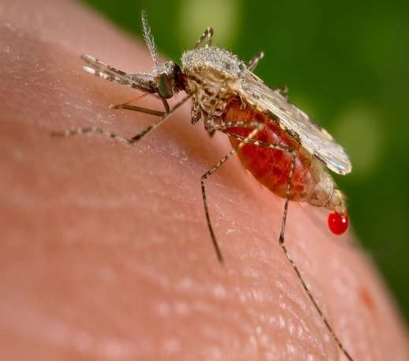
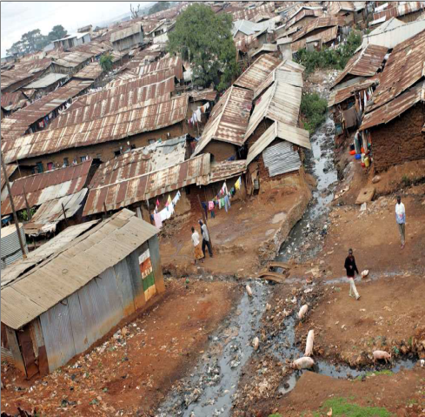
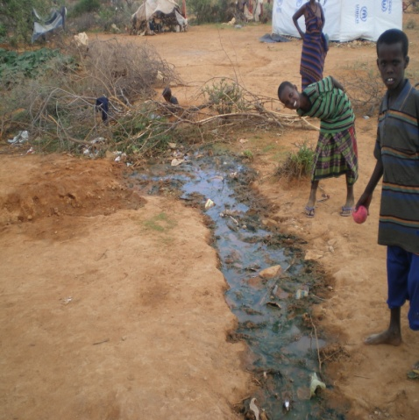
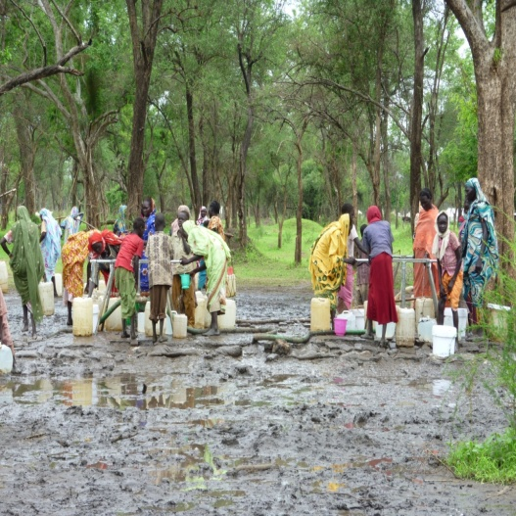
Vectorborne disease
WASH Response
Drainage (especially at water points)
Waste management
NFI distributions
Hygiene promotion
Promotion of continued breastfeeding of the sick child
Notes:
Supporting

Slide 14
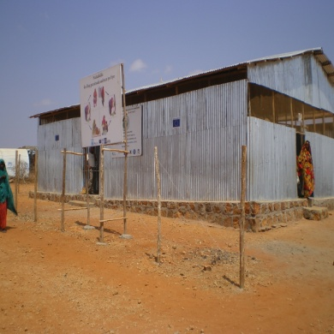
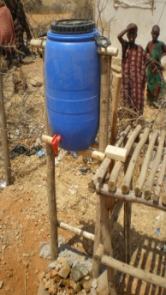
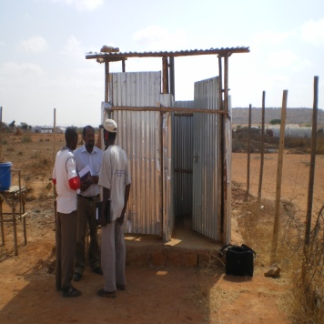
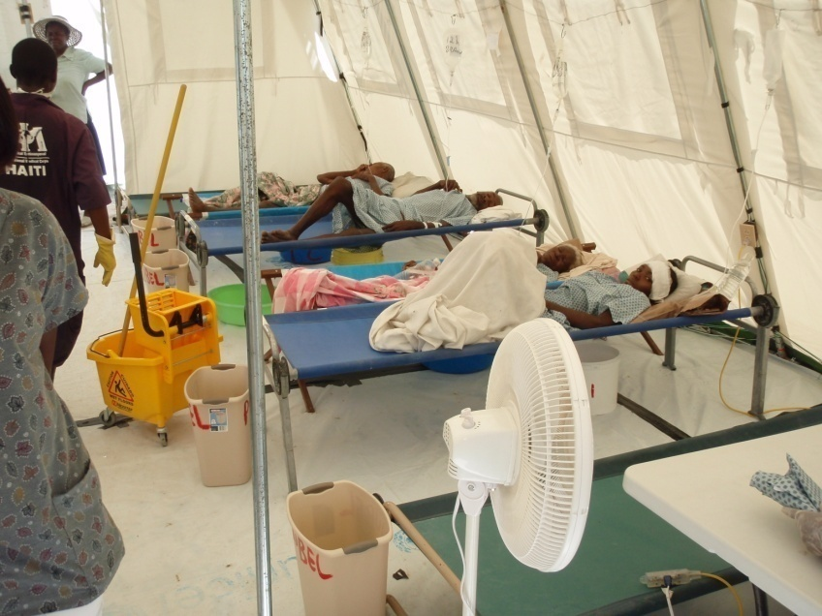
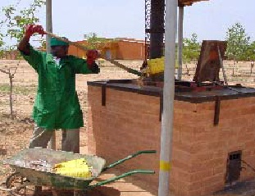
WASH Services At Health Facilities
Joint assessments using health facility as a model for community
Provision of infrastructure, materials, training and outreach
Safe water chain
Excreta disposal
Vector control
Infection prevention and control protocols training
Waste management
Location
Health post, health centre, clinics, stabilization centres, waiting mothers units
Notes:
Supporting
This slide is from the CDC/Emory/IMC nutrition in emergency course.
yes. although budget is always an issue here. need to differentiate nutrition centered managed by NGO, or nutrition integrated into local health center, as capacity & budget are very different. if support to governemental health center, Advocacy to health ministry for wash in health center is a priority

Slide 15
Notes:
Supporting
Adapted from WHO/UNICEF 2015. Water, sanitation and hygiene in health care facilities: status in low- and middle-income countries and way forward.

Slide 16
Integrated WASH and FSL Activities for Improved Nutrition Outcomes
Provision of hand washing and toilet facilities in the field and food processing facilities
Behavior change on good hygiene practices around food preparation
Reducing mycotoxins in food through controlled irrigation, moisture control, and through washing
Reducing animal waste contamination

Slide 17
Integrated WASH and FSL Activities for Improved Nutrition Outcomes
Reducing chemical contamination
Ensuring that irrigation runoff is not used for drinking water.
Multiple use water systems
Composting or ecosan for production of fertilizer
Water retention for aquifer recovery – sand dam construction
Erosion control – soil retention & flash flood mitigation
Drip irrigation

Slide 18
Monitoring and Evaluation
Domain | Indicator
Water | Proportion of HH’s consistently storing their drinking-water safety
 | Proportion of HH’s with knowledge of at least one HHWT method
Sanitation | Proportion of HH’s safely dispensing of children's feces
 | Proportion of HH’s with sanitation facilities that are accessible by children and disabled members of the HH’s
Hygiene | Proportion of HH’s where primary caregiver can cite critical times for hand washing with soap
 | Proportion of HH’s safely storing children’s food
 | Proportion of HH’s with no visible feces (animal or human) in the compound/yard/ children’s play area
Notes:
Monitoring and Evaluation
Use slide 18-19 to discuss that it is essential to monitor and there are commonly used indicators. You can measure the impact of WASH activities on nutrition outcomes through this.

Slide 19
Monitoring and Evaluation
 | Domain | Indicator
Impact | Diarrhea | Proportion of children under 2/5 years of age who had diarrhea and diarrhea with blood in the 2 weeks preceding the survey Proportion of children under 2/5 years of age who had diarrhea in the preceding 24 hours
Outcome | Water | Proportion of households with access to an improved water source Proportion of households consistently storing their drinking water safely Proportion of households consistently treating their drinking water with recommended HWT technology Proportion of households with knowledge of at least one HWT method
Output | Increased policy and institutional support for integrating WASH into nutrition programmes | Country has developed a national nutritional plan that includes WASH National WASH plans include explicit targeting of areas with high rates of malnutrition and food insecurity Number of strategies, initiatives and/or partnerships/agreement advocating for integrating WASH and nutrition programmes Proportion of targeted institutions with (increased) expenditures for integrated WASH-nutrition programming

Slide 20
Take Home Messages
WASH plays a critical role in the prevention of diseases and malnutrition.
Target WASH interventions to most malnourished children and communities, ensuring community level linkages
Ensure that WASH and Nutrition interventions use a multi-skilled approach to community outreach and community mobilization
Ensure that WASH and Nutrition interventions have harmonised behaviour change messages and approaches
Ensure adequate WASH services at health facilities
WASH is also for food security and livelihoods
Notes:
Discussion and Sum up. In Key Messages, add the point that WASH and Nutrition interventions use a multi-skilled approach to community outreach and community mobilization-community outreach workers that provide both nutrition and WASH (health also) messages, instead of beneficiaries having to deal with 3 community outreach workers, one from health, one from nutrition, and one from WASH.

Slide 21
Acknowledgements
This training package was developed by the Intercluster Nutrition Working Group
This training package was funded by
This training package was developed with the technical support of

