Slide 1
2.3 Needs Assessment and Analysis

Slide 2
Objectives
Describe the importance of needs assessment and analysis within the Humanitarian Programme Cycle.
Contrast between Needs Assessment Framework phases in sudden onset and protracted emergency contexts.
Identify the roles, responsibilities and accountabilities of partners across the assessment phases.
Describe how the nutrition cluster partners and other clusters can work together to maximise the efficiency of assessment and analysis.

Slide 3
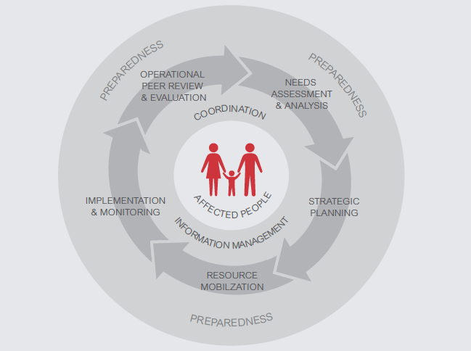
Humanitarian Programme Cycle

Slide 4
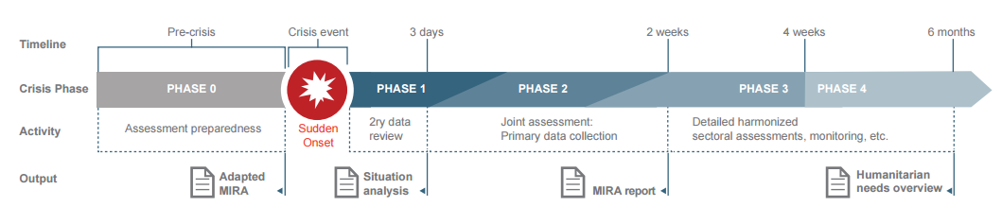
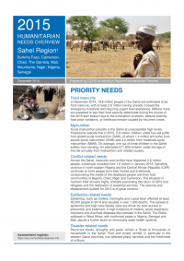
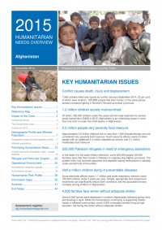
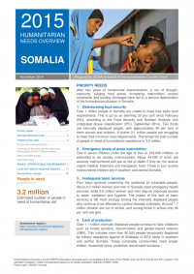

Coordinated Assessment
Framework & Phases
Notes:
Phase I and II are supported by the MIRA methodology
Phases III and IV are supported by Cluster-specific assessment methodologies
If some of the outputs are unknown by the audience, the facilitator can opt for extending this session with slides added after the key messages.

Slide 5
Aperçu des besoins humanitaires (HNO)
(Urgences Prolongées)
Notes:
.

Slide 6
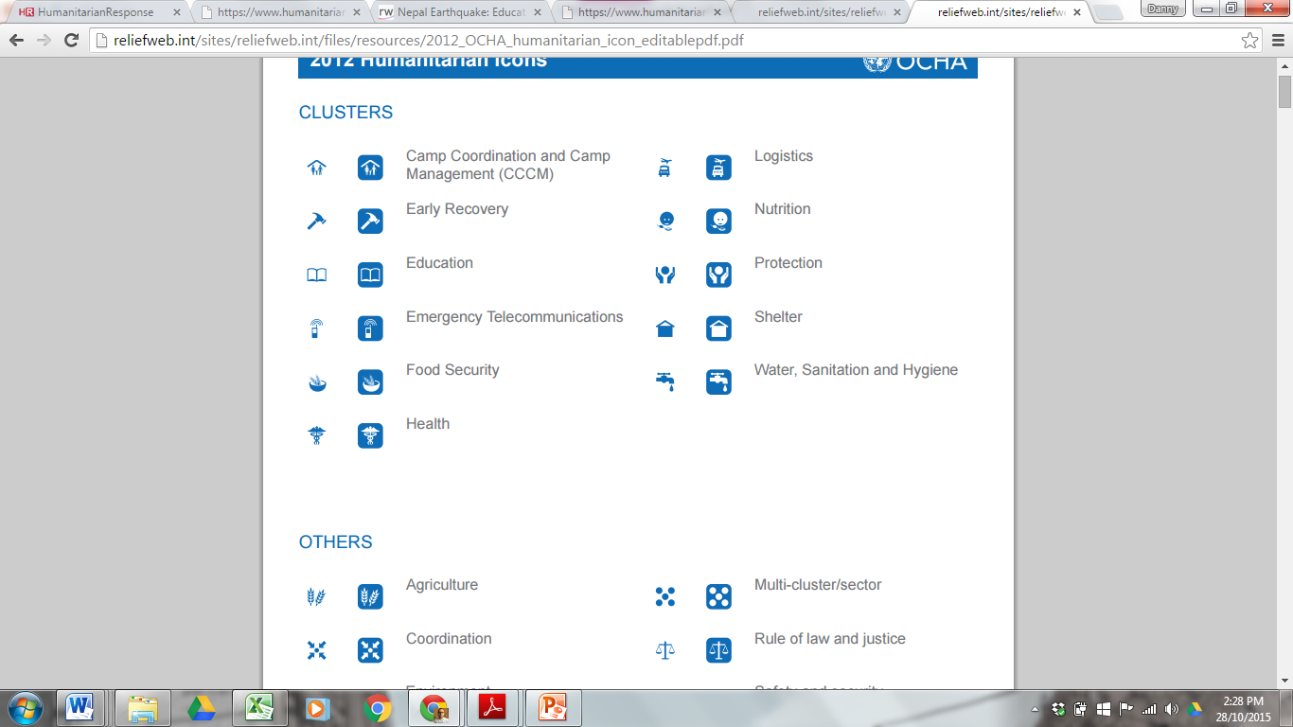
HNO Structure
Part I: Summary
Humanitarian needs and key figures
Impact of the crisis
Breakdown of People in Need
Severity of need
Part II: Needs overviews by sector
Needs overviews by sector
Information gaps and assessment planning

Slide 7
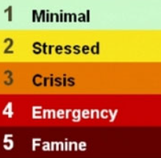
Inter-Sectoral Analysis
Nutrition Causal Analysis (NCA):
Prevalence and severity of wasting and/or stunting
Prevalence of key risk factors for under-nutrition
Causal “pathways of under-nutrition”
Changes over time
Links from causal pathways to under-nutrition
Recommendations
Integrated Phase Classification (IPC):
IPC Acute Food Insecurity
IPC Acute Food Insecurity and Acute Malnutrition

Slide 8
Exercise: Roles and Responsibilities of the Sub-national Cluster in Needs Assessment and Analysis
Group | Discussion Questions
Group 1: | Discuss the role of the sub-national Cluster and Cluster Coordinator in Needs Assessment
Group 2: | Discuss how the sub-national Cluster can work with Health, WASH and FSAC clusters in Needs Assessment
Group 3: | Discuss the role of the sub-national cluster and Cluster Coordinator in Needs Analysis
Group 4: | Discuss how the sub-national Cluster can work with Health, WASH and FSAC clusters in Needs Analysis
Notes:
3.1 - Assessments.ppt
8

Slide 9
Roles and Responsibilities of the NC in Assessment & Analysis
Cluster Partners
Develop a common approach
Collect and share data
Support joint approaches to primary data collection
Carry out a joint analysis
Ensure affected people’s views are collected
Ensure cross-cutting issues are included in analysis
Contribute to MIRA and HNO
Regularly review and update situational and needs analysis
NCC (and IM) should:
Coordinate and facilitate the role of partners in assessments
Consolidate assessment data and present analysis through IM tools
Share and integrate nutritional assessment results with partners, OCHA and CLA
Contribute NC inputs into PDNA, MIRA, HNO, etc.
Facilitate discussions around results and intervention strategies

Slide 10
Assessment/Analysis & AAP
ALWAYS opportunities to engage with affected communities in the assessment process, regardless of the crisis type
In the early stages of a crisis, it may be difficult to organise and get access to affected communities, so clusters may have to rely on partial information from:
  Key informant interviews – local experts, community leaders, community members
  Community meetings, focus group sessions, HH or KAPS surveys
  Direct observation in the field
Over time, clusters should attempt to improve the quality of assessments through more thorough engagement with communities
Also consider ways to check and validate the results of assessments – do they match the expressed needs and priorities of different groups of the population?
Use joint approaches whenever possible to avoid burdens on communities

Slide 11
Key Messages
Needs Assessments and Analysis are a critical foundation for cluster response, planning, delivering and monitoring of the context.
The assessment framework helps to define information needs, timing, methodologies, tools.
The NCC needs to facilitate the process and promote joint approaches to data collection and analysis
This helps increase efficiency and improve quality of the analysis.
Engagement with communities can help improve the quality and validity of assessment findings.

