Slide 1
2.3 Consensus Building and Conflict Management
Notes:
First – the facilitators ask 4 people to volunteer being today’s EYES (2 persons) and EARS (2 persons). They will be asked to observe and listen to the day’s events and give feedback at the end of the day for the EVALUATION.

Slide 2

Objectives of the Session
By the end of the session, participants will be able to:
List six decision-making methods and when to use them.
Describe how to build consensus in the context of cluster coordination.
Identify common causes of conflict.
To list key tips for resolving conflict and handling impasse.

Slide 3

Decision Making Methods
Voting
Delegate
Consultation
Negotiation
www.workingatmcmaster.ca
Unilateral
Consensus
Notes:
UNILATERAL – use when needed very quickly; expert; not important enough for time to be spent…
DELEGATE- when doesn’t need everyone’s buy in and there are experts who others trust the decision of
VOTING – can be quick and involves all but limitations include: clarity on rules, what will happen if the outcome is not clear. Not useful if the outcome could be bad for response/beneficiaries.
CONSENSUS – Useful when we need buy in from all relevant stakeholders; when solutions to ta problem are not obvious; when you want to build relationships; when you want to better understand the reasons behind people’s positions and what would help them change their minds; when you want to generate ideas and options. DO NOT USE when solutions are obvious; when there is little available time for the decision; if the issue at had is very technical; if the outcome means humanitarian standards are compromised; other options are more effective or give a clearer outcome; decision-makers not at the table. Remember consensus is a process not black and white and there are steps within it. It can be time consuming.

Slide 4
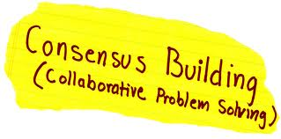
What is Consensus?
Maximum agreement among people while drawing on as much of everyone’s ideas as possible.
Notes:
Discussion on implications and handed out Building Consensus Scale

Slide 5
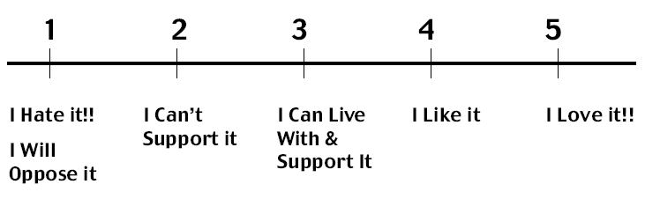
Building Consensus
Suggest proposal and ask: “Where are you on the scale?”
“What keeps you from choosing a higher number?
Notes:
Decision making skills:
Consensus building processes use different skills and activities. You can by using:
“polling” – take pulse of the group on an issue. Reflects a temporary attitude to an issue, rather than a decisive position. – shows strength of support or opposition for an idea. Not used to end discussion but to clarify communication and focus further discussion. It can be a good start.
Methods:
Thumbs up, Thumbs down, Level Hand (ok with others deciding)
Five fingers and a fist (5=strong support, 1=willing to live with it, fist=blocks the idea)
Line up on floor and persuade person next to you to move up
Be able to use different decision making styles as appropriate and recognize their benefits/costs and best use in cluster approach
Acknowledgement and value seen in alternative decision making options not depending on full consensual agreement (see next slide)
Those who disagree must be encouraged to put an alternative proposal forward
Critics of blocking is that it is “tyranny of one”. However, without allowing it, decisions which are passed by majority, are later resisted or undermined by subversive behaviors.
BEFORE THE NEXT SLIDE THE FACILITATORS WILL STATE THAT HE/SHE HAS FORGOTTEN TO TELL THE GROUP THIS MORNING THAT BECAUSE OF LOGISTCAL REASONS THE TRAINING WILL START FROM TOMORROW ONWARDS AT 7.30.
MOST LIKELY THIS WILL PROVOKE SOME CRITICISM. THIS CAN BE USED AS AN INTRODUCTION FOR THE NEXT SLIDE ON HOW WE TAKE DECISIONS.
From tomorrow onwards we will start the training at 7.30
You can move to another area and practice using the scale with some simple problems.

Slide 6

Why is Consensus Important for Cluster Coordinators?
No line authority (mutual accountabilities)
To facilitate inclusive process
Obtain participation and buy-in from stakeholders
Creative solutions
Notes:
One challenge you have as a cluster/sector lead is to encourage participation in the cluster and ownership of the decisions and responsibility / accountability for the action required. Consensus building is one process for encouraging participation and ownership.
Terms in italics are directly out of the Cluster Guidelines.
Cluster members are “equal partners” - you do not have line authority over them – SO YOU HAVE LITTLE CHOICE BUT TO LEAD IN THIS WAY.
C/S leads are to “facilitate a process” involving all humanitarian actors in a collaborative and inclusive way focused on areas of common interest.
CB process uncovers common interests
“Buy-in” b/c decision-making process will be perceived as fair – YOU CAN’T DO IT ALL AS C/S LEAD. 99 % of the cluster work gets done by the cluster members – or NOT. You must get buy in of the most important partners/members.
Creative solutions: But consensus is more than just a compromise. It is a process that can result in surprising and creative solutions - often better than the original suggestions.
A central element of the humanitarian reform process is the need to strengthen strategic
partnerships between NGOs, international organizations, the International Red Cross and
Red Crescent Movement and UN agencies. Indeed, successful application of the cluster
approach will depend on all humanitarian actors working as equal partners in all aspects
of the humanitarian response: from assessment, analysis and planning to implementation,
resource mobilization and evaluation.
Give example from DRC – where UNICEF was appreciated for facilitative style
When members of small groups have the opportunity to express their opinions, they are more likely to feel the decision-making process is fair. And they are more likely to support ultimate decisions made by leaders or authorities
Successful application of the cluster approach will depend on all humanitarian actors working as equal partners in all aspects of the humanitarian response
It is essential that sectoral groups find non-bureaucratic ways of involving all humanitarian actors in a collaborative and inclusive process focused on areas of common interest.
Sector leads should ensure, however, that all humanitarian actors are given the opportunity to fully and equally participate in setting the direction, strategies, and activities of the sectoral group.
(from TOR) Secure commitments from humanitarian partners in responding to needs and filling gaps, ensuring an appropriate distribution of responsibilities within the sectoral group, with clearly defined focal points for specific issues where necessary;

Slide 7
Consensus Building Requirements
Time
Willingness to contribute
Openness and honesty
Willingness to confront and resolve conflicts and differences of opinion
No right answers
Facilitation skills.
Notes:
Builds on leadership skills; meetings skills and facilitation skills

Slide 8
Facilitating Consensus
Listen
Limit own ideas
Link others’ ideas
Encourage reactions
Ask questions
Check understanding
Summarise regularly
Balance contributions
Notes:
Discuss:
How might this be useful to you?
What particularly are you going to try out in meetings today?

Slide 9
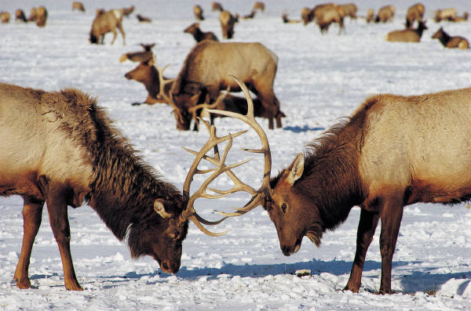
Conflict Management
Notes:
What is it and how to deal with it?

Slide 10
Causes of Conflict
Power
Unequal access to resources, status and position
Strategy
Lack of agreement on objectives, best strategies
Structures and Systems
Access to Information
Cultural difference
Personalities
Lack of shared values and beliefs, lack of cultural sensitivity and awareness
Individual's’ communication styles, personalities and skills
Unequal access to information or conflicting data and analysis
Structures and systems that don’t facilitate collaboration
-
Notes:
Need to be aware of the causes – and identify which are within your control but need to be managed to minimise the impact.

Slide 11
Constructive Outcomes of Conflict
Awareness of problems
Encourages change
Better decisions
Creativity
Energises
Heightens interest
Cohesiveness
Clears air
Understand yourself better
Notes:
Disagreement/Conflict is not ‘bad’ so focus on the positive benefits of conflict.
Ask for examples from the participants, then reinforce

Slide 12
Tips for Resolving Conflict
Check agreement
Invite suggestions
Listen to each point of view
Focus on core problem
Identify causes
Tackle early
Recognise symptoms
Notes:
Use one of the main ideas of common causes of conflict generated in the group work before as an example – try to resolve!

Slide 13
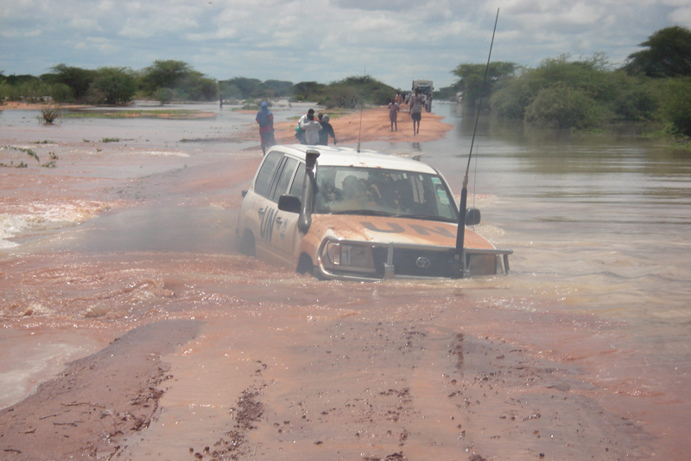
If you’re stuck….
Notes:
draw out their feedback and capture tips.

Slide 14
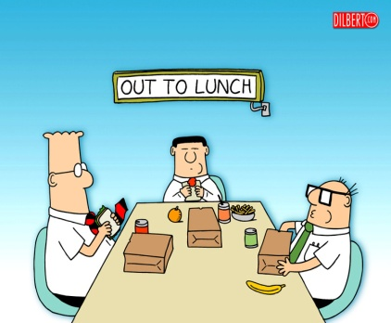
Dealing with Impasse
Mix up small groups = new dynamic
Use small groups, then meet reps.
Summarise agreement and disagreements
Ask for suggestions
Take a break
Meet separately with primary disputants
Bring disputing parties together
Remind all of humanitarian consequences
Notes:
When facilitating consensus building, an impasse may be reached. Either there is stark disagreement over the problem analysis, the cluster priorities or the solution proposed. Impasse occurs when the key stakeholders are unable to perceive effective solutions to their dispute or differences. People feel stuck, frustrated, angry, and disillusioned – all are ready to withdraw. As a result, they might either dig their heels in deeper, anchoring themselves in extreme and rigid positions, or they might decide to "take their marbles and go home," withdrawing from the cluster or sector group. Either way, impasse represents a turning point in our efforts to negotiate a solution to the conflict. As such, rather than avoiding or dreading it, impasse should be viewed with calm, patience, and respect. Know that you are near a “breakthrough”
“Polling” – where do people stand?
Sumamrize areas of agreement and disagreement
Take a break – diffuse tensions – withdraw temporarily but schedule follow up (physiology of anger and stress – hormones and chemicals blocks our ability to see solutions, to listen to the other party, etc. Taking a “time out” helps get rid of these to start afresh). Take a structured break...or CAUCUS (as appropriate). Be sure people go to the break with "homework" to do.
Caucus with primary disputants during the break – Ask them, “ What could be changed so that you can support it ?”
Bring disputing parties together – during break - facilitate conflict resolution and problem solving. Ask the parties for a way to break the impasse. Brainstorm about a way.
Get more information or facts
Build consensus in mixed small groups, then send representatives to cluster steering group
Mix up the small groups = new dynamics
Ask for suggestions, help from others – ask the disputants : How do you suggest we proceed? Brainstorm ways to break the impasse. Or propose a way forward by using a question? I believe we want to move forward, but we seem to be stuck - . How about if we take a break and in 10 minutes I caucus with John and Ali.” or “We seem to be stuck, there are a lot of viewpoints out there, (ask people to stand next to their viewpoint), then ask each group to appoint one representative to caucus with facilitator and others to work on a solution [small group easier than large group] – promise to report back to the larger group.
Remind all of humanitarian consequences – alternative to an agreement must be worse than the effort to reach agreement. Focus on how agreement will benefit the populations you are all there to serve. Also remind them that the longer-term relationship and cooperation is at stake.
Set a time limit – and then suggest that after 2 hours, you will put it to a majority vote.

Slide 15
Tips
Have clear goals
Allow time
Be calm and respectful
Use collaborative skills
  active listening
  questions
  communicate openly
Identify ‘agreements’
Break into smaller groups
Involve all
Be willing to confront and resolve.
Notes:
Discuss:
How might this be useful to you?
What particularly are you going to try out in meetings?

Slide 16

Key Messages
Consensus building is a key decision-making method in the coordination context
Achieving maximum agreement amongst a diverse set of stakeholders takes effective facilitation and active listening skills
Conflict is not always a bad thing, but coordinators need to tackle it early.
Focusing on the needs, rights and perspectives of affected people can be a good guide to finding appropriate solutions to conflict.

