Slide 1
2.2 Inter-Cluster Coordination

Slide 2
Objectives of the Session
By the end of this session, participants will be able to:
Explain the role of the NCC and cluster partners in the formulation of an effective inter-cluster coordinated response
Identify ways to proactively engage with and involve other clusters in operational work
List the seven cross-cutting issues and link them to inter-cluster coordination possibilities.

Slide 3
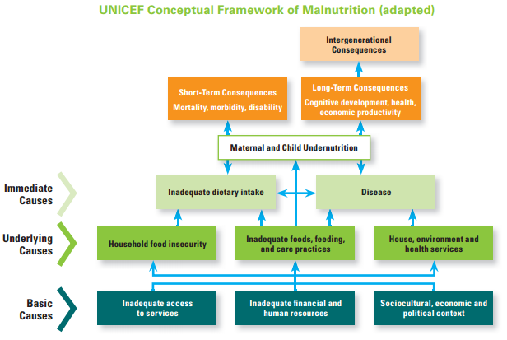
Why working with other clusters is important?
Notes:
Introduce the Conceptual Framework for Malnutrition as an example of the importance or and an approach to, inter-sectoral response and how different sectors contribute to nutrition as an outcome.
The facilitator can refer to the case study where there will be an exercise on integration of cross-cutting issues
What are the links between nutrition an other sectors.

Slide 4
Group Work:
Inter-cluster Coordination
Why is inter-cluster coordination important to the sub-national cluster/sector?
What are some examples of how nutrition cluster/sector can better work with other clusters/sectors?
WASH and Nutrition
Health and Nutrition
Food Security and Nutrition
Protection and Nutrition

Slide 5
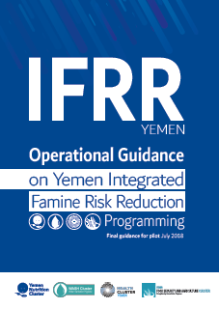
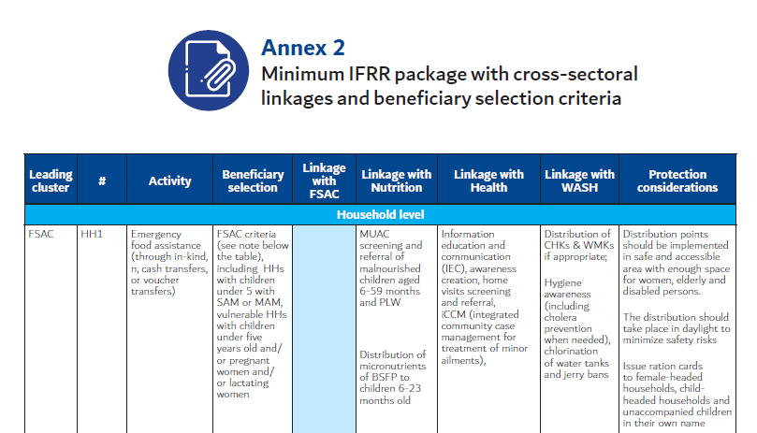
Integrated Famine Risk Reduction Package
Operational Guidance on Yemen IFRR Programming

Slide 6
Cross-cutting issues
Can you name the 7 cross-cutting themes?
Age
Gender
Environment
Early recovery
HIV/AIDS
Disability
Disaster Risk Reduction (DRR)
Cross-cutting themes are an excellent way to operationally link with other clusters!!
Notes:
The facilitator can refer to the case study where there will be an exercise on integration of cross-cutting issues

Slide 7
Centrality of Protection
The IASC Principals committed to ensuring the centrality of protection in all aspects of humanitarian action:
identifying who is at risk, how and why at the very outset of a crisis;
taking into account the specific vulnerabilities that underlie these risks
developing and implementing a comprehensive protection strategy to address these risks;
In all undertakings, primary consideration will be given to our accountability to affected populations, to identify, understand and support their own protection measures.
Notes:
The facilitator can refer to the case study where there will be an exercise on integration of cross-cutting issues
, including those experienced by men, women, girls and boys, and groups such as internally displaced persons, older persons, persons with disabilities, and persons belonging to sexual and other minorities;

Slide 8
Challenges to integrating cross cutting issues
Often considered as “optional” and not a priority in responses
Can be seen as requiring specialised technical expertise to integrate into programming
Competing definitions and approaches can create confusion and fatigue
Notes:
The facilitator can refer to the case study where there will be an exercise on integration of cross-cutting issues

Slide 9
Why are they important?
From a people-centred perspective, considering these issues is essential to achieving better results and protecting rights of affected people.
It also helps ensure the connectedness between humanitarian and development programming, and can contribute to greater resilience.
Notes:
The facilitator can refer to the case study where there will be an exercise on integration of cross-cutting issues

Slide 10
Tips for Inter-cluster Coordination
Draw support
from OCHA
Use matrices to identify
overlap/gaps
Be
Proactive!!
Advocate for
Nutrition
Share information
Be prepared to compromise
Encourage attendance
of other clusters in NNC meetings
Build relationships
outside meetings
Keep the focus on affected people’s protection and assistance needs
Notes:
- Ensure regularity and joint decision-making
Understand role of cluster leads, chairs & co-chairs: Demand lead agency and HC support and engagement - Coordination requires Cluster leads to be pro active and not wait for HC/RC to direct them.
Advocate for support (from HC/RC and OCHA) but also support their roles!
Be willing to compromise (a little!) in inter-cluster prioritisation of resources
Encourage attendance at other cluster meetings
Regular Bilateral connections between cluster leads are required in addition to cluster leads meetings – do you (or your cluster members) need to be attending other cluster meetings??
Identify areas of potential overlap/gaps: Awareness of and identification of areas of potential overlap/gap with other clusters is necessary to deal with issues through the cluster rather than on crisis management basis. To support this Matrices have been developed with other key clusters e.g. Nutrition
Share information
Share strategies, plans, and initiatives as widely as possible
Spend time on strategic and contingency planning (it may feel like a waste of time but it is critical to the response)
Contribute to inter-cluster IM (3W, sitreps, mapping) – it’s in everyone’s interest
Be proactive
REMEMBER: Your internal cluster activities will be much more effective if the inter-cluster environment is robust and effective!
Ensure common messaging to donors on priority needs and response plans
Speak with a common voice to govt, NSAs, military, and other entities

Slide 11
Key Messages
Other clusters’ activities can operationally interlink with the work of the NC, particularly WASH, Food Security and Health – look for integration!
Protection and cross-cutting issues, such as gender, age, disability, HIV/AIDS and Early Recovery should be looked at in every cluster
Use inter-cluster mechanisms as an opportunity to regularly discuss how to engage with and respond to feedback from affected people
Notes:
Complement for feedback suggestions from Handbook chapter 2.2.4. Table 2.8 might be helpful also

