Slide 1
1.6 Soft Skills for Coordination

Slide 2
Objectives of the Session
By the end of the session, participants will be able to:
Identify common cluster coordination meeting challenges
Identify tips and tools for improving coordination meeting management and facilitation
Describe actions to take before, during and after cluster meetings to ensure their effectiveness
List three alternatives to meetings and when it would be appropriate to use them
Describe how to build consensus in the context of cluster coordination.
To list key tips for resolving conflict and handling impasse.

Slide 3
Challenges
Participation in clusters has come to mean
attending (often poorly managed) meetings
But meetings should be thought of as a
part of a process…
That leads to more and better outcomes for
affected people

Slide 4
Group work: Key tips for effective and participatory meetings
Group 1
BEFORE:
Group 2
DURING:
Group 4
Alternatives to meetings and when to use
Group 3
AFTER:
Key actions
Key actions
Facilitation Skills
Key actions
Notes:
Use guidance from NCC Handbook Chapter

Slide 5
Before: Preparation
Why: Clear objectives
What: Clear agenda
Who: Right people? Anticipate issues?
Where: Choice? Layout? Seating?
When: Best time? Enough time?
How: Engage all? Translation? Clarify?

Slide 6
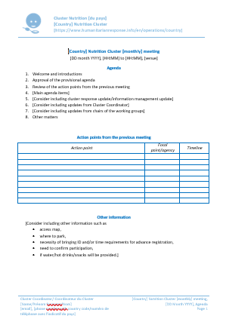
Meeting Management Resources GNC IM Toolkit
Meeting Agenda Template
Notes:
Show them on the internet if possible: http://nutritioncluster.net/topics/im-toolkit-admin/

Slide 7
During: Creating a Positive Start
The beginning of each meeting needs to:
Relax and reassure
Set the tone
Important to build trust!
Encourage involvement
Focus attention on purpose

Slide 8
During: An Effective Facilitator
Task
Keeps to agenda
Maintains focus
Process
Listens and observes
Resolves conflict
Establishes common ground
Records decisions
Remains neutral
Manages pace
Encourages all
Uses tact and diplomacy
Notes:
You can encourage participating DURING a meeting with effective facilitation. – go through the role and importance of balancing both TASK and PROCESS. See NCC Handbook 2.2.4 for more information.

Slide 9
After the Meeting
Also: Remember to share any important issues or decisions with the national cluster or OCHA
Clear action notes on minutes
Who, what, when
Effective follow up
Actions, non-attendees
Share minutes appropriately and quickly
Debrief meeting process
Collate attendance sheets
Notes:
Facilitator could hand out an example of the template for the NC meeting minutes from the IM toolkit.
Publish meeting minutes
Begin by publishing your minutes and action plan within 24 hours. People will most effectively contribute to results if they get started on action items right away. They still have a fresh memory of the meeting, the discussion and the rationale for the chosen direction. They remain enthusiastic and ready to get started. A delay in the distribution of minutes will hurt your results since most people wait for the minutes to arrive before they begin to tackle their commitments.
Effective Meeting Follow-up
Respecting and observing deadlines and follow-up will help you achieve results from your meetings. The deadline was established during the meeting. Following the meeting, each person with an action item should also make a plan for their personal accomplishment of their commitment. Whether they write the steps in their planner, delegate the tasks to another staff person, or just complete the task, the individual is responsible for follow-up.
So is the meeting planner. You can improve meeting results by following up with each person who has an action item mid-way between meetings. Your goal is to check progress and ensure that tasks are underway. Remember that what you ask about gets accomplished.
Accountability for Follow-up during the Next Meeting
Have you ever sat in a follow-up meeting that consisted of each participant telling the group why they were unable to accomplish their commitment? I have, and the result is deplorable. Establishing the norm or custom of accountability for results begins early in your meeting cycle.
Follow-up by the facilitator mid-way between meetings helps, but the group must make failure to keep commitments unacceptable. Report on progress and outcomes at the next meeting and expect that all will have been accomplished. Alternatively, check progress at the next meeting and if there is a real roadblock to progress, determine how to proceed.
Debrief the Meeting Process for Continuous Improvement
The practice of debriefing each meeting is a powerful tool for continuous improvement. Participants take turns discussing what was effective or ineffective about the current meeting process. They also discuss the progress they feel the group is making on the topic of the meeting.
Taking continuous improvement to another level, successful teams debrief their entire project as well as the process to determine how effectively they managed to create results. Future meetings reflect the evaluation. Meetings evolve as an even more effective tool for creating organization results.

Slide 10
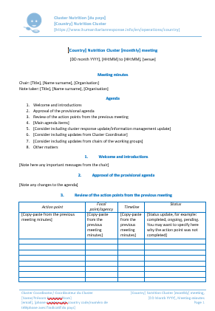
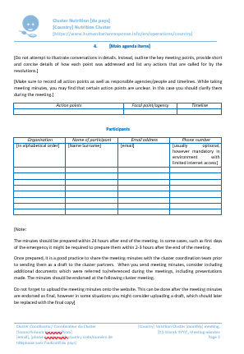
Meeting Management Resources GNC IM Toolkit
Meeting Minutes Template
Notes:
Show them on the internet if possible: http://nutritioncluster.net/topics/im-toolkit-admin/

Slide 11
Alternatives to Meeting?
Nowhere is it written that you have to hold meetings!

Slide 12
Possible Alternative
Circulation of written memos/reports
Email messages
Phone calls
Instant messaging
Teleconferencing/videoconferencing
Questionnaires/surveys
(Joint) field visits
Online options, e.g. Google Groups, Nutrition Cluster website
Social gathering and/or networking
Others?

Slide 13
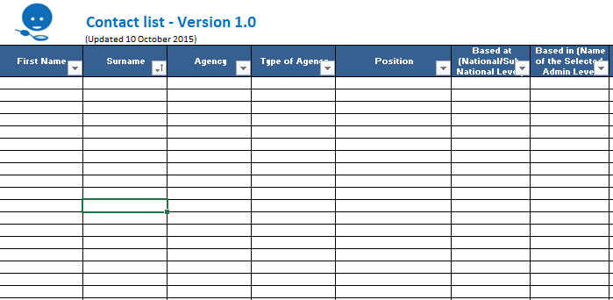
Meeting Management Resources GNC IM Toolkit
A contact list helps all cluster members stay connected
Store it on-line so it can be updated and available to all!
Notes:
Show them on the internet if possible: http://nutritioncluster.net/topics/im-toolkit-admin/

Slide 14
Key Messages
A meeting is only part of the Cluster coordination process.
Preparing for, conducting, and wrapping up after a meeting are equally important.
Effective facilitation is a key coordination skill.
There are numerous alternatives for meetings.

Slide 15
Consensus Building Requirements
Time
Willingness to contribute
Openness and honesty
Willingness to confront and resolve conflicts and differences of opinion
No right answers
Facilitation skills.
Notes:
Builds on leadership skills; meetings skills and facilitation skills

Slide 16
Facilitating Consensus
Listen
Limit own ideas
Link others’ ideas
Encourage reactions
Ask questions
Check understanding
Summarise regularly
Balance contributions
Notes:
Discuss:
How might this be useful to you?
What particularly are you going to try out in meetings today?

Slide 17
Causes of Conflict
Power
Unequal access to resources, status and position
Strategy
Lack of agreement on objectives, best strategies
Structures and Systems
Access to Information
Cultural difference
Personalities
Lack of shared values and beliefs, lack of cultural sensitivity and awareness
Individual's’ communication styles, personalities and skills
Unequal access to information or conflicting data and analysis
Structures and systems that don’t facilitate collaboration
-
Notes:
Need to be aware of the causes – and identify which are within your control but need to be managed to minimise the impact.

Slide 18
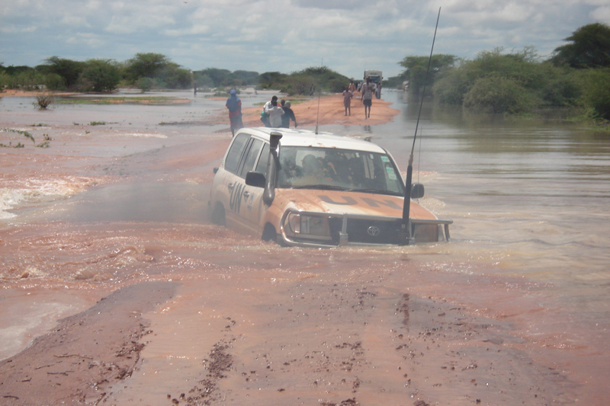
If you’re stuck….
Notes:
draw out their feedback and capture tips.

Slide 19
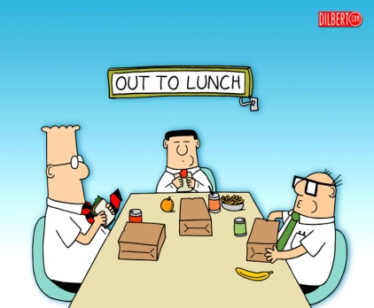
Dealing with Impasse
Mix up small groups = new dynamic
Use small groups, then meet reps.
Summarise agreement and disagreements
Ask for suggestions
Take a break
Meet separately with primary disputants
Bring disputing parties together
Remind all of humanitarian consequences
Notes:
When facilitating consensus building, an impasse may be reached. Either there is stark disagreement over the problem analysis, the cluster priorities or the solution proposed. Impasse occurs when the key stakeholders are unable to perceive effective solutions to their dispute or differences. People feel stuck, frustrated, angry, and disillusioned – all are ready to withdraw. As a result, they might either dig their heels in deeper, anchoring themselves in extreme and rigid positions, or they might decide to "take their marbles and go home," withdrawing from the cluster or sector group. Either way, impasse represents a turning point in our efforts to negotiate a solution to the conflict. As such, rather than avoiding or dreading it, impasse should be viewed with calm, patience, and respect. Know that you are near a “breakthrough”
“Polling” – where do people stand?
Sumamrize areas of agreement and disagreement
Take a break – diffuse tensions – withdraw temporarily but schedule follow up (physiology of anger and stress – hormones and chemicals blocks our ability to see solutions, to listen to the other party, etc. Taking a “time out” helps get rid of these to start afresh). Take a structured break...or CAUCUS (as appropriate). Be sure people go to the break with "homework" to do.
Caucus with primary disputants during the break – Ask them, “ What could be changed so that you can support it ?”
Bring disputing parties together – during break - facilitate conflict resolution and problem solving. Ask the parties for a way to break the impasse. Brainstorm about a way.
Get more information or facts
Build consensus in mixed small groups, then send representatives to cluster steering group
Mix up the small groups = new dynamics
Ask for suggestions, help from others – ask the disputants : How do you suggest we proceed? Brainstorm ways to break the impasse. Or propose a way forward by using a question? I believe we want to move forward, but we seem to be stuck - . How about if we take a break and in 10 minutes I caucus with John and Ali.” or “We seem to be stuck, there are a lot of viewpoints out there, (ask people to stand next to their viewpoint), then ask each group to appoint one representative to caucus with facilitator and others to work on a solution [small group easier than large group] – promise to report back to the larger group.
Remind all of humanitarian consequences – alternative to an agreement must be worse than the effort to reach agreement. Focus on how agreement will benefit the populations you are all there to serve. Also remind them that the longer-term relationship and cooperation is at stake.
Set a time limit – and then suggest that after 2 hours, you will put it to a majority vote.

Slide 20
Key Messages
Consensus building is a key decision-making method in the coordination context.
Achieving maximum agreement amongst a diverse set of stakeholders takes effective facilitation and active listening skills.
Conflict is not always a bad thing, but coordinators need to tackle it early.
Focusing on the needs, rights and perspectives of affected people is a good guide to finding appropriate solutions to conflict.

