Slide 1
1.5 Working Together Effectively: Principles of Partnership and Mutual Accountability

Slide 2
Objectives
Summarize the minimum commitments for participation in the Nutrition Cluster
Explain the origin and meaning of the Principles of Partnership.
Describe how the Principles of Partnership can contribute to more effective coordination and enhanced accountability to affected populations.

Slide 3
Minimum Commitments for Participation
As per the IASC Commitments for Participation in Clusters for Partners (in the Transformative Agenda)
They should be regarded as an absolute minimum and a starting point
They are not set in stone and should be adapted to each country’s context

Slide 4
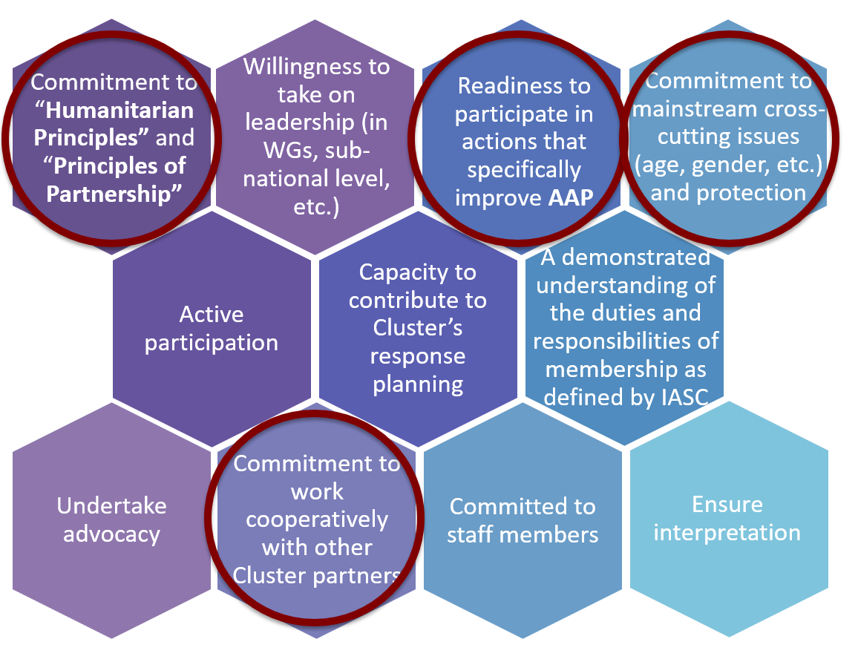
Partner Commitments
Commitment to “Humanitarian Principles” and “Principles of Partnership”
Willingness to take on leadership (in WGs, sub-national level, etc.)
Readiness to participate in actions that specifically improve AAP
Commitment to mainstream cross-cutting issues (age, gender, etc.) and protection
Active participation
Capacity to contribute to Cluster’s response planning
A demonstrated understanding of the duties and responsibilities of membership as defined by IASC
Undertake advocacy
Commitment to work cooperatively with other Cluster partners
Committed to staff members
Ensure interpretation

Slide 5
Principles of Partnership
Complementarity: Build on comparative advantage
Transparency: Communication
Principles of Partnership
Equality: Mutual respect
Results-oriented: Coordinate capability & capacity
Responsibility: Commit only what can be delivered

Slide 6
Exercise: Principles for Peter
Peter is a new Nutrition Cluster member from a small international NGO
Spend 10 minutes preparing to meet Peter and explain the principle to him.
Use simple language and don’t use the name of the principle.
Tell him what the principle means for him and his organization.
Your group member will do the role play with Peter and then others will guess which principle it is.

Slide 7
Key Messages:
The Minimum Commitments help establish common criteria for participation in the cluster and apply to CLA as well!
A commitment to Accountability to Affected People underline the commitments, and can be leveraged to build common approaches to AAP amongst partners
The Principles of Partnership help define the ideal culture for cluster coordination.
These same principles can apply to our relationships with vulnerable and affected communities.
The partner commitments and principles should be reflected in the accountability framework for clusters

