Slide 1
1.3 The Nutrition Cluster Roles and Responsibilities

Slide 2
Objectives of this Session
By the end of this session, participants will be able to:
Describe the Cluster Core Functions with a focus on AAP
Explain how Cluster Core Functions relate to the Nutrition Cluster at the national and sub-national level.

Slide 3
Core Cluster Functions

Slide 4
Core Cluster 6 +1 Functions
AAP
Support service delivery
Inform strategic decision-making
Plan and implement cluster strategies
Monitor and evaluate performance
Build national capacity
Advocacy
Notes:
Rethink the functions and they all lean towards AAP!
All the system does is supposed to support meeting the needs of AP holistically, and clusters need always to put the specific needs in one sector into the broader perspective....

Slide 5
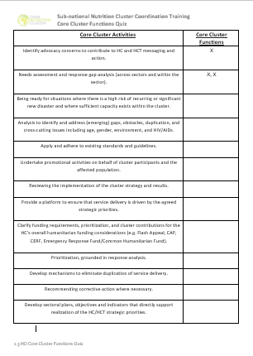
Group Work: Core Cluster Functions Quiz
Complete the Core Cluster Functions Quiz in pairs.
Enter the number of the Core Cluster Function(s) that match the description on your quiz.

Slide 6
1. Support service delivery
Cluster Actions:
Providing a platform that ensures service delivery is driven by the Humanitarian Response Plan and strategic priorities.
Developing mechanisms to eliminate duplication of service delivery.
What does this mean?
Ensure strategic priorities are aligned to meeting affected people’s needs and priorities AND nutrition outcomes.
Mobilise capacities and resources of partners to maximise coverage and minimise gaps.
Regularly assess the context and identify changing needs, gaps and priorities.
Advocate for integration of nutrition into other cluster/sector plans and strategies.

Slide 7
2. Inform HC/HCT’s strategic decision-making
Cluster Actions
Prepare needs assessments and analysis of gaps to inform the setting of priorities.
Identify and find solutions for gaps, obstacles, duplication and cross-cutting issues.
Formulating priorities on the basis of analysis
What does this mean?
Ensure affected people’s needs and priorities AND nutritional needs and cross-cutting issues are included in assessment processes.
Identify existing capacities and resources, good programme practices, and advocate for additional resources to minimise gaps.
Ensure that response priorities address affected people’s needs and intervention strategies are relevant and appropriate to the context.

Slide 8
3. Plan and implement cluster strategies
Cluster Actions
Develop sectoral plans, objectives and indicators to support the overall response’s strategic objectives.
Apply and adhere to common standards and guidelines.
Clarify funding requirements, helping to set priorities, and agreeing cluster contributions to the HC’s overall humanitarian funding proposals.
What does this mean?
Ensure affected people’s needs and nutrition outcomes are reflected in plans, objectives and indicators.
Promote and build capacity of partners to apply relevant nutrition and quality and accountability standards (like the CHS).
Consider ways to monitor and promote technical quality, accountability and support to local capacity building in funding criteria.
Advocate for integration of nutrition criteria and activities into other cluster/sector plans and funding requirements.

Slide 9
4. Monitor and evaluate performance
Cluster Actions
Monitoring and reporting on activities and needs.
Measuring progress against the cluster strategy and agreed results.
Recommending corrective action where necessary
What does this mean?
Promoting joint approaches to monitoring and reporting on quality and accountability, including feedback from communities.
Identifying and regularly discussing gaps, quality, consistency, protection, access, and feedback from local partners and affected people.
Collecting, analysing and consolidating monitoring data, and informing partners, other clusters and HCT.
Inform other clusters, HCT, donors and other actors on major issues and provide regular feedback to partners and communities on how their concerns are being addressed.
Regularly discuss how well the cluster is working in meeting its coordination functions.

Slide 10
5. Build national capacity in preparedness and contingency planning
Cluster Actions
In preparing for and responding to an emergency, international humanitarian actors are expected to cooperate with national authorities and support national capacity wherever it is feasible and appropriate to do so.
What does this mean?
Map local capacities and identify gaps prior to a crisis and as part of needs assessments processes
Encourage partners to share resources, peer-to-peer learning, and other forms of capacity development of local actors.
Regularly consult with local actors on their immediate and long-term needs and priorities
Advocate for funding and support for local partners and actors.

Slide 11
6. Support robust advocacy
Cluster Actions
Identifying concerns, and contributing key information and messages to HC and HCT messaging and action.
Undertaking advocacy on behalf of the cluster, cluster members, and affected people.
What does this mean?
Advocate for support and resources to ensure engagement of affected people in all aspects of the response.
Use monitoring data and information from cluster partners, communities and local actors to identify advocacy issues.
Ensure affected communities views and perspectives are fairly and accurately represented in any advocacy activities.
Advocate within the cluster and at the inter-cluster level on integrating affected people’s concerns into response plans and strategies.
Advocate on behalf of the cluster for integration of nutrition issues at the inter-cluster and HCT level, and with other stakeholders like donors.

Slide 12
+ Accountability to Affected People
Cluster Actions
Mechanisms to consult and involve affected people in decision-making agreed upon and used by partners
Mechanisms to receive, investigate and act upon complaints on the assistance received agreed upon and used by partners
Key issues relating to PSEA have been raised and discussed
What does this mean?
Review and assess cluster partners’ capacities to implement complaints and feedback mechanisms
Promote common approaches to engaging with communities, including joint feedback and complaints mechanisms.
Ensure that all cluster partners are aware of and know procedures for dealing with sensitive issues and complaints, including PSEA.
Promote regular discussions of feedback from affected people and ensure any actions or decisions are shared back to communities.

Slide 13
All this contributes to responses that…
OPTIONAL
Are appropriate and relevant
Are timely and effective
Strengthen local capacities and avoid negative effects
Are based on communication, participation and feedback
Provide safe and accessible complaints and response mechanisms
Are coordinated and complementary
Support continuous learning and improvements
Are delivered by competent staff
Use resources efficiently and effectively

Slide 14
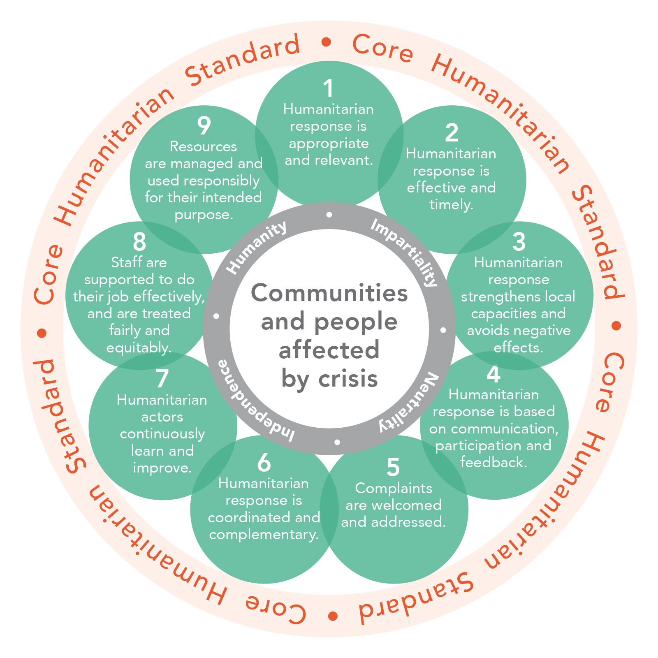
And the CHS commitments

Slide 15
Key Messages:
Cluster Core Functions revolve around supporting better outcomes and accountability to affected people
The core functions help ensure partners align their work towards collective and coordinated approaches
The functions form the basis of how a cluster works together, and include issues beyond implementation

