Slide 1
1.2 The Evolution of Humanitarian Coordination

Slide 2
Objectives of the Session
In this session we will look at:
The role and purpose of coordination and the link to quality, effectiveness and accountability
How humanitarian coordination has evolved over time
Introduction to the Transformative Agenda
Introduction to the Cluster Approach

Slide 3
Why is coordination important?
At your tables, list 2-3 reasons why coordination is important
Write one answer per post-it note
Notes:
Ask the group to put their answers on post-its, collect and group and then feedback core elements and link to the slide with why coordination is important, just covering anything they did not raise themselves.

Slide 4
Some reasons for coordination:
Improve efficiency
Minimize gaps
Increase coverage
Minimize risks
Ensure quality and consistency
Avoid duplication
Share knowledge, resources, capacities
Notes:
A simple answer is: to deliver results to affected communities that are timely and appropriate. The reality is much more. In the past was every organisation doing what they felt was right and often standards were not in place and outcomes for affected populations poor, it was also inefficient and overwhelming for local authorities. Coordination seeks to resolve these problems in service of those in need of assistance.

Slide 5
Evolution of humanitarian coordination
Solferino
Red Cross, IHL
Ethiopia famine
SCHR
World War I
World War II
Darfur,
Indian Ocean Tsunami
Haiti, Pakistan
WHS, Grand Bargain
IFRC, INGOs
UN system
Humanitarian Reform
Transformative Agenda
Notes:
The process of humanitarian evolution has seen significant changes to how we view ourselves and the communities we serve. The Red Cross has been and continues to be at the heart of those decisions including as part of the IASC. Its really only since 2000 that we have viewed ourselves as a collective community willing to work to agreed standards and accountabilities in the service of affected communities. The most recent structural changes and guidance reflect our collective experience that we must work together using sound evidence and common strategies where there is an international response. The future following the WHS and Grand Bargain reinforces this and the need to include communities more effectively in decision making, to build stronger evidence for decisions and to consider all the ways we can to build resilience and sustainability for response, including linking with development actors more effectively.

Slide 6
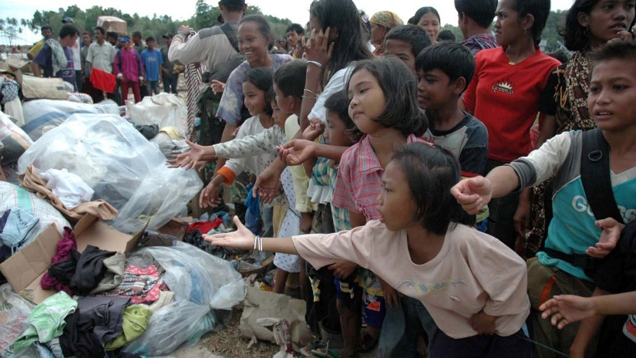
Humanitarian Reform
2005 Humanitarian Response Review first to assess the whole “system” – and found many weaknesses.
Gaps in responses
Inconsistent quality
Poor linkages between UN and non-UN actors
Weak coordination mechanisms
Inconsistent, personality driven leadership
Lack of accountability at all levels
Notes:
In early 2004, responding to what he viewed as a lack of an appropriate and coordinated humanitarian response to the crisis in Darfur, Sudan, then UN Emergency Relief Coordinator commissioned the Humanitarian Response Review. To create “a joint plan of action to improve the effectiveness and timeliness of the humanitarian response to emergencies”. The Humanitarian Response Review (published in 2005) made 36 recommendations for reform at the international level.
The report noted: Gaps in response; Limited linkages between UN and non-UN actors; Coordination erratic and dependent on personalities and overall there was Insufficient Accountability.
The reform outlined three main areas of system-wide change: humanitarian financing, predictability and capacity and leadership. All underpinned by a partnership approach.
From this reform we saw the creation of:
Cluster Approach: to ensure globally there is adequate capacity and predictable leadership in all sectors
Humanitarian Coordinator systems: effective leadership and coordination in humanitarian emergencies
Humanitarian Financing: adequate, timely and flexible financing such as the CERF
Partnership: strong partnership between UN and non-UN actors

Slide 7
Outcomes of Humanitarian Reform
Focus on more predictable, reliable responses
Recognition that “system” is more than the UN, and includes Red Cross/Red Crescent and NGOs (underpinned by partnership)
Humanitarian Coordinator role established
Cluster System developed
New, funding mechanisms established that were faster and more predictable e.g. CERF
Notes:
Builds on the history of the sector attempting to improve performance and address failures of the "system"
Looked for more reliable, predictable responses to major crises
Emphasized that the "system" was more than the UN, and that it needs to build on the different roles and competencies of other actors, including the Red Cross Red Crescent, NGOs and national and local actors
The reform also aimed at strengthening and clarifying mutual accountabilities of actors for results
Humanitarian reform introduced three important concepts that are still used today:
The role of Humanitarian Coordinators - to provide better strategic oversight and accountability for the overall response
The Cluster Approach - to provide more consistent quality and coherence in different programming sectors
Humanitarian Financing - to ensure more timely, flexible and predictable funding for responses (for example, CERF, HRF, CHF, ERF, etc.)
A core outcome was the cluster approach.
The role and purpose of clusters is to provide an integrated, consistent, coherent and coordinate means to address the needs, priorities and rights of affected people.
While the slide shows the HC in the centre, in reality, the whole purpose of the cluster approach is to ensure more timely, predictable, consistent responses and better outcomes for affected people.
Do the short quiz about clusters (T/F) and give a brief overview of what the cluster approach is and what UNICEF leads, highlighting that it is underpinned by partnership. Link this element to the rest of the course structure where they will explore: the what and how of coordination and the inter-personal skills needed to be successful.

Slide 8
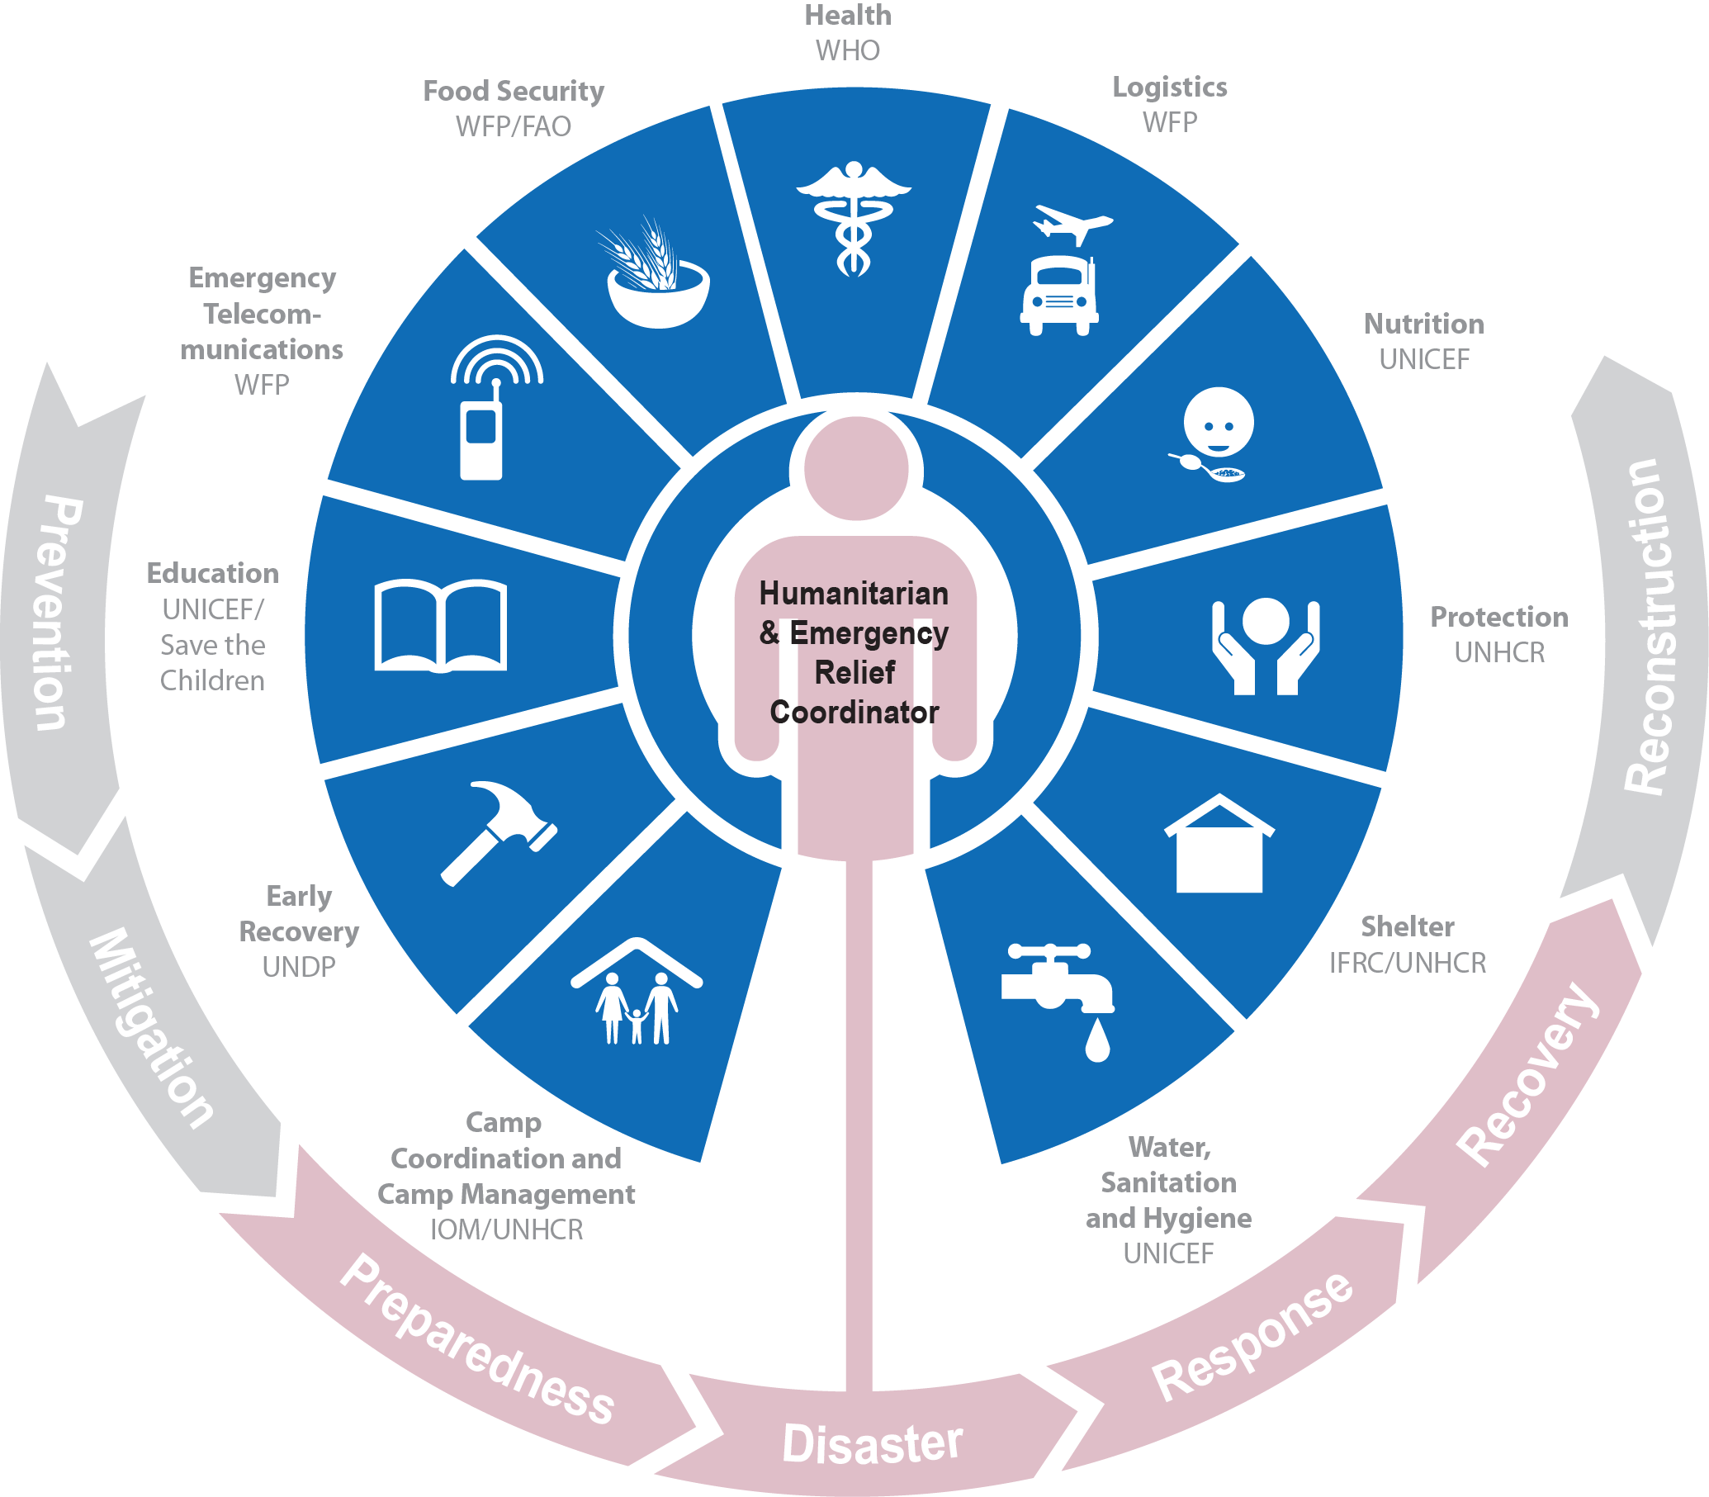
The Cluster Approach
Notes:
The cluster approach was proposed as one way of addressing gaps and strengthening the effectiveness of humanitarian underpinned by a partnership approach. It ensures clear leadership, predictability and mutual accountability in international responses to humanitarian emergencies by clarifying the division of labour among organizations and better defining their roles and responsibilities within the different sectors of the response. It aims to make the international humanitarian community better organised and more accountable and professional, so that it can be a better partner for the affected people, host governments, local authorities, local civil society and resourcing partners.
However, the cluster system relies on an understanding it is not the only humanitarian coordination solution. In some cases, the cluster approach may co-exist with other “non-cluster” coordination modalities – whether national or international – or an alternative sectoral approach may be preferable. An indiscriminate application of all clusters in every emergency may waste resources and reduce opportunities for governments to exercise their primary responsibility to provide humanitarian assistance to people in need. Developing complicated coordination arrangements should be avoided; not all clusters need to be activated in every response.
Clusters are also responsible for mainstreaming cross-cutting issues throughout the sectoral response.
This is a dynamic approach that facilitates joint efforts, It supports the strategy and leadership of the national authority, and fills gaps where needed. It is a flexible approach, providing structure but also recognizing that each emergency is unique and systems must adapt to context.
It is not: It is not an attempt to undermine the government response, but strives to help strengthen government or existing coordination. It is not UN-centric; it depends on the active participation of all humanitarian members, e.g. UN agencies, the Red Cross/Crescent Movement and NGOs…. and of course….. The Government. It is not a “one size fits all” approach; In each emergency it is up to humanitarian actors on the ground, in consultation with relevant national authorities, to determine the priority sectors for the response, how the structures will be led and how the group will work together to meet humanitarian goals.
No matter what modality is put in place, cluster or sector or working group, the logic of coordination remains sound, the rest of this course will focus on how coordination gets done in partnership with all the relevant actors.
What is it?
A dynamic approach that facilitates joint efforts
Supports the strategy and leadership of the national authority and fills gaps where needed
A flexible approach recognizing that each emergency is unique
It is a product of the IASC
What is it not?
It is not an attempt to undermine the government response, but strives to help strengthen government or existing coordination.
It is not UN-centric; it depends on the active participation of all humanitarian members, e.g. UN agencies, the Red Cross/Crescent Movement and NGOs… and of course….. The Government
It is not a “one size fits all” approach; In each emergency it is up to humanitarian actors on the ground, in consultation with relevant government counterparts, to determine the priority sectors for the response.
8

Slide 9
True or False
The NC is a physical structure?
The NC has a legal status?
The NC has programme funding?
The NC is a coordination mechanism?
The NC only has funding for the coordination team?
The NCC represents all members?
The United Nations Secretary General is responsible for all clusters
Notes:
The answers of the game (explained in the ppt) are as follows:
The NC is a physical structure - false
The NC has a legal status - false
The NC has programme funding - false
The NC is a coordination mechanism - true
The NC has only funding for the coordination team – true. It is not a fund for programming.
The NCC represents all members - true
Who is responsible for all clusters, SG - false (ERC) who is currently Mark Lowcock 2017, though the ERC is accountable to the SG.

Slide 10
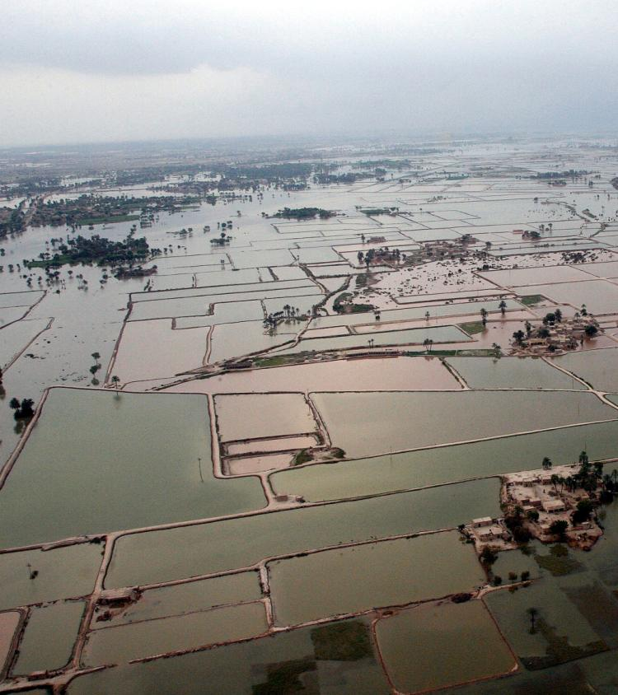
2010
Then a reality check…
Still too many weakness and inefficiencies
Floods in
Pakistan
Earthquakes
In Haiti
UN Photo/Evan Schneider
UN Photo/Logan Abassi
Notes:
The response to the Haiti earthquake and Pakistan floods in 2010 exposed a number of weaknesses and inefficiencies in the international humanitarian response. The Transformative Agenda aims to ensure that these shortcomings are addressed.
The risk of future large-scale emergencies remains high due to the increasing frequency and scale of climate-related disasters; violent conflicts; HIV/AIDS and other communicable diseases and pandemics; rapid population growth and urbanization; and increased vulnerability due to poverty, hunger, unemployment, displacement and migration.
Governments, affected communities, humanitarian organisations, donors and the UN General Assembly itself have stressed the need for a more efficient and well-coordinated international response to major disasters.
The actions we are now taking as part of the Transformative Agenda build on the 2005 Humanitarian Reform. We recognize that we need to focus not on the process of implementing change, but on the impact of change. Through the changes agreed, more lives will be saved, and we will all be more accountable for our actions.

Slide 11
Transformative Agenda
Notes:
Transformative Agenda
Despite the progress that reform build, the experiences of large scale disaster such as Haiti Earthquake and Pakistan Floods highlighted the need for further improvements. “In December 2011, the IASC adopted the Transformative Agenda. Which sought to improve response through: better leadership, improved accountability and improved coordination. This resulted in:
Leadership: Roster of senior leaders to deploy for L3 emergencies, increased role of HCTs to support HCs, greater access and participation of local actors in HCTs, etc.
Key messages:
Leadership is a shared responsibility for all actors, and can and should be exercised at all levels, not just for the HC.
At the same time, the HC and HCT have greater accountability for protecting the rights and generating results for affected people - and should be held to account for the overall response.
Coordination: Greater clarity on roles of clusters and partners, tools to support better cluster management and performance, more inclusive for local and national actors, more emphasis on cross-cluster (or inter-cluster) collaboration
Key messages:
Coordination is a mutual responsibility to achieve more effective outcomes for affected people.
Clusters have a key role in promoting quality assurance (coverage, consistency and coherence), and risk management (minimizing gaps and addressing risks)
Like HCs and HCTs, this is a mutual accountability for protecting the rights and generating results for affected people - to the extent that clusters have control over the delivery of assistance in their sectoral area.
Accountability: Greater emphasis on Accountability to Affected People (AAP), as well as common tools and approaches to improve coherence and consistency, such as Humanitarian Programme Cycle (HPC) and cluster performance management. Also more emphasis on accountability at the level of HC, HCT, clusters, etc.
Key messages:
Accountability is the mutual responsibility of CC, cluster partners, inter-cluster/sector, HC/HCT, donors, etc) to achieve more effective outcomes for affected people while protecting their rights.
While tools and processes can help facilitate this, the most important element is shifting attitudes and behaviours to become more "people-centred" in our ways of working.
Clusters (coordinators and partners) can play an important role in advocating, promoting these ideas and putting them into practice.

Slide 12
Empowered Leadership
Roster of Emergency Coordinators for Level 3 Emergencies
Empowered Leadership
Inter-Agency Rapid Response Mechanism
Leadership Training

Slide 13
Improved Coordination
Strategic Use of Clusters
Simplified Cluster Management
Minimum Commitments for Participation in Clusters
Strengthening NGO Representation in the Humanitarian Country Team

Slide 14
Greater Accountability
Common Humanitarian Programme Cycle to Achieve Collective Results
Assessment, Strategic Statement, Resource Allocation, Implementation, Monitoring, Reporting and Evaluation
Common Performance and Reporting Framework
Accountability to Affected People

Slide 15
Outcomes of the TA
Strengthened country level coordination
Reinforced the Cluster Approach
Introduced new tools and processes
Introduced categorization of crises
Explicit focus on individual and collective accountability to affected people
Reinforced the centrality of protection
Notes:
Notes for the centrality of protection IASC doc. Protection of all persons affected and at risk must inform humanitarian decision-making and response, including engagement with States and non-State parties to conflict. It must be central to our preparedness efforts, as part of immediate and life-saving activities, and throughout the duration of humanitarian response and beyond. In practical terms, this means identifying who is at risk, how and why at the very outset of a crisis and thereafter, taking into account the specific vulnerabilities that underlie these risks, including those experienced by men, women, girls and boys, and groups such as internally displaced persons, older persons, persons with disabilities, and persons belonging to sexual and other minorities. It means that HCs, HCTs and Clusters need to develop and implement a comprehensive protection strategy to address these risks and to prevent and stop the recurrence of violations of international human rights and humanitarian law – a strategy that clearly articulates and identifies the The$Centrality$of$Protection$in$Humanitarian$Action,$Endorsed$by$the$IASC$Principals,$17$December$2013 Inter-Agency Standing Committee (IASC), www.humanitarianinfo.org/iasc 2 complementary roles and responsibilities among humanitarian actors to contribute to protection outcomes; that identifies and makes use of all available tools to effectively protect those affected by humanitarian crises; that takes into account the role and contribution of other relevant actors, such as peacekeeping and political missions and development actors, to achieve protection goals and develop durable solutions. These strategies must be regularly revised to reflect changing circumstances, priorities and needs. Resources commensurate to the realisation of these efforts must be mobilised. It also means that HCs, HCTs and Clusters need to strengthen the collection, management and analysis of information to inform and adjust early warning, preparedness, response, recovery and policy efforts, and support strategic and coordinated advocacy, dialogue and humanitarian negotiations on behalf of persons affected and at risk, and in a manner that addresses the risks they face in conflict, violence and natural disasters. In this regard, the complementary roles, mandates and means of action of all relevant actors need to be recognized and reinforced. In all undertakings, primary consideration will be given to our accountability to affected populations, to identify, understand and support their own protection measures. Different segments of affected populations need to be meaningfully engaged in all decisions and actions that have a direct impact on their well-being. A commitment to support national and local civil society in their important role to enhance the protection of persons affected and at risk is central to this endeavour. At the field level, the responsibility for placing protection at the centre of international humanitarian action rests with Humanitarian Coordinators, Humanitarian Country Teams, and all Cluster Coordinators. Protection Clusters play a crucial role in supporting humanitarian actors to develop protection strategies, including to mainstream protection throughout all sectors and to coordinate specialised protection services for affected populations. But the responsibility is not theirs alone. We, the IASC Principals, recognize our leadership in supporting their efforts in a consistent, principled and impartial manner, including through policy development, dialogue, advocacy, and engagement with States. We commit to provide the necessary support and to work with them and all IASC members to ensure the centrality of protection in humanitarian action.

Slide 16
Other recent developments
SDGs: increased focus on national authorities to define development priorities, manage development
WHS: Putting People at the Centre, new ways of working
Grand Bargain: Participation Revolution, Localization, Humanitarian Funding, Transparency, Cash, Humanitarian-Development Nexus
Alternative coordination mechanisms: national coordination platforms, consortia, private sector actors, hybrid models
Use of technology: facilitating communications, feedback and data collection and analysis
.
Notes:
There is no need to explain in detail, but facilitators can briefly present these new developments, and explain how this may affect clusters' work. These include:
SDGs - increased "sovereignty" of national authorities to define development priorities
World Humanitarian Summit - putting people at the centre
Grand Bargain
Participation Revolution - commitment to greater engagement and participation of affected people in the design and implementation of humanitarian responses
Localization - greater recognition and prioritization of local knowledge, capacities and resources in the management of responses
Humanitarian Financing - moving to multi-year funding
Transparency - greater emphasis on transparency on how and where aid resources are used
Cash - increased use of cash in responses
Humanitarian-development nexus
Facilitators can explain to participants that these trends are already influencing how UNICEF, partners and clusters function in many crises situations.
Also an opportunity to remind participants of alternative coordination mechanisms and approaches
Sector coordination mechanisms
Government-led coordination
Sub-national coordination
Consortia approaches.

Slide 17
Scale-Up Activation (formerly L3 system)
System-wide mobilisation for sudden onset disaster or rapid deterioration of a humanitarian situation
6-month timescale
Issued by the Emergency Relief Coordinator
Empowers IASC members to very quickly:
Establish an HCT and empowered leadership
Deploy coordination capacity
Activate Clusters for priority sectors
Identify Key Strategic Priorities
Conduct a Multi-cluster Initial Rapid Assessment
Activate funding mechanisms (CERF, CBPF)
Notes:
The Scale-Up activation replaces the previous L3 system by seeking to reinforce focused collective and time-bound emergency procedures. Scale-Up activation is time-bound (limited to 6 months) and can only be extended once (for an additional 3 months in exceptional circumstances). The IASC Protocols developed to support humanitarian system-wide emergency response activation, such as empowered leadership of the Humanitarian Coordinator, remain relevant and have been updated and aligned with the Scale-Up activation protocols. Peer reviews and evaluations seek to strengthen the accountability of the system to respond in a timely and effective manner in response to a sudden onset crisis or a rapidly deteriorating humanitarian situation.
Key features [NB: Main new elements are noted in italic for ease of reference]
Definition: The IASC Scale-Up activation is a system-wide mobilization in response to a sudden onset and/or rapidly deteriorating humanitarian situation in a given country, including at the subnational level, where capacity to lead, coordinate and deliver humanitarian assistance does not match the scale, complexity and urgency of the crisis.
Duration: This exceptional measure shall only be applied for a time-bound period of up to six months where the gravity of the humanitarian situation justifies the mobilization of system-wide capacities and resources, beyond standard levels, to respond to critical humanitarian needs on the ground. It can only be extended once -- for an additional 3 months in exceptional circumstances.
Activation: The Scale-Up activation shall be issued by the Emergency Relief Coordinator (ERC), in consultation with the concerned RC/HC and IASC Principals, on the basis of an analysis of the following criteria: scale, complexity, urgency, capacity, and risk of failure to deliver at scale to affected populations.
Implications: The Scale-Up activation commits IASC members to the procedures as laid out below. It does not, however, prejudge or affect the ability of IASC member organizations to decide on activation of their respective emergency mechanisms and procedures, nor the manner in which those would be applied
Immediate, establishment of the HCT, with the current RC re-hatted as HC a.i. pending decision on the most appropriate leadership model;
Designation and deployment of a Humanitarian Coordinator within 72 hours of the onset of the crisis for up to six months, to lead the coordination of the overall humanitarian response, exercising empowered leadership in line with the IASC protocol in this regard. Based on the IASC Principals’ decision this may be one of a number of options including: (a) senior to the RC or HC, (b) Deputy to the RC/HC, or (c) parallel to the RC in-country (as a separate HC). Another alternative which may be considered include the deployment of a Special Envoy. Depending on the agreed leadership model, a Head of Agency in situ may be identified to serve as HC ad interim, pending the identification and deployment of a HC or Deputy from the Humanitarian Coordinators Pool. Agencies shall endeavor to propose and release colleagues suitable for the role, in particular colleagues identified in the Humanitarian Coordinators Pool.
Activation of clusters for priority sectors by the ERC after consultation with the IASC Principals, no later than 72 hours after activation of the Scale-up, based upon request from the RC/HC in consultation with the HCT.
Immediate deployment of appropriate coordination capacity, including qualified Cluster Coordinators and Information Managers as necessary, within 72 hours of the activation, upon decision by the IASC Principals and in consultation with the Global Cluster Lead Agencies;
Within the first 72 hours, the issuance of a ‘Statement of Key Strategic Priorities” by the RC/HC for purposes of common messaging and advocacy from headquarters level and for press releases;
Immediate implementation of the Multi Cluster/Sector Initial Rapid Assessment (or alternative rapid assessment) based upon coordinated assessments, which consists of a Situation Analysis within the first 72 hours followed by a multisector assessment and report within the first two weeks;
Development of a Flash Appeal (by day 5) that is supported by the Situation Analysis and consisting of a top-line analysis of the scope and severity of the crisis and setting out the priority actions and their financial requirements19; Within 4 weeks, the Flash Appeal shall be revised. If a longer response is required (beyond the initial activation period of six months), the HCT should develop or update the Humanitarian Needs Overview (HNO) which consolidates and analyses information on the needs, vulnerabilities and capacities of the affected population, and develop or update a Humanitarian Response Plan (HRP) which communicates the strategy to respond to the assessed needs, and serves as the basis for implementing and monitoring the collective response;
Immediate announcement of Central Emergency Response Fund (CERF) and Country- Based Pooled Fund (CBPF) (if available in country) funds. Allocations to be issued by the ERC (by the HC for CBPFs) within 72 hours of the crisis onset, on a “no regrets” basis, in support of priorities identified in the strategic statement;
Activation of the “empowered leadership” model;
An Operational Peer Review (OPR) no later than five months after the initial activation. The OPR provides the HC and HCT an opportunity to reflect on the direction and performance of the response, its recommendations should inform the Emergency Directors, the RC/HC and HCT at the end of the activation period. The agreed context specific benchmarks should be used as the basis for the review.
An Inter-Agency Humanitarian Evaluation (IAHE) conducted according to the Terms of Reference of IAHE and within 9-12 months of a Scale-Up activation. The IAHE should take into consideration the findings of the OPR.
Work is on-going in the IASC to come up with a separate set of protocols for ‘sustained’ large scale and complex emergencies that would require continuous IASC support.

Slide 18
Putting People at the Centre
It’s about sustainable RESULTS that meet the affected people’s needs priorities and preferences
People at the Centre
RIGHTS
RESULTS
RELATIONSHIPS
It’s about respecting and supporting affected people to exercise their RIGHTS and dignity.
It’s about leveraging our RELATIONSHIPS with partners to address needs and support local capacities and resilience
Notes:
Make the link from the previous discussions on the evolution of humanitarian coordination back to the first exercise: coordination is about generating the best possible results for the greatest number of people in need.
The humanitarian system has constantly evolved in order to be more accountable to the people we intend to assist.
The systems and processes we have developed over time, like the Cluster Approach, are all aimed at improving the way we work, and to put people at the centre.
In this next part of the session, we will introduce some of the key guiding principles and policies that help us to better consider and address the needs, priorities and perspectives of affected people in humanitarian action.

Slide 19
Collective accountability
Evolution of the humanitarian system has been towards greater collective accountability
Shared responsibility to work towards for timely, relevant, appropriate, RESULTS that maximise coverage and minimise gaps.
People at the Centre
RIGHTS
RESULTS
RELATIONSHIPS
Shared responsibility to protect the RIGHTS and dignity of affected people, including the right to access, protection, quality, coordinated responses, participation and two-way communication.
Shared responsibility to promote effective and equitable RELATIONSHIPS between communities, aid provider and local national actors.

Slide 20
Humanitarian Principles
Humanity | Neutrality | Impartiality | Independence
Human suffering must be addressed wherever it is found. The purpose of humanitarian action is to protect life and heath and ensure respect for human beings. | Humanitarian actors must not take sides in hostilities or engage in controversies of a political, racial, religious or idealogical nature. | Humanitarian action must be carried out on the basis on need along, giving priority to the most urgent cases of distress and making no distinctions on the base of nationality, race, gender, religious belief, class or political opinions. | Humanitarian action must be autonomous from the political, economic, military or other objectives that any actor may hold with regard to areas where humanitarian action is being implemented.
Notes:
Briefly remind participants of the importance of being guided by Humanitarian Principles as the foundation for our responses to emergencies – and to coordination.
In particular, the participants can be asked to focus on the principle of impartiality:
What does acting without discrimination mean? Is it appropriate to focus on a single sub-set of the affected population at the expense of others (example, mothers and children?)
What about prioritizing actions based on the most urgent needs?
What does this mean when only parts of the region or population are covered (like those easy to access)?
What about when affected people themselves prioritize other interventions equality with, for example, nutrition interventions?

Slide 21
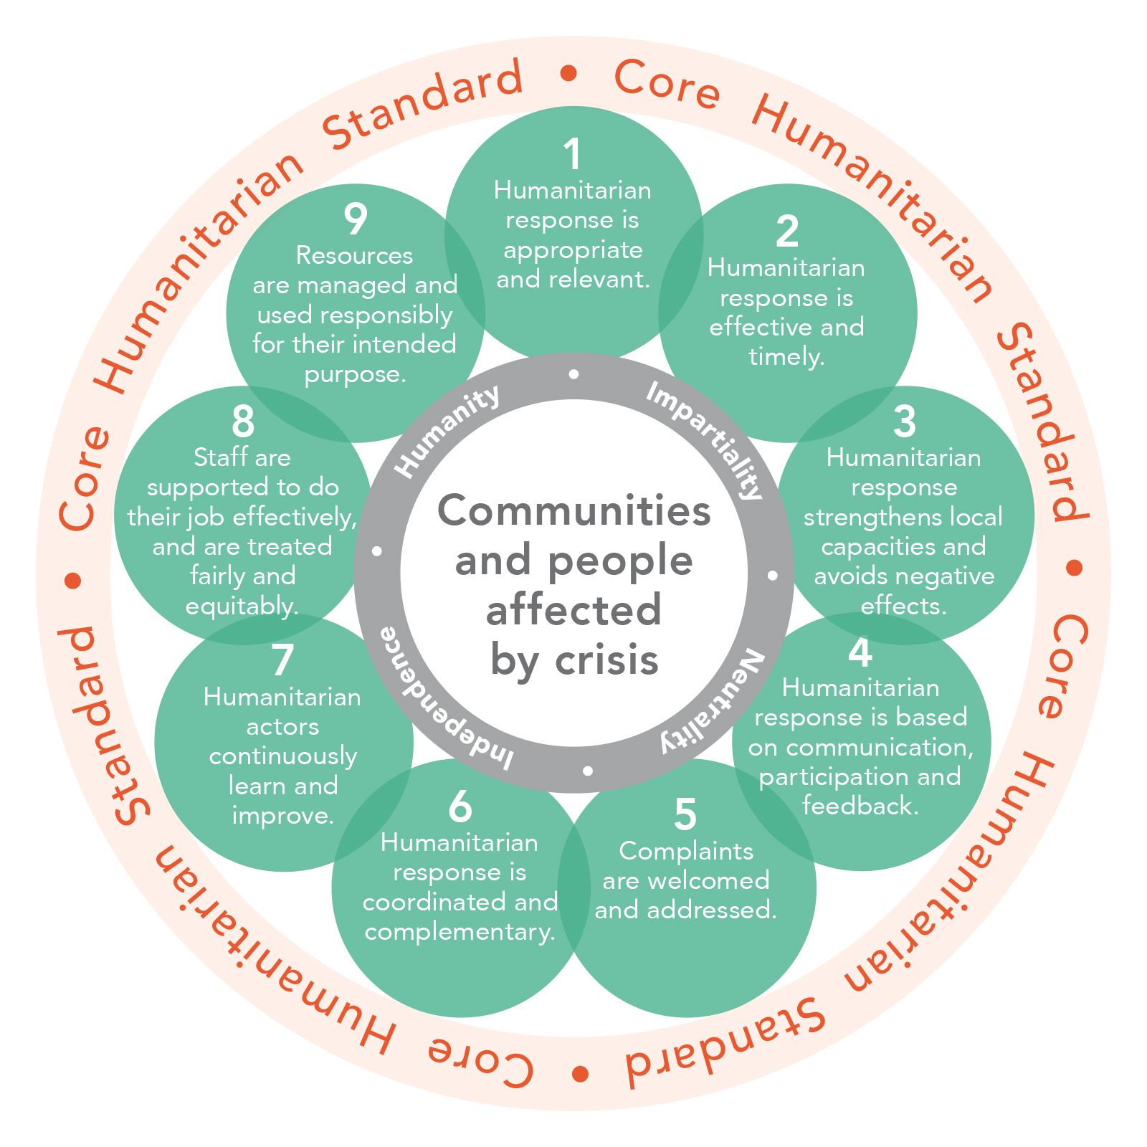
Core Humanitarian Standard for quality and accountability
Launched in 2014 and endorsed by many stakeholders in sector
Provides a common framework to consolidate technical, quality (like Sphere) and accountability standards
Built around 9 Commitments with Key Actions and Organizational Responsibilities
Notes:
Comprised of nine inter-related commitments, with related quality criteria, key performance indicators, key actions and organizational responsibilities.
Many organizations and cluster partners have already adopted the CHS and are now undergoing self-assessment and external verification and certification to show progress.
Clusters agreed to use the CHS as a framework to orient collective quality and accountability
Work is underway to adapt the key actions and indicators for coordination mechanisms and other networks and partnerships.
Present CHS "flower slide" with the nine commitments.
Stress that affected people are at the center
Builds on Humanitarian Principles of Humanity, Impartiality, Neutrality and operational Independence
Integrates and consolidates many existing codes of conduct and standards around quality and accountability (HAP, Sphere, People In Aid, etc.).
Meant to provide a framework for related technical standards.
Developed in wide consultation with stakeholders, including aid providers, governments, donors, and affected communities.
Comprised of nine inter-related commitments, with related quality criteria, key performance indicators, key actions and organizational responsibilities.
Many organizations and cluster partners have already adopted the CHS and are now undergoing self-assessment and external verification and certification to show progress.
Clusters agreed to use the CHS as a framework to orient collective quality and accountability
Work is underway to adapt the key actions and indicators for coordination mechanisms and other networks and partnerships.
Core Humanitarian Standard - the 9 commitments
Remind participants that each of the nine commitments are inter-related: it is very difficult for aid providers to improve in one commitment without also working and improving in others.
Then go through the commitments in groups of three, highlighting what affected people can expect from aid providers.
If time, highlight some of the key actions most relevant to clusters and indicators .
The facilitators can stress that most or all of these actions should be done by individual agencies BUT clusters have a role to ensure coherence, common approaches, and joint actions.
Mention that e-learning courses, trainings, and other resources are available in several languages.
We should include what these are in the session brief to help future facilitators.
lectively articulated how we will implement our commitments to AAP in our work.
Core Humanitarian Standard - the 9 commitments
Remind participants that each of the nine commitments are inter-related: it is very difficult for aid providers to improve in one commitment without also working and improving in others.
Then go through the commitments in groups of three, highlighting what affected people can expect from aid providers.
The facilitators can stress that most or all of these actions should be done by individual agencies BUT clusters have a role to ensure coherence, common approaches, and joint actions.
Mention that e-learning courses, trainings, and other resources are available in several languages.

Slide 22
What?
Humanitarian response is appropriate and relevant
Humanitarian response strengthens local capacities and avoids negative effects
Humanitarian Response is effective and timely
Notes:
CHS framework for quality and accountability consist of 9 Interrelated commitments that consolidate existing technical, accountability and management standards and good practices.
Let’s look at the nine commitments.
Clearly, we have a responsibility to make sure whatever we do (UNICEF does) either through direct programming, through partners, or through our advocacy is appropriate and relevant. The key to this is having a comprehensive understanding of the crisis context, the needs and priorities of vulnerable and affected people, existing culture and social relationships, including gender, as well as other more technical information, such as nutritional status, access to water and sanitation, education, and protection risks. If we don’t do this in a holistic way, there is a huge risk that our interventions will not be relevant or appropriate. And this can have serious consequences for people.
Similarly, we have a responsibility to make sure that our responses are timely and effective at meeting the needs and priorities of affected people. This means we have to monitor and be aware of how needs change over time as the crisis situation changes, and monitoring our responses in order to see if we are actually meeting the needs and priorities of affected people. For example, a nutrition intervention without considering WASH is not likely to be effective. And affected people may have their own perspectives on what aid priorities should be and how effective aid organizations support them on meeting those priorities.
We often talk about the centrality of protection and DO NO HARM. We also recognise the importance of linking relief to rehabilitation and development, or the importance of preparedness, local capacities, and resilience. But if we don’t consider this in the design of interventions, this can lead to situations where people are actually more vulnerable and at risk. And there are many situations where local people have many different capacities, resources and knowledge that can help us avoid these risk, have more effective programmes and more lasting, sustainable outcomes for them.

Slide 23
How?
Humanitarian response is based on communication participation and feedback
Complaints are welcomed and addressed
Humanitarian Response is coordinated and complementary
Notes:
So, if we want timely, relevant, appropriate and effective responses for affected people, and we want to strengthen their capacities and resilience, it means we need to think about how we engage with them.
Commitment Four is around making sure we have mechanisms in place to promote better two-way communications with affected people, and appropriate and equitable ways for them to participate in all phases of programmes. It is also about making sure we have mechanisms to listen to them, collect and analyse their feedback, and use this to help adapt programmes to better meet their needs. And it means closing the feedback loop, informing them about how we have acted on their concerns and suggestions.
Another central commitment is making sure we have good systems in place to register, track and respond to complaints. This is especially important around sensitive issues like sexual exploitation, corruption, or other unethical or illegal behaviour by our staff, partners or in the community. There are many specific responsibilities for UNICEF around this, and many tools to help make sure this is done in a timely, sensitive and appropriate manner.
Coordination is another area where UNICEF has a clear responsibility to make sure responses are coordinated to avoid duplication, gaps in the response, but also to ensure there is consistency in approaches between different actors or in different regions. Thi is about maximising the use of local, national and international resources so that we can best meet ALL the needs and priorities of affected people, not just the sectors or geographic areas where we have programming.

Slide 24
Enablers
Humanitarian actors continuously improve and learn
Resources are managed and used responsibly for their intended purposes
Staff are supported to do their job effectively and are treated fairly and equitably
Notes:
Finally, the CHS includes commitments that help enable us to be more predictable and reliable at meeting affected people’s needs.
Commitment 7 is around continuous learning and improvement. Here it is important to stress the role of field level monitoring the crisis situation, the quality of responses, and the perceptions of people themselves on how useful and relevant assistance is, so we can adapt and adjust responses BEFORE we find out there are problems. It is also important in terms of our preparedness work to learn from past experiences, and integrate this into the design on current interventions. In all cases, it is critical to make sure we are adapting and contextualising to the culture and context where we are working. The experiences and views of affected people can be a critical way to complement and triangulate data from other sources so that we have a good understanding of what works and what doesn’t.
Accountability to affected people begins with individual staff members’ own personal responsibility to act ethically, professionally and responsibly. But if organisations don’t provide the necessary training, support and leadership, it is hard to make AAP part of our organisational culture. This includes our work with partners. This is why its important to integrate AAP into all our capacitiy development and partnership strategies, and make sure the tools and processes are in place to help people do their jobs effectively.
Finally, commitment 9 is around using resources efficiently and responsibly. Normally, we think about this as an obligation to our donors, or for our partners. But it is important to remember that affected people themselves are often concerned about poorly designed, inefficient interviention, duplication and misuse of resources and corruption. Our primary responsibility is to make sure that resource are actually making a difference to affected people, and if we can provide evidence that this is happening, we are also building confidence and trust in the donors that support our work.

Slide 25
IASC Commitments to AAP (CAAP)
Leadership
Participation
Standards
Information & Feedback
Ensure AAP and PSEA are systematically integrated through appropriate incentives and mechanisms.
Support operationalization and mainstreaming of AAP and PSEA in humanitarian response.
Support collective approaches to communication and community engagement.
Regularly monitor, analyse and report on the views of affected people, identify trends from feedback, and share with decision makers.
Ensure communities’ views are reflected in strategic and operational decision-making.
Ensure participatory and inclusive approaches of AAP.
Partner equitably with local actors.
Adapt methods and tools to support engagement and communications.
Uphold key standards like the CHS and relevant technical standards.
Adapt operational frameworks to local contexts.
Notes:
Option: This slide can be used here or at the end of the presentation of functions to use it as a framework to review the action points from a people-centred perspective.
AAP is not only about communicate engagement and complain mechanisms.
If we do not understand the context we cannot understand the best approach can be to support affected people
Finding the consistency in the approach by applying and identify standards.
Present a slide on the REVISED version of the IASC Commitments to AAP
The revised CAAP is based on four elements, with a strong emphasis on collective, coordinated actions, reinforcing the importance of clusters:
Leadership
Put in place appropriate incentives and mechanisms to ensure Accountability to Affected Populations (AAP) and Protection from Sexual Exploitation and Abuse (PSEA) are systematically integrated at country and programme level. (Examples: access to funding?)
Support operationalization and mainstreaming of AAP and PSEA in humanitarian response.
Information and Feedback
Support collective approaches to communication and community engagement such as coordinated information provision and inter-agency community-based feedback and complaints mechanisms.
Regularly monitor, analyse and report on the views of affected people, identify trends from feedback and share with decision-makers.
Close the feedback loop by ensuring communities’ views are reflected in strategic and operational decision-making, adapting preparedness and responses and ensuring communities are informed accordingly.
Participation
Ensure participatory and inclusive approaches to enable women, girls, boys, and men of affected communities, to play an active role in decision-making which impact their lives.
Partner equitably with local actors and build upon their long-term relationship and trust with communities.
Continually adapt methods and tools to support engagement and communications with highly connected and increasingly mobile communities.
Standards
Uphold key standards such as the Core Humanitarian Standards and the Minimum Operating Standards on PSEA; the Best Practice Guide to establish Inter-Agency Community-Based Complaint Mechanisms (CBCM); and ensure they are complemented with relevant technical standards such as Sphere.
Adapt the related operational frameworks to the local context after consultations with local stakeholders and communities, ensuring community and individuals’ safety and protection are not compromised.

Slide 26
Applying the CAAP and CHS
Key Actions
Community Engagement
Indicators
Key Actions
Organizational Processes
Indicators
Notes:
Briefly present the GNC guidance on AAP in the HPC.
Stress to participants that the guidelines provide suggestions to help them think about how to integrate and apply AAP in the work of clusters.

Slide 27
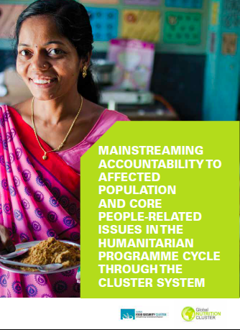
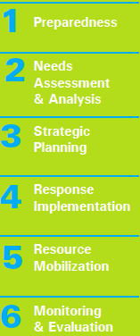
Applying the CHS in the HPC
Minimum Steps
Notes:
Most of the sessions over following days will look at each phase of the HPC, and they will be asked to link this back to AAP, so encourage them to reference these tools later.

Slide 28
Key Messages
Humanitarian coordination is constantly improving, requiring greater learning, adaptability.
The TA outlined concrete measures to further improve coordination, leadership and accountability.
Coordination is a mutual responsibility to achieve more effective outcomes for affected people.
Coordination mechanisms need to find the most appropriate way to collectively deliver better outcomes
The IASC CAAP, the CHS and GNC AAP guidelines all help reinforce why and how we apply accountability in coordination

