Slide 1
Introduction to Basic Nutrition Concepts

Slide 2
Learning Objectives
By the end of this module, participants will be able to:
Define terms nutrition, a balanced diet and nutritional status
Explain the different forms of malnutrition
Analyse the consequences and the costs of malnutrition
Notes:
Introduction
Introduce the session and share the learning objectives

Slide 3
Definitions

Slide 4
Actual and balanced diet?
Actual Diet | Balanced Diet
Notes:
Use in case of need to visually explain flipchart outline

Slide 5
A Balanced Diet
A diet that provides an adequate amount and diversity/variety of food to meet women, men, girls and boys energy and nutrient requirements for a healthy and active life. It must be composed of a variety of foods from different food groups:
Credit: Republic of Benin, 2015
Notes:
Exercise: Definitions
Divide the participants into groups of five or six. Ask them to use a flipchart and divide it in two. Then ask them to brainstorm the following (they can draw images if they wish) and present one on each half:
The actual diet in your context
A balanced diet in your context
Debrief in plenary through inviting participants to share their findings. Use slide 5 (A Balanced Diet) to consolidate. Encourage them to consider why there may be differences between the actual and balanced diet and use slide 6 (Nutrition) to conclude that when we discuss nutrition, we are also looking at the biological, social and economic processes which influence the growth, function and repair of the body, and not just the food eaten. (If you prefer you can write these definitions out on flipcharts instead, leaving them up for the duration of the trainings).

Slide 6
Nutrition, Food and Nutrients
Nutrition
“The intake of food, and the interplay of biological, social, and economic processes that influence the growth, function and repair of the body.”

Slide 7
Nutritional Status
Nutritional status
Nutrient intake
Nutrient requirements
Body’s ability to digest, absorb and use nutrients
Notes:
Transition into slide 7 (Nutritional Status), and ascertain that we have looked mainly at the nutrient intake through our first activity. What other factors do we need to consider when we talk of nutrition? The definition of nutrition gives clues. Elicit some answers from the participants, and if no one can add, show the headings ‘Nutrient Requirements’ and ‘Body’s ability to digest, absorb and use nutrients’. Ensure that the concepts are clear and cement the definition of nutritional status:
“the physiological state of an individual that results from the relationship between nutrient intake, requirements and the body's ability to digest, absorb and utilize these nutrients.”
Ask if they see connections to other sectors here, such as WASH and Health?
Only bring in slide 8 and 9 (Nutrient Intake and Nutrient Requirements) if necessary or there are specific questions about these areas from the group.

Slide 8
Nutrient Intake
Nutrient intake refers to the different nutrients taken in by the body.
There are 2 main types of nutrients:
Macronutrients
Micronutrients
Fats
Vitamins
Protein
Macrominerals
Water
Microminerals
(“trace elements”)
Carbohydrates
Notes:
Supporting

Slide 9
Nutrient Requirements
The different nutrients needed by the body for energy, growth and repair, and protection from disease.
Nutrient requirements differ according to the age, gender, level of physical activity, height, weight, stage of life, and health status of each individual.
WFP Nutrition_FAS_Basic concepts_Syria2016

Slide 10
Types of Malnutrition
Acute Undernutrition
(Wasting- too thin for one’s height)
Measure by:
Weight for height Z scores (WHZ)
Mid upper arm circumference MUAC)
Chronic Undernutrition
(Stunting – too short for one’s age)
Measured by:
Height for age z scores (H/LAZ)
Chronic Overnutrition (Overweight / obese – to large for one’s height)
Measured by:
Body mass index (weight for height measure); waist-hip ratio
Micronutrient Deficiency
Excess or Inadequacy
Clinical or subclinical
Clinical signs or biochemical assessment
Notes:
Presentation: Malnutrition in Emergencies
Prior to showing slide 10 (Types of Malnutrition), ask for ideas on what happens when dietary intake does not meet dietary needs? Bring up the slide and remind participants that we normally consider there to be four types of malnutrition. Clarify and ensure the participants have a correct understanding as you go along.

Slide 11
Differences Between Acute and Chronic Undernutrition
Acute
Acute shortage of food and/or disease
Recent rapid weight loss
Results in wasting
Children and adults can become wasted
Typical for emergencies
Can be prevented and treated
Is reversible
Chronic
Chronic shortage of nutrients or presence of multiple infections
Occurs over a long period
Results in stunting
Adults cannot become stunted
Is common in underdeveloped but relatively stable settings
Can be prevented but cannot be treated
Notes:
Exercise: Acute and Chronic Undernutrition
Invite the participants to discuss with the person next to them and ask half the room to brainstorm what acute undernutrition is (in pairs) and the other what chronic undernutrition is. Keep this brief and invite an open brainstorming atmosphere where the participants are free to guess based on their knowledge. After a few minutes, break and invite volunteer to present their key points. Consolidate using slide 11 (Differences between acute and chronic undernutrition). Make sure that participants understand that they both exist in emergency and non-emergency setting and at times a child can be stunted and wasted at the same time.

Slide 12
Acute Malnutrition - Wasting
Terminology
SAM (Severe Acute Malnutrition)
MAM (Moderate Acute Malnutrition)
GAM (Global Acute Malnutrition)
Causes
Low birth weight
Growth faletering/rapid weigh loss due to
Illness onset
Sudden decrease in intakes/breastfeeding
Infant and young child feeding practices, poverty, conflict, famine, natural disasters, mental health, illness
Notes:
Continue going through the different types of malnutrition that take place in emergencies using slides 13-18
Acute malnutrition
Wasting
Classification
Severe acute malnutrition
Show the pictures and ask if participants can name what type of malnutrition this child has
General information for the participants: The most visible consequences of acute malnutrition are weight loss (resulting in moderate or severe wasting) and/ or nutritional oedema (i.e. bilateral swelling of the lower limbs, upper limbs and, in more advanced cases, the face).
This child has (Kwashiorkor) Malnutrition resulting from inadequate protein, over-reliance on carbohydrates
Diet quality-functional nutrients (antioxidants)
Visible signs: Odema-swelling (in both feet); Flaking skin; Thin, light hair
Moderate acute malnutrition

Slide 13
Acute Malnutrition Classification
NUTRITIONAL STATUS | WHZ SCORE | MUAC | WH % OF MEDIAN
MAM | Between -3 SD and <-2 SD | Between 115 mm and 125mm | Between 70% to 80%
SAM | < -3SD or Oedema | < 115 mm or Oedema | <70% or Oedema
GAM | < -2SD or Oedeam | < 125 or Oedeam | <80% or Oedema
Notes:
Core slide

Slide 14
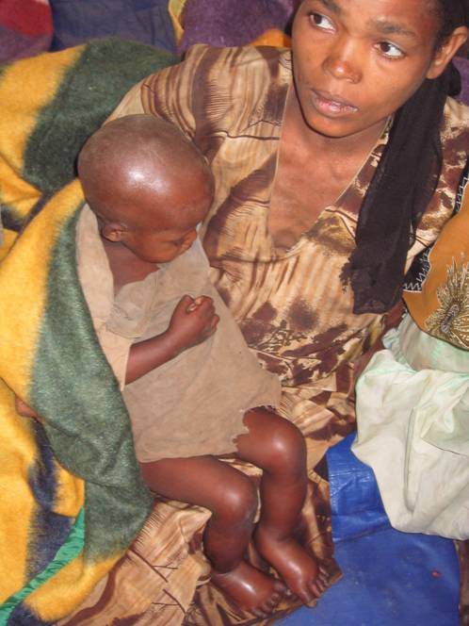
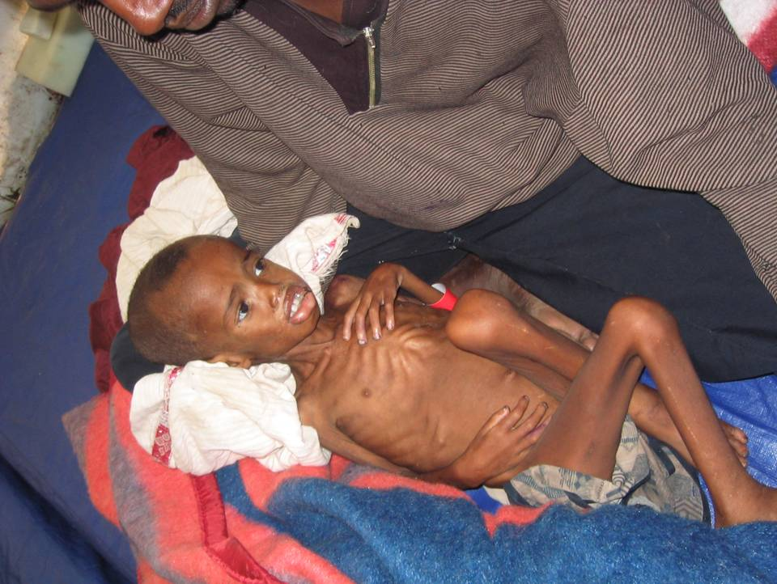
Severe Acute Malnutrition
Notes:
Core

Slide 15
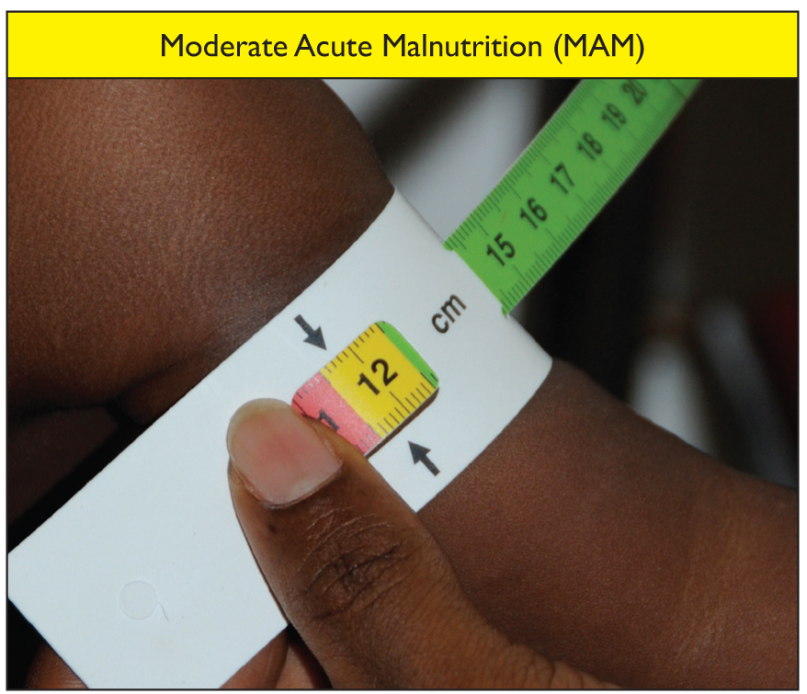
Moderate Acute Malnutrition
Notes:
Core

Slide 16
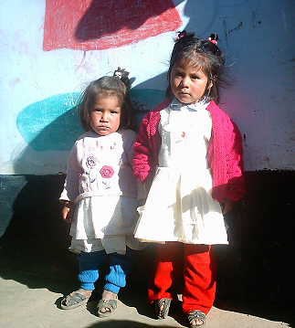
Chronic Undernutrition - Stunting
Long term undernutrition that stunts linear growth (i.e. short stature)
Begins in utero and continues through infancy and childhood
Limited catchup possible after 2 years of age (i.e. irreversible)
Long term impacts on health, development, education, agriculture productivity, economic productivity and future generations
Age: 2 y 9 mo
Wt: 10.7 kg
Ht: 78.3 cm
2 y 6 mo
11.6 kg
86.4 cm
Image: GNC-HTP presentation
Notes:
Chronic Undernutrition
Stunting
Causes:
compromised maternal health and nutrition before and during pregnancy and lactation,
inadequate breastfeeding, poor feeding practices for infants and young children, and
Unhealthy environments for children, including poor hygiene and sanitation.
Insufficient energy, protein, zinc, vitD, calcium intakes
Repeated infections
Repeated periods of weight loss with little recovery
Stunting is also associated with an increase in risk of death. While lower overall than for wasting, the risk is still 5.5 times that of a healthy child for severe stunting (a higher risk than moderate wasting at 3.4 times) (Olofin et al 2013). When stunting and wasting (either severe or moderate) are combined, the mortality risk rises to 12.3 times that of a healthy child (McDonald et al 2013).
If there is time, show the video on Slide 17 on ‘What is Stunting?

Slide 17
Notes:
Trainer: this is a WHO video “What is stunting”, 4 minutes and 42 seconds. If you need to, you can start with what is stunting at 1 minutes 42 seconds if you need to skip data from 2012 since you have shared the most recent numbers in your slides already https://www.youtube.com/watch?v=4Fx72r7BKb0

Slide 18
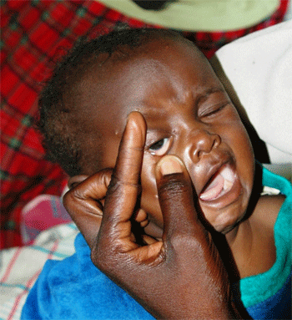
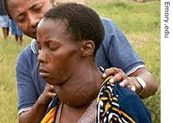
Micronutrient Deficiencies
Notes:
Micronutrient deficiency
Ascertain if the group knows what micronutrient deficiencies are and if they can name any examples. Bring three examples using the pictures on slide 18 (Micronutrient Deficiencies) and ask if any participants are familiar with these and can came the micronutrient deficiencies shown? 1. Vitamin A deficiency, 2. Goiter - Iodine deficiency and 3. Iron deficiency. The lack of access to vitamin A, iodine and iron are the three micronutrient deficiencies of greatest public health significance. Depending on the population vitamin D may be an issue also.
These three deficiencies affect the population’s ability to work, decreases productivity, increases illness, and decrease the quality of life.
Ask for or bring other deficiencies that are relevant in country.
Take questions as you go.

Slide 19
Malnutrition in X Country
Needs to be adapted before training!
Undernutrition (Stunting and Wasting in <5yo)
Overnutrition (Overweight and Obesity)
Micronutrient Deficiencies
Moderately wasted ___%
Severely wasted ___%
Overweight in <5yo ____%
Overweight or obese WRA ____%
___ % of children age 6-59 months are anemic.
___ % of WRA are anemic
Moderately stunted ___%
Severely stunted ___%
SAM in WRA (MUAC)
___%
Notes:
Trainer: add the numbers of undernourished children and adults, prevalence of overweight and micronutrient deficiencies in the country where the training is taking place. Data can be found from the nutrition and health clusters/sector, MICS , DHS, World Bank, Other sources

Slide 20
Nutrition response in X country
Needs to be adapted before training!
At household level (through CHVs)
Screening and referral of children and PLW with AM
IYCF counselling
MNPs distribution
At community level
Mother to mother support groups with CHVs support
BSFP
At HF level (through HWs)
SAM/MAM treatment
IYCF counselling, IYCF corners
FeFo supplementation of PLW
Vitamin A and deworming of children
Notes:
PPT 1.2

Slide 21
Inadequate care for children and women in X country
Needs to be adapted before training!
Exclusive breastfeeding under 6 months
Continued breastfeeding at 1 year
Continued breastfeeding at 2 years
Introduction of solid, semi-solid or soft foods by 6 months of age
Notes:
PPT 1.2

Slide 22
Determinants/Causes, Consequences and Costs of Malnutrition

Slide 23
Exercise: Case Study
What you think the causes of Amina’s malnutrition are? Can you see any different levels in these causes, from more to less direct?
How do they compare to the causes of malnutrition in the country you are working in?
Notes:
Exercise: Case Study
Explain that we will now be looking at Determinants/Causes, Consequences and Costs of Malnutrition. If they have not heard these terms before, that is fine, we are working on learning about these concepts. To start the participants will get to work with a case study.
Put the participants into four case study groups. These should be pre-formed by you as a trainer and have an as equal cluster representation as possible. Ask the participants to read the case study in their workbooks and discuss two questions (on PPT slide and in the case study document):
What you think the causes of Amina’s malnutrition are? Can you see any different levels in these causes, from more to less direct?
How do they compare to the causes of malnutrition in the country you are working in?
The participants have 15 minutes and should take notes on a flipchart to present back to the group. Allow 15 minute facilitated debrief, emphasising the questions posed.

Slide 24
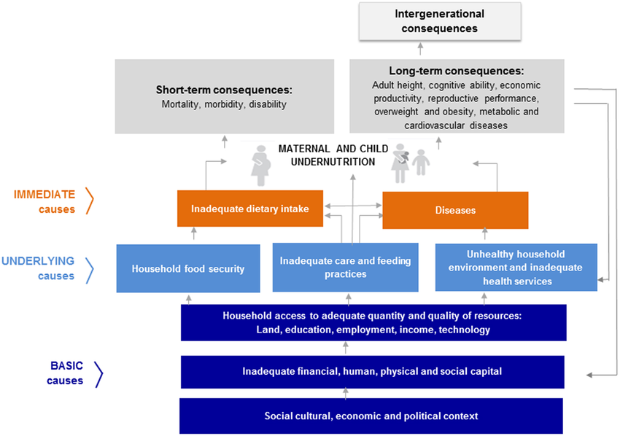
UNICEF Malnutrition Conceptual Framework
Notes:
Introduce Unicef’s conceptual framework and put it in relation to the case study. Draw on what the participants have defined to clarify and explain the framework, using their identified causes to connect to immediate, underlying and basic causes. Only use slide 26-28 if necessary.

Slide 25
Basic Drivers/Determinants
Access to resources
Poverty and urban pressure
Discrimination
Marginalization
Volatile food prices
Climate change
Political, legal and cultural factors

Slide 26
Underlying Drivers/Determinants
Food Insecurity (poor access to markets, poor availability of a variety of food, lack of access to appropriate weaning foods, poor production of own crops)
Social and Family Care-Practices (Optimal infant and young child feeding practices, Health seeking behaviors, Psycho-social support)
Public Health Services (access to health facilities and services, appropriate and timely curative care, routine preventative care for children and pregnant and lactating women especially during emergencies)
WASH (access to clean water for humans, hygienic environment, sanitation, distance to water source)
Notes:
Link this discussion to Amina’s case

Slide 27
Immediate Drivers/Determinants
Inadequate dietary intake
Burden of Disease
Diversity
Amount
Consistency
Frequency
Safe
Breastfeeding
Complementary feeding
Diarrhea
Acute Respiratory Infections
Measles
Malaria

Slide 28
Poor nutrition throughout the lifecycle
Mortality Rate
Impaired Mental Development
Reduced Mental Capacity
Reduced Mental Capacity
Malnourished
Higher Maternal Mortality
Fetal Malnutrition
Low Weight Gain
Reduced Capacity to care for baby
Reduced capacity to care for baby
Fetal Malnutrition
Inadequate food, health and care
Untimely/ inadequate complementary foods
Frequent infections
UNSCN, 2000
Notes:
Exercise: Consequences of Malnutrition throughout lifecycle
Explain that the lifecycle impacts on the consequences and causes of malnutrition. Show the lifecycle without the other factors and share that the group will get a n opportunity to work with this.
Use game or other way to divide the group into six smaller groups and assign each one an age group:
0-6 months
6-24 months
Adolescent girls
Pregnant and Lactating Women
People with chronic illnesses (HIV/AIDS, tuberculosis)
Older people and People living with disabilities.
Ask the group to brainstorm what they think the consequences are of malnutrition (inadequate food, health, care) for the age group they have and what the impacts are for different sectors?
Use slides 28 (Poor Nutrition throughout the lifecycle) and 29 to debrief.

Slide 30
Take Home Messages
Nutritional status pertains to the intake, bodily requirements and ability to absorb nutrition.
The main types of malnutrition in emergencies are chronic malnutrition, acute malnutrition and micronutrient deficiencies
Malnutrition in all its forms needs to be addressed in crisis setting.
The drivers of malnutrition are complex and very contextual and need to be understood in order to design the right programs to address or prevent malnutrition
In order to improve the nutritional status of populations especially in emergencies, sectors such as FSL, WASH, Health, protection including GBV, etc have to play a critical role in the prevention and treatment of malnutrition in all its forms

Slide 31
Acknowledgements
This training package was developed by the Intercluster Nutrition Working Group
This training package was funded by
This training package was developed with the technical support of

