Slide 1
1.2 The Humanitarian Landscape
INFORMATION MANAGEMENT

Slide 2



Coordination challenges in the early 2000’s
Who needs assistance?
What organisations are already here?
Is anyone already doing X?
Where can I get information?
Who is doing Y in X-town?
What is the government doing ?
Who is in charge?
Where do people need assistance?
How can I get funds?

Slide 3
What is the IASC?
The Inter-Agency Standing Committee (IASC) = Global humanitarian forum established in 1991 by a UN GA resolution to bring together the main operational relief agencies from the United Nations, the Red Cross/Red Crescent Movement, the IOM and international NGOs.

Slide 4
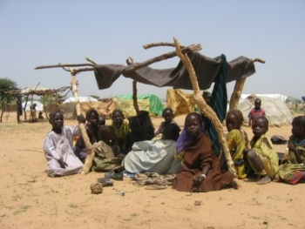
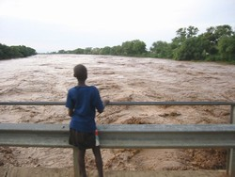
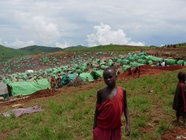
Why was Humanitarian Reform (2005) needed?
Well-known, long-standing gaps
Unpredictable capacity
Ad-hoc responses
Erratic coordination, weak partnerships
Insufficient accountability among humanitarian agencies
Donor policies inconsistent
Notes:
Hum reform is about ensuring that hum response is completely congruent to the hum needs
The HRR recommended a range of reform measures to address these issues which became known as the Humanitarian Reform Agenda. Various issues we identified at the beginning of the session were identified in the HRR 2005
Bullet 2 Change ‘limited linkages’ to inconsistent linkages, and say “ this makes for an incomplete response, gaps in aid to beneficiaries.”
Bullet 3 on our side, our coordination efforts are too contingent on what our mothers taught us, we need to upgrade and ensure better quality across the board in coordinating, facilitating, in leading meetings and assessments.
Note that the Humanitarian Response Review is available on CD Rom

Slide 5
Humanitarian Reform
STRENGTHENING HUMANITARIAN RESPONSE
CAPACITY & PREDICTABAILITY
FINANCING
LEADERSHIP
PARTNERSHIPS
Notes:
The Humanitarian Reform Agenda aims to dramatically enhance humanitarian response capacity, predictability, accountability and partnership. It is an ambitious effort by the international humanitarian community to reach more beneficiaries, with more comprehensive, needs-based relief and protection, in a more effective and timely manner.
The reform packages has four main objectives:
Sufficient humanitarian reform capacity and enhanced leadership, accountability and predictability in 9 'gap' sectors/areas or response. (see Cluster Leadership Approach)
Adequate, timely and flexible humanitarian financing. (see CERF)
Improved humanitarian coordination and leadership. (IASC Principals Meeting of April 2006: approved Action Plan on Strengthening the Humanitarian Coordination System)
More effective partnerships between UN and non-UN humanitarian actors.
Flash Appeal / CAP
CERF
Codes of Conduct/Standards – Sphere
Reporting mechanisms
IASC in 1992
Cluster System in 2005
HC Training
HCTs
Training for aid workers (incl. Cluster Coordination Training)
Guidelines (eg, Oslo on CivMil, Needs Assessments, SGBV, Sphere, Global Humanitarian Platform, etc)

Slide 6
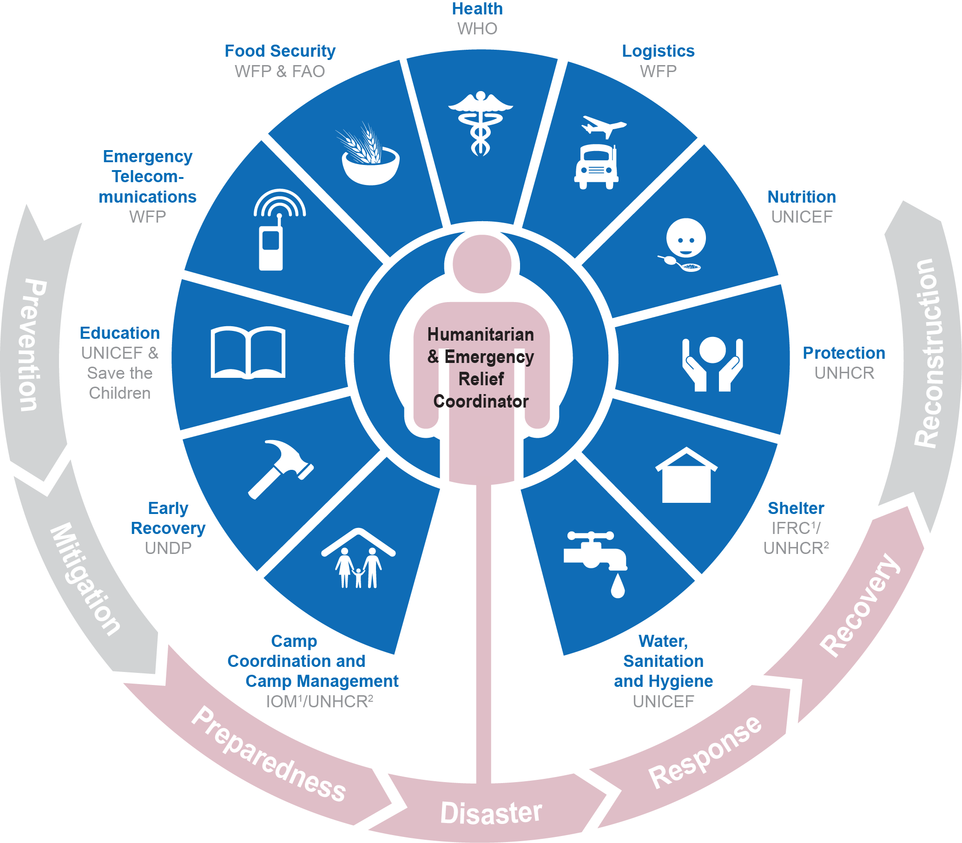
The Cluster system
Notes:
The architecture from the reform process largely remains the same (clusters, RC/HC, partnerships, coordinated response etc) but the timeframes and outputs have changed (and are still evolving). Some components apply to L3 emergencies (like empowered leadership), others like elements of the HPC will apply to all emergencies. The protocols for old functions like clusters have been refined including new minimum commitments for cluster membership. New functions have been created like the IARRM. The changes are more than just language. The protocols give new guidance to HPCs, clusters, IASC etc. Some of the changes are not yet endorsed in final form. Experiences of the past 12 months have led to revisions and current issues might contribute to more revisions. The system was designed to cope with 2 L3s in 12 months. We have three (Syria, CAR, SS) and had a fourth only downgraded in the past few week (Philippines). Itr has stretched the new systems enormously.

Slide 7
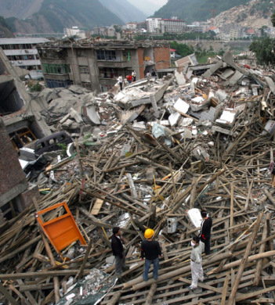
Responsibilities of global clusters
Normative
Standard setting and consolidation of ‘best practice’
Build response capacity
Training and system development at local, regional and international levels
Surge capacity and standby rosters
Material stockpiles
Operational Support
Emergency preparedness
Advocacy and resource mobilisation
Notes:
At the global level, cluster leads are responsible for:
up-to-date assessments of the overall needs for human, financial, and institutional capacity;
reviews of currently available capacities and means for their utilisation;
links with other clusters, including preparedness measures and long-term planning, standards, best practice, advocacy, and resource mobilisation;
taking action to ensure that required capacities and mechanisms exist, including rosters for surge capacity;
training and system development at the local, national, regional, and international levels.

Slide 8
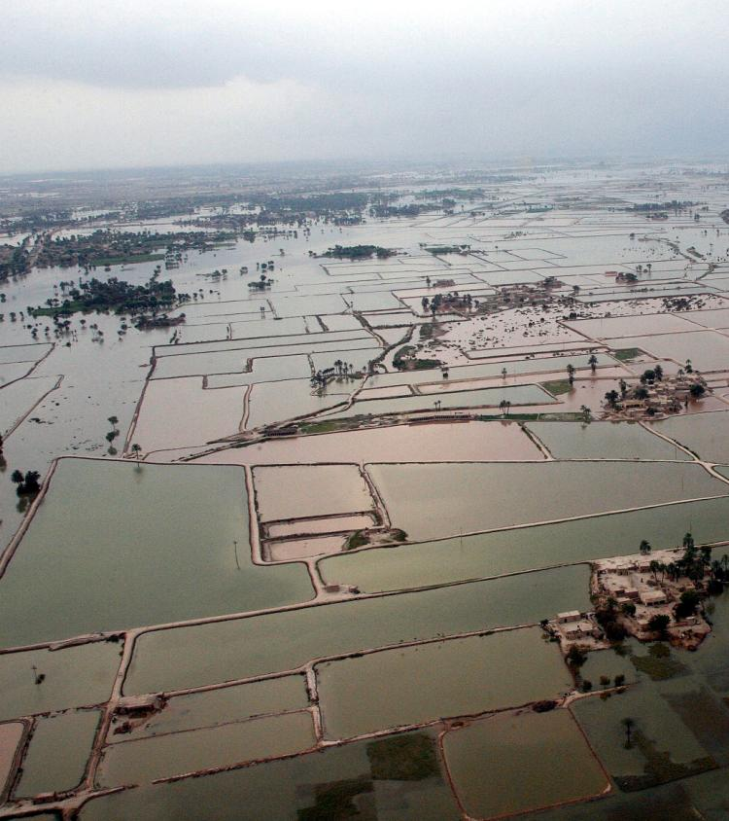
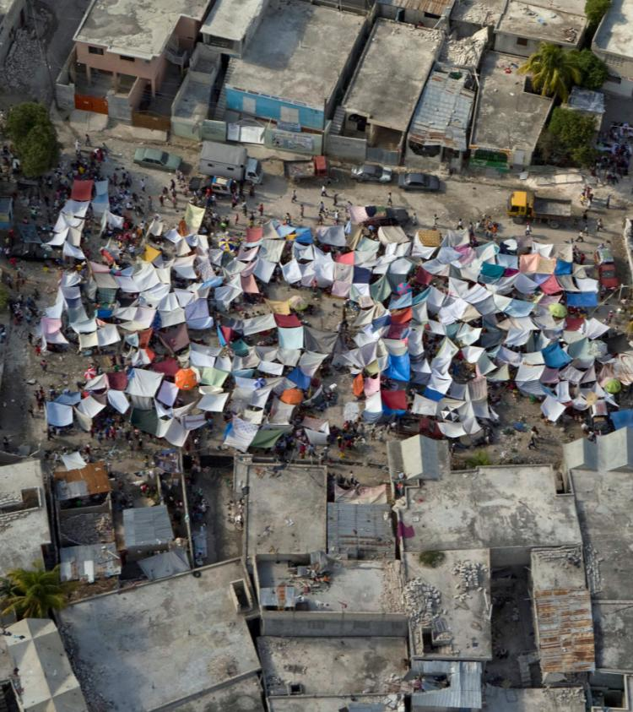
2010
Then we learnt new lessons…
With still some weakness and inefficiencies
Floods in
Pakistan
Earthquakes
In Haiti
UN Photo/Evan Schneider
UN Photo/Logan Abassi
Notes:
The response to the Haiti earthquake and Pakistan floods in 2010 exposed a number of weaknesses and inefficiencies in the international humanitarian response. The Transformative Agenda aims to ensure that these shortcomings are addressed.
The risk of future large-scale emergencies remains high due to the increasing frequency and scale of climate-related disasters; violent conflicts; HIV/AIDS and other communicable diseases and pandemics; rapid population growth and urbanization; and increased vulnerability due to poverty, hunger, unemployment, displacement and migration.
Governments, affected communities, humanitarian organisations, donors and the UN General Assembly itself have stressed the need for a more efficient and well-coordinated international response to major disasters.
The actions we are now taking as part of the Transformative Agenda build on the 2005 Humanitarian Reform. We recognize that we need to focus not on the process of implementing change, but on the impact of change. Through the changes agreed, more lives will be saved, and we will all be more accountable for our actions.

Slide 9

What is the Transformative Agenda?

Slide 10

Roster of Emergency Coordinators for Level 3 Emergencies
Empowered Leadership for staff (women and men) and affected people with specific needs, women, girls, boys and men.
Inter-Agency Rapid Response Mechanism (IARRM)
Leadership Training

Slide 11

Strategic Use of Clusters
Simplified Cluster Management
Minimum Commitments for Participation in Clusters
Strengthening NGO (women’s rights organization, in particular) Representation in the Humanitarian Country Team
Notes:
The architecture from the reform process largely remains the same (clusters, RC/HC, partnerships, coordinated response etc) but the timeframes and outputs have changed (and are still evolving). Some components apply to L3 emergencies (like empowered leadership), others like elements of the HPC will apply to all emergencies. The protocols for old functions like clusters have been refined including new minimum commitments for cluster membership. New functions have been created like the IARRM. The changes are more than just language. The protocols give new guidance to HPCs, clusters, IASC etc. Some of the changes are not yet endorsed in final form. Experiences of the past 12 months have led to revisions and current issues might contribute to more revisions. The system was designed to cope with 2 L3s in 12 months. We have three (Syria, CAR, SS) and had a fourth only downgraded in the past few week (Philippines). Itr has stretched the new systems enormously.

Slide 12

Common Humanitarian Programme Cycle (HPC) to achieve collective results
Cross-cutting issues are addressed and incorporated in AAP and HPC for an effective nutrition programming in emergencies (e.g. gender, GBV, empowerment, environment etc.)
Assessment, Strategic Statement, Resource Allocation, Implementation, Monitoring, Reporting and Evaluation
Common Performance and Reporting Framework including gender and GBV protection performance
Accountability to Affected People (AAP) using a gender and GBV inclusive approach (e.g. survivor centered, community based and human rights approaches)

Slide 13
Six Core Functions of Clusters
  Support service delivery
  Inform the HC/HCT's strategic decision-making
  Plan and implement cluster strategies
  Monitor and evaluate performance
Build national capacity in preparedness and contingency planning
Advocacy
  + Accountability to affected population (AAP)
Notes:
Concerning Cross Cutting issues: Focal Points nominated for Early Recovery and for AGREED priorities
Cross-cutting issues as appropriate to ensure these are included in sector work plans and appeals.

Slide 14
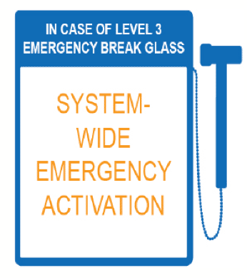
When is the cluster activated?

Slide 15
Level 3 Emergencies declared by IASC to be exceptional in:
Complexity
Scale
Urgency
Capacity
Reputational Risk

Slide 16

Exercise: Building the HPC
5 minutes to put together the stages of the HPC on Flipchart
You may be asked to explain the logic behind your cycle.
Notes:
The overall purpose of the HPC is to deliver a fast, coordinated, effective and protection-driven response to people affected by humanitarian crises. The HPC is a coordinated series of actions undertaken to prepare for, manage and deliver humanitarian response.
The focus is primarily on the HPC in the context of multilateral humanitarian response operations - in support of the national and local response – but again, the approach is intended to be accessible to all humanitarian actors.
The actions in the cycle, described below, are inter-related and should be managed in a seamless manner using a coherent approach and a common set of tools.
While implementation of the cycle should be flexible and adaptable to different country situations, it must at a minimum address the above elements. Whenever possible, it should support national and local partners, including NGOs, civil society and communities, and complement or build on existing frameworks; it should contribute to a response that builds resilience to future disasters.

Slide 17
Humanitarian Programme Cycle
The phases are inter-related and should be managed in a seamless manner using a coherent approach and a common set of tools.
Notes:
Discuss variation between quick onset and protracted crises and clarify differences between them and what this means for preparedness, response and recovery.
Ask participants to look at the HPC Reference Module in their files
Big change is to put the emphasis back at country level to determine the time-line and mechanisms they will employ.
17

Slide 18
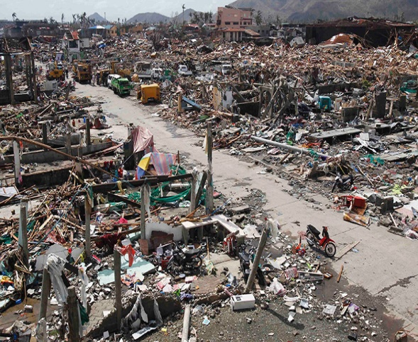
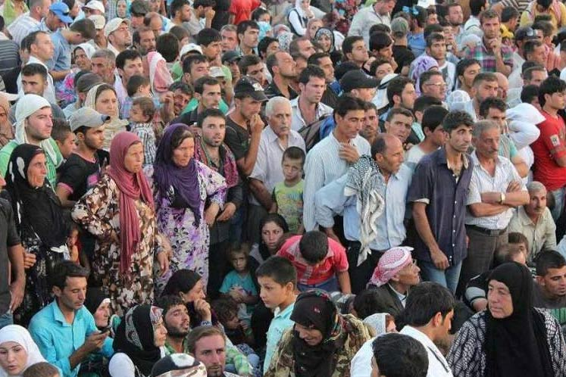
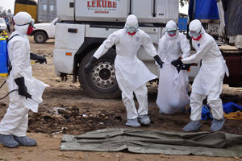
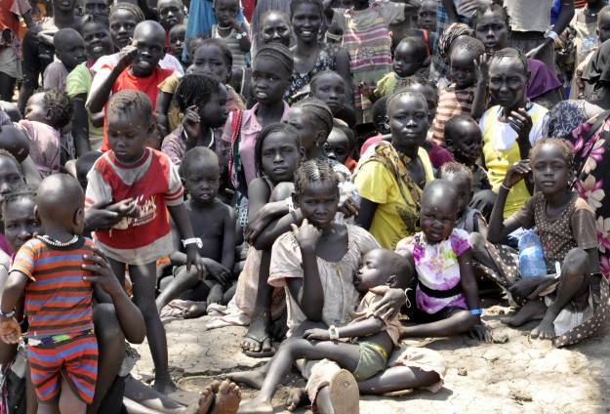
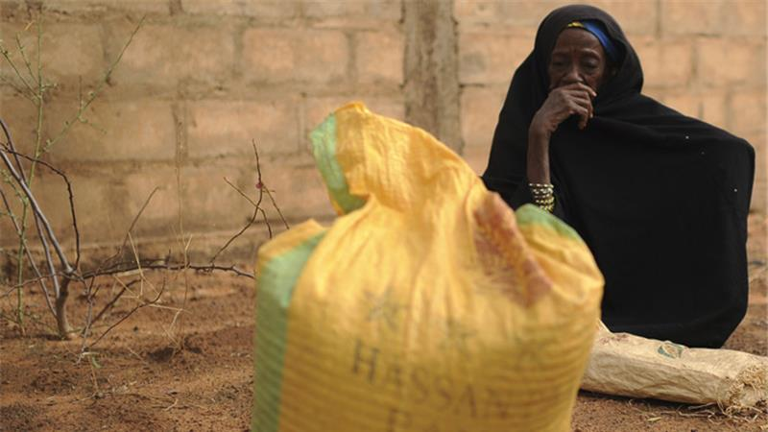
Typhoon Haiyan – Philippines 2013
You are here
Syrian Refugees in Amman, Jordan, 2011-present
Ebola epidemic Sierra Leone, Liberia, Guinea 2013-2015
Conflict IDP and food security crisis South Sudan 2013-present
Sahel Food insecurity 2011-present
Notes:
Divide participants into teams of four (can reduce number of photos depending on group size)
10mins to identify who would be the key players involved in a response to their particular emergency
Note these on a flip-chart and designate someone to briefly summarise in plenary
Debrief by going through and highlighting any gaps as well as country-specific differences and similarities
LEAVE UP FOLLOWING SLIDE DURING THE EXERCISE

Slide 19
In your assigned scenario…
Who are the main actors in responding to the humanitarian situation and what impact does the context have on information management?

Slide 20
Humanitarian Actors
HCT
National Government
HC
OCHA
Humanitarian Response
Other Clusters
Cluster
Lead Agency
Nutrition Cluster
UN Agencies
Global Nutrition Cluster
NC-CT
NGOs
Observers
Notes:
-Highlight the overlapping but distinction of the CLA, CC, and Nutrition Cluster.
-The GNC sits partially within the country level humanitarian response but also in the policy/global realm. GNC supports CLA and CC but not involved in national Cluster.
20

Slide 21
National Government
  Has primary responsibility for safety, security and well being of own citizens
  Responsibility for protection of displace people and refugees (particularly women, girls and children) within its borders
  Responsibility for safety and security of humanitarian workers and other expatriates from the risks of any sort of violence and harassment
  Is responsible for maintaining law and order and legal aid support
  Has control of admission to the country
  Is responsible for facilitating coordination between the agencies and partners
Notes:
As a pre-curser to the system in which we operate, its important to remember that Government has responsibility to protect those within its borders. Sovereignty underpins a great deal of the legal backdrop to humanitarian action and the system in which we operate, is founded on this concept. International support systems are there to ‘enable’ government to do its job and or fill gaps when it cannot or not willing to fulfill these obligations.

